Slide 1
Smart+Connected Government
Transforming a Community, a Country, the World
Rick Hutley
Vice President, Cisco Systems

Slide 2



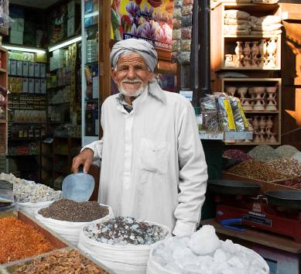
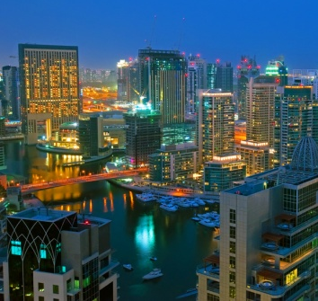

Four Mega-Trends Changing our World
Developed countries’ labor forces substantially age
and decline in numbers
Population growth increasingly concentrated in emerging countries
Economic power shifts to developing nations
World’s population becomes urbanized
The strategic and economic policies of the 20th century are outmoded - time to find new ones.
Notes:
The world around us is undergoing a major transition. For the first time in human history majority of the people in the world live in urban areas. Over the next five years, some 500 million people will be added to the world’s cities. By 2050, at least 100 new cities will be inhabited by more than a million residents. Villages are moving from agricultural to industrial economies. The environmental impact of this massive urbanisation is significant. Cities consume 75 percent of the world's energy and are responsible for 80 percent of greenhouse gas emissions. The need for all these cities to sustainably balance social, economic, and environmental resources is more critical than ever before.

Slide 3





Drivers of Economic and Social Transformation
Hypergrowth
Aging/Shrinking
Revitalization of cities, states, countries
700+ million urbanized
S+CC
3 billion will be connected
Mobility will be the platform
Connected life
New business models & ecosystems
Capacity planning
Everything as a service
The Network as the Transformational Platform
Notes:
With world populations shifting to urban areas and other demographic shifts, community leaders are pressed for answers to overcrowding, pollution, budget and resource constraints, inadequate infrastructures, and the need for continuing growth.

Slide 4
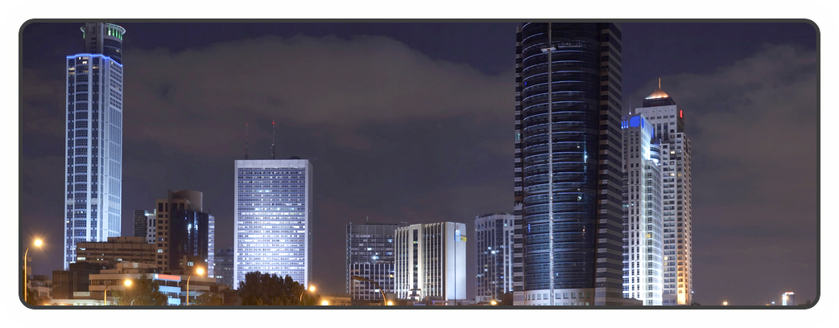
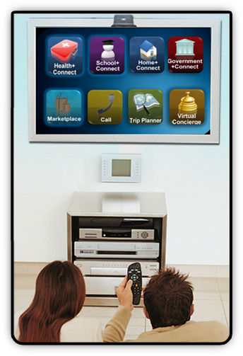
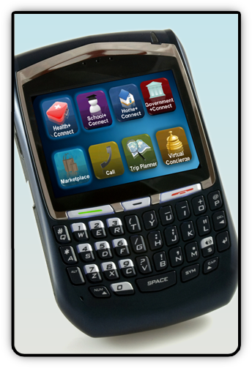
Trend: Smart + Connected Communities
Delivering Comprehensive Services to Citizens as they Live, Work, Learn, and Play in a Smart+Connected Community
Notes:
As communities develop and grow, they struggle with a variety of complex and conflicting priorities such as safety and security, efficient delivery of government services, education, and healthcare. At Cisco, we believe that communities can be connected to enable real-time information exchange, facilitate interaction, and provide access to resources that help spur economic, social and environmental sustainability, and enhance the quality of life for its constituents.

Slide 5
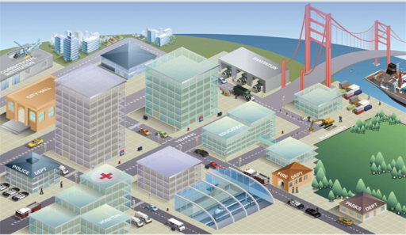
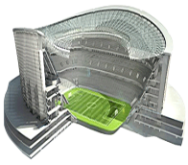
Linking Services to Create
Smart + Connected Communities
Connected Residential Services
Connected Education
Connected Government
Connected Sports & Entertainment
Connected Real Estate
Connected Utilities
Connected Retail
MALL
Connected Transportation
Connected Health
Core City Network

Slide 6



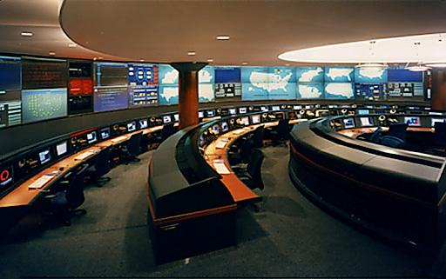




Community Exchange:
Enabling a Smart + Connected Community
Transportation
Back-Office operations center
Streamlined planning & operations (transport, healthcare etc..)
Secure network - Collaborate across:
  Government agencies
  Private sector community eco-system
Utilities
Safety & Security
Government
Real Estate
Notes:
Government visionaries and their private sector community partners can take a sustainable management approach to help ensure thriving communities. "Community+Exchange" is a back office operations center, "behind the scenes approach" that streamlines planning and management operations at the community level. By providing the network as a highly secure and resilient service delivery platform, you can share information and collaborate across a community's ecosystem of government agencies and private sector partners to facilitate utilities planning, transportation systems enhancements, and health and government social services needs.

Slide 7
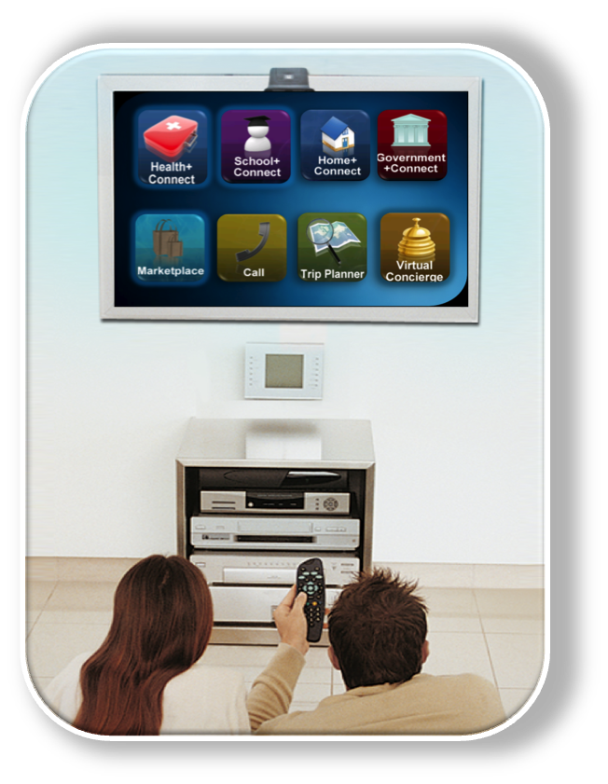
The Home Experience:
Services Accessed from the Comfort of Home
Increase small business access and entrepreneurship
Deliver key citizen services anytime, anywhere
Real-time energy and security management for the home
Notes:
Have quick and easy access to the information and government services needed to enhance personal and professional life. Access real-time data about your home's energy use or visit the doctor or attend school from the comfort of your own living room. All this and more is possible when you live in a Smart+Connected Community.

Slide 8
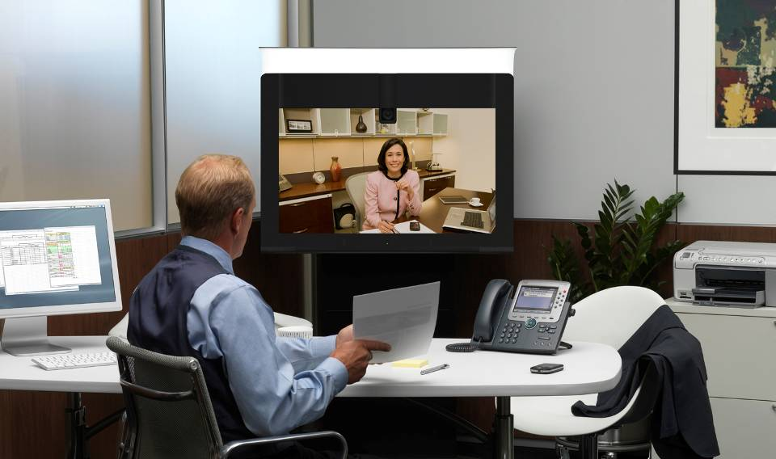
The Office Experience:
Improving Performance, Purpose and Profitability
More efficient, effective use of workspaces
Easier to manage with centralized functions
Integrated building management, energy, and security operations
More economical to operate
Notes:
Cisco Smart+Connected Real Estate solutions enable effective management of a building’s resources for increased operating efficiency. A Smart+Connected Real Estate is responsive to its users’ needs and adjusts quickly to changing requirements, both internal and external. Cisco Connected Workplace and Cisco Smart+Connected Real Estate solutions make new and existing buildings:
More effective, efficient, and productive work places
More economical to operate
Easier to manage with centralised functions
Environmentally sustainable

Slide 9





















Integrating Disparate Building Systems
Information Technology (IT)
Building Management Systems (BMS)
High Speed Internet
Lighting
Wireless
Elevator
VPN
24/7 Monitor
IP Telephony
HVAC- Sensors
Audio and Video Conferencing
Fire
Guest Access
Access
Interactive media
Video Surveillance
Digital Signage
Energy Management
Notes:
9
The new IP infrastructure provides in principle two great opportunities.
First, the network helps to make the user more productive while intensifying the use of your real estate
By converging and providing among other technologies, high speed internet, telephony, visitor management (remote receptionist), audio and video conferencing, web-conferencing, rich media, and digital signage, one can support collaboration and productivity of the workforce and users of the building.
The network helps you to connect people with people, and people with machines to get the most out of the network in terms of voice, video, and data services and any other productivity technologies. The features will add tremendous value to the user, operator, and owner of the building—resulting in a positive impact on the value of the physical assets.
This is more than a IP technologies pitch…the technologies make it possible to re-think the utilization of space; and achieve higher occupancy or revenue per square foot, while optimizing productivity and effectiveness of everyone that is using the environment. We want to help you put forward a comprehensive IP communications solutions in support of innovative space planning and optimized utilization.
Again, the features can be chosen in order of relevance that best accommodates your business needs/goals.

Slide 10
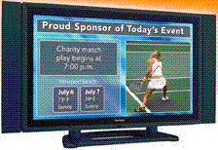





Integrating Across the Corporation, or Across the City
Agency 1
Agency 2
Building N
IP Network (LAN)
Databases
Service Delivery Platform (SDP)
Video Management
Enterprise & Business Applications
Data Center

Slide 11

The Wellness Experience:
Delivering Better Healthcare to Citizens
Improve quality of care and simplify communications
Prompt and secure access
to digital images and reports
Safeguard patient records and clinical applications
Notes:
Cisco’s HealthPresence solution integrates a variety of technologies and medical devices to create a live, “face-to-face” experience over the network for remote doctors and patients. You can achieve a collaborative, responsive, and highly secure communications system where information can flow directly to the point of care. Smart+Connected Health supported by the Cisco Medical Grade Network, helps communities:
Respond to patients more efficiently
Expand preventive healthcare initiatives
Boost the overall health of communities

Slide 12



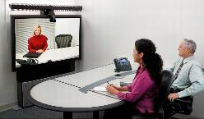

The Wellness Experience:
Remote Experts
New Business Model:
Virtual Presence
Citizen Benefits:
Hospital:
  More services
  More revenue
  Higher quality services
Patients:
  Broader specialists available
  Faster treatment
  Better clinical outcome
Community:
  More effective service
  Reduced costs
Specialists On Call:
National Coverage
Specialists:
  More productive time
  40% More patients
  15 Min response time
Patient
Rapid Response
Improved Outcome
TelePresence Collaboration
Specialist
More Interesting Cases
Increased Revenue
Hospital
Increased Services
Greater Revenue Potential

Slide 13
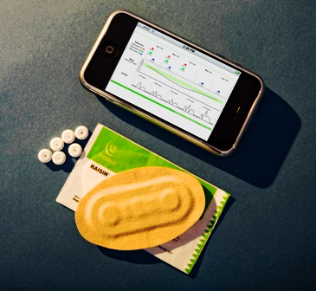


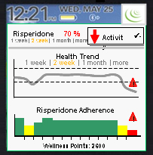
The Wellness Experience:
Ingestible Sensors, Social Networks
Informed Health Community:
Respond when needed:
  Reduced redundancy
  Reduced cost
More effective services
1
2
3
Sensor
Ingestible (“raisin”)
Reader
Detects
Med Levels,
Med Type
Sends Report
delivered
to Social Network
Body water activates sensor, transmits electrical signal throughout body
Source: Proteus Biomedical
Notes:
See Economist 14 Jan. 2010 for a description of how the system works. “When one of Proteus’s pills is taken, stomach fluids activate the edible communications device it contains, which sends wireless signals through the body to another chip worn as a skin patch or embedded just under the skin. That, in turn, can upload data to a smart-phone or send it to a doctor via the internet. Thus it is easy to make sure a patient is taking his pills at the right time, to spot adverse reactions with other drugs and so on.”
Risperidone is an anti-psychotic drug used to treat schizophrenia. Must be maintained at proper levels or it won’t work.

Slide 14
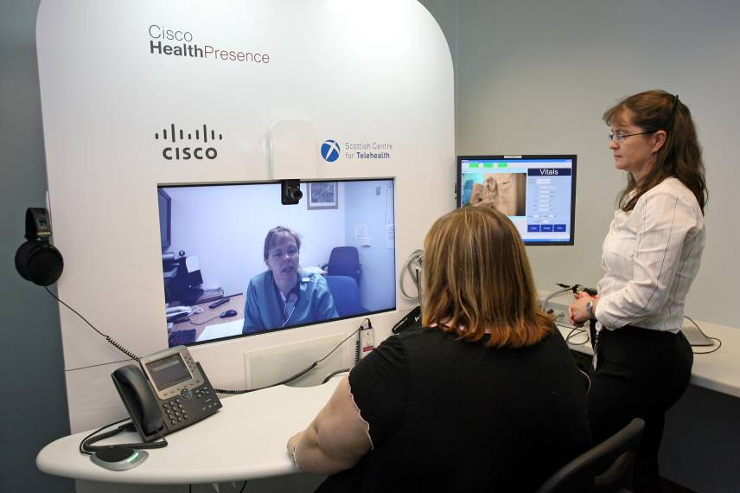
The Wellness Experience:
New Business Model for Medicine: Remote Doctors
HealthPresence – Changing the Business Model: The Dr Will Go the the Patient
HealthPresence pilot study conducted at Aberdeen Royal Infirmary in Scotland

Slide 15
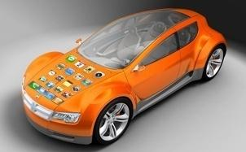
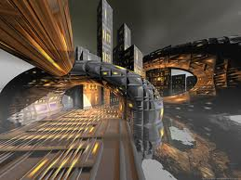
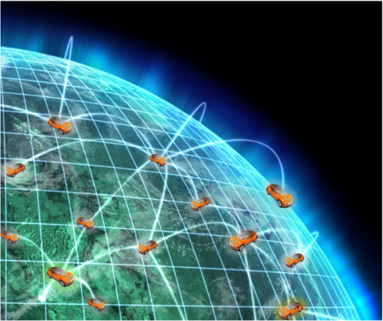
The Travel Experience:
Intelligent Transport, Control and Management
Smart Vehicle
Intelligent Transportation
Internet
of Cars
Networked
Pervasive Computing
Electric
Smart Grid
Source: Cisco IBSG Automotive 2011
Notes:
Vehicles need to become smart in three ways:
Smaller, and lighter like the MIT concept of the folding car or GM’s EN-V
Smart like actively preventing crashes and congestion in concert with an intelligent transportation system that is running on networked information
Smart in the sense that vehicles need to become our little helpers that anticipate our needs and create better travel experiences
Vehicles need to ubiquitously and securely connect to the global network, other vehicles and the infrastructure that is powered by pervasive computing
Vehicles need to be powered by electricity, be it as fuel cell, fully electric or hybrid and connect to a smart grid that provisions power when needed and uses vehicles to better balance peak demand and supply
Transition: Key is that we can take the internet to the road and run transportation on networked information

Slide 16
















The Connected Traveling Experience
Seamless Hand Off – Massive Data – Multiple Touch Points
HOME
ROAD
OFFICE
Home
Security &
Automation
3G/LTE
WLAN
Media
DSRC
City Mesh
Hotspot
Cable / DSL
“Switching”
Ethernet / LAN
Source: Cisco IBSG Automotive 2011
Notes:
The ability to off-load data and to seamlessly and securely switch between technologies will become mission critical to improve user experience but also to contain cost o data transport
A diverse set of complementary technologies will be needed to connect vehicles with the home, the office, and with other vehicles on the road.
On the road, technologies like dedicated short range communications (DSRC) will need to support latency-critical applications of intelligent traffic systems (ITS), while 3G, LTE, WLAN, and, potentially, wireless mesh are alternative options for data-intense applications.
The convenience of ubiquitous vehicle connectivity while driving at speed and across multiple regions will require network-agnostic radio technology that automatically and securely switches among multiple networks and technologies.
In addition to switching from a “weaker” to “stronger” signal, this capability would inevitably enable vehicles to switch from more-expensive to less-expensive networks.
Transition: This brings us to the question – How much does all the infrastructure cost that we need to create the internet of cars?

Slide 17
In 2015, 9M Vehicles Will Be Connected – Growing Fast To More Than 50M Units each year
Global New Passenger Vehicle Sales, Share of SCVs [in Millions]
New P. Vehicle Sales p.a. | 69.0 | 73.0 | 77.0 | 78.9 | 80.8 | 82.8 | 84.8 | 86.8 | 89.0 | 91.1
SCV
SCV mkt Share | 4% | 8% | 12% | 19% | 27% | 39% | 47% | 55% | 58% | 62%
Source: Cisco IBSG, 2010, based on US-DOT, iSupply, McKinsey data
Notes:
17

Slide 18

The Government Experience:
Delivering Better Services to Citizens
Providing the Vision and Drive for Smart Communities
Increase productivity and
better serve constituents
Improve citizen experience and quality of life, at work or home
Notes:
eGovernance embeds IT infrastructure and connectivity into the governance mechanisms of a city’s administration. Cisco solutions give government agencies the ability to be more connected, contain costs, and better serve the needs of an on-demand culture by:
Increase the effectiveness of public safety, justice, and corrections agencies
Help the government workforce increase productivity and better serve constituents
Improve citizen experience and quality of life

Slide 19
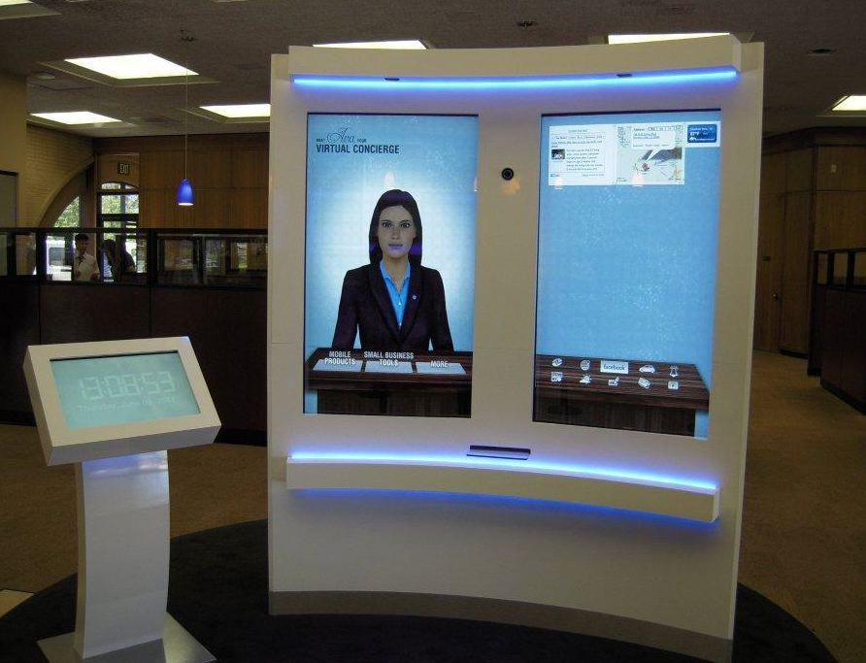

Virtual Assistants
At Work or Home
At Home:
Self help in the home (aging population)
Avatar guided activity (e.g. medication reminders)
Activity sensors
Better use of scarce Social Services resources
At Work:
Avatar guided processes
Office automation (eg. Lights, sockets, doors…)

Slide 20





















Smart+Connected Communities Worldwide
Proof Points
New Development
Revitalization & Growth
Amsterdam: Urban EcoMap Smart Working Centers
South Korea: Songdo
Canada: Vancouver
Seoul: Personal Travel Assistant
China: Chengdu
Spain: Barcelona
San Francisco: Urban EcoMap; Connected Bus
India: Lavasa
USA, Colorado: UCCS; CCI
Portugal:
PlanIT Valley
USA: Holyoke
Case Studies
China: Chongqing; Chengdu
Kuwait: Al Hamra Tower
Russia: Skolkovo
NYC: Yankee Stadium
Malaysia: Nusajaya City, Iskander
UK: London
Cisco on Cisco
India: Large Real Estate Developer*
Philippines: GGLC
India: UST Global, Kerala
South Korea: Busan
Philippines: Twin Oaks Place
Vietnam: Saigon M&C Tower
* To be announced shortly
Notes:
As you can see, the Smart+Connected Communities initiative is global in reach and includes new development in areas such as Songdo, South Korea and Chendu, China. Revitalization and growth are also a significant S+CC opportunity and include Holyoke, MA, Vancouver, Canada, and London, UK.
Case studies include Cisco’s Banyan Building in Bangalore, the Kuwait Al Hamra Tower, and the Saigon M&C Tower in Vietnam.
Proof points include a breadth of solutions, including: the Connected Bus in San Francisco, Smart Work Centers in Amsterdam, and the Personal Travel Assistant in Seoul.
The following case studies provide more detail about some of these deployments, the initial challenges and objectives associated with each, and the S+CC solutions that are designed to address these challenges.

Slide 21
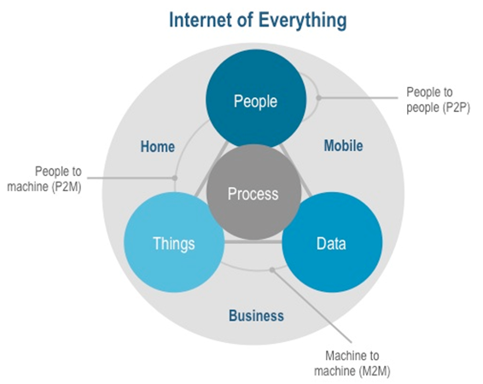
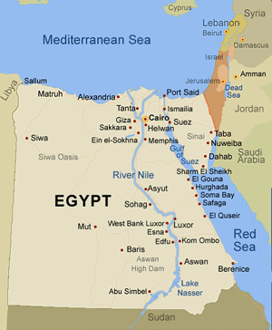
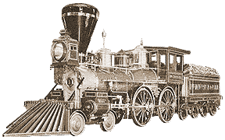



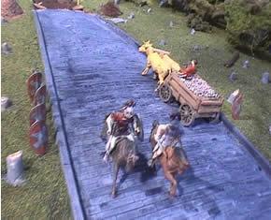

The Next Big Evolutionary Stage:
The Internet of EVERYTHING
3000 BC
River Networks
1800:
Rail Networks
1900:
Flight Networks
Today
1989:
World Wide
Web
1000 BC
Road Networks
1890:
Telephone Networks

Slide 22
What is this Number?
  340,282,366,920,938,463,463,374,607,431,768,211,456 addresses
Notes:
IPV6 = 340,282,366,920,938,463,463,374,607,431,768,211,456 addresses (or 3.4 E38 addresses)
Pronounced: Three hundred and forty undecillion, two hundred and eighty-two decillion, three hundred and sixty-six nonillion, nine hundred and twenty octillion, nine hundred and thirty-eight septillion, four hundred and sixty-three sextillion, four hundred and sixty-three quintillion, three hundred and seventy-four quadrillion, six hundred and seven trillion, four hundred and thirty-one billion, seven hundred and sixty-eight million, two hundred and eleven thousand, four hundred and fifty-six.
95 trillion sheets of paper produced every year - multiply by 150 to get an approximate number of sheets of paper overall of human history – results in 2.4 E12 IP addresses per sheet of paper
Earths surface is 510,072,000 square kilometers – multiple by 10,000,000,000 square centimeters in a square kilometer results in 6.7 E19 addresses per square centimeter.

Slide 23


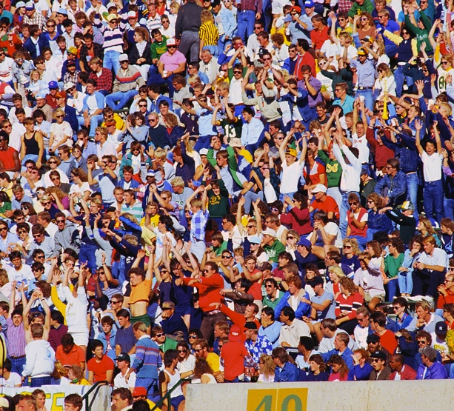
Biggest Opportunity – Biggest Challenge
Connectivity Without Meaningful Limits
Internet address limitation under IPv6:
  340,282,366,920,938,463,463,374,607,431,768,211,456 addresses
2.4 E12 addresses for every piece of paper ever created
4.25 E28 addresses per person on the planet
6.7 E19 addresses square centimeter of the earths surface
EVERYTHING could have an address
Notes:
IPV6 = 340,282,366,920,938,463,463,374,607,431,768,211,456 addresses (or 3.4 E38 addresses)
Pronounced: Three hundred and forty undecillion, two hundred and eighty-two decillion, three hundred and sixty-six nonillion, nine hundred and twenty octillion, nine hundred and thirty-eight septillion, four hundred and sixty-three sextillion, four hundred and sixty-three quintillion, three hundred and seventy-four quadrillion, six hundred and seven trillion, four hundred and thirty-one billion, seven hundred and sixty-eight million, two hundred and eleven thousand, four hundred and fifty-six.
95 trillion sheets of paper produced every year - multiply by 150 to get an approximate number of sheets of paper overall of human history – results in 2.4 E12 IP addresses per sheet of paper
Earths surface is 510,072,000 square kilometers – multiple by 10,000,000,000 square centimeters in a square kilometer results in 6.7 E19 addresses per square centimeter.

