Slide 1
The Basics of 1991 and 2011 Realignments
Realignment 101:
September 27 & 28, 2018

Slide 2
Presenters
Diane Cummins –
Special Advisor to the Governor
Robert Manchia, San Mateo – County Manager’s Office
Andrew Pease, San Diego – Health & Human Services
Bruce Wagstaff, Sacramento – Social Services
Geoff Neill, CSAC

Slide 3
Video

Slide 4
Agenda – Day 1
Introductions
History, Policy, Politics and People
1991 Realignment Structure
2011 Realignment Structure
Group Activity

Slide 5
Agenda – Day 2
Tools and Models
Recap - Similarities & Differences
Outcomes & Opportunities
Group Activity
Trends
The Realigned View
Discussion & Wrap-up

Slide 6
1991 and 2011 REALIGNMENT
History, Policy, Politics and People
CSAC Institute
September 27 & 28, 2018

Slide 7
What’s It All About?
The State-Local Relationship
Governance
Services
Money
And, outside influences/pressures

Slide 8
What’s It All About?
Governance – State programs administered by counties
Services - Realignment is meant to be a way to improve the ability of the state and counties to serve the citizens
Money - What program couldn’t benefit from more money?

Slide 9
The Road To 1991 Realignment
Proposition 13 and the State Bail-Out
Property tax rate of 1% - $6.88 B loss
State assumes greater funding for schools: transfers property tax to other local governments
State also changes HHS sharing ratios and provides program money to assist counties

Slide 10
Detour During the 1980’s
Budget Problems (1981-82 to 1984-85)
VLF Cuts
Medically Indigent Health (MIA) transfer
New Partnership Task Force (1983)
Stabilize local government funding
Realign Programs
Realignment, Restructuring or Disengagement – trade Trial Court costs for AFDC. Didn’t happen but there was a benefit……..

Slide 11
1991 – Getting to Yes
Prior budget reductions to Community Mental Health and Indigent Health programs
1990 election of Governor Wilson
January $7 billion budget problem – a major recession
Only two significant discretionary programs – community mental health and indigent health funding (AB 8 Block Grant and MIA programs) proposed for elimination
Willing to tax? Could realign programs

Slide 12
1991 January Budget Proposal
Increase alcoholic beverage tax to national average; change VLF depreciation – revenue for Realignment ($942 million)
Transfer responsibility /funding to counties for AB 8 block grant, MIA block grant and community mental health ($942 million)
Provide counties authority to increase sales tax by ½% for drug enforcement and crime prevention

Slide 13
Politics
A Different Era
New Governor but old relationships
“Big 5” met weekly
Members knew the programs
As budget problem grew to $14 billion, Realignment grew to $2.2 billion
Revenue structure changed – no alcohol beverage tax; ½ cent sales tax added
Added shares of cost in social services programs

Slide 14
Money, Policy, Meeting Needs
Flexibility for counties – Mental Health
Policy Changes through fiscal incentives
Money – 1 account or many
Who did the allocations and why
Maintained baseline funding plus growth
Mandate protection for the State
Poison pills
Sales tax and Proposition 98
MIA Lawsuits
Mandates in general

Slide 15
Lessons Learned
Programs realigned may be underfunded
Growth in revenue may not cover increased costs
New legislation costs money
Federal or state government can change requirements
Poison pills limit the policy discussion
Generally considered a “success”

Slide 16
If Successful, Why Wait 20 Years?
1994 – Community-Based Punishment Act
1997 – State Trial Court Funding (initial steps in 1988)
1997 – CYA Sliding Scale
2007 – Juvenile Justice Realignment
2009 – Felony Probation (SB 678) BUT
Lawsuits regarding state prison overcrowding
No overcrowding solution

Slide 17
A New Governor With Motivation
Build on previous success
Move government closer to the people
More flexibility/accountability at local level
Interconnected programs together
Focus on core services/improve services
Clarify state/local roles – reduce duplication
Help address budget gap of $26.6 billion
Federal 3-Judge panel on prison overcrowding

Slide 18
What Did the Governor Want?
Constitutional Amendment for June ballot – a 2/3 vote
Extension of $5.9 billion in temporary taxes
5 year temporary tax for Realignment with an on-going guarantee
Protections for both the state and counties
Why a Constitutional Amendment?

Slide 19
2011 Public Safety Proposal
Public Safety defined broadly ($5.9 billion)
Child Welfare and Foster Care
Behavioral Health – EPSDT and SUD
Adult Protective Services
Court security
Law enforcement subventions
Juvenile justice programs Community Corrections Program (AB 109)
1991 Mental Health Funding to CalWORKs MOE

Slide 20
Who Else Was Involved?
Counties
Health and Human Services interests
The Legislature
California Department of Corrections
Law Enforcement (Sheriffs, Probation, DAs, Police Chiefs)
Criminologists
Other interests

Slide 21
What Happened?
AB 109 enacted in March, 2011
No vote on a Constitutional Amendment
2011 Budget Act (June) included the entire Public Safety Realignment package
Funded with 1.0625 cent state special fund sales tax and certain VLF funds – reduced GF sales tax by the same amount
Agreement to delay AB 109 until October 1

Slide 22
Why and How?
Governor committed to Constitutional protections – Prop 30 - November, 2012
Benefits to children’s programs - $200 million for Child Welfare Services
Mental Health Funding protected
Possibility of additional growth funding
Saved General Fund Prop 98 costs
No other major solution for 3 Judge Panel
Majority Vote Budget

Slide 23
But It Didn’t End There
Change builds on previous Realignment actions
2013 Health Care Reform – move money from 1991 Health Account to new Family Support Account
CCI Initiative and IHSS “savings” due to MOE to fund new Child Poverty Account - CalWORKs COLAs and Maximum Family Grant
Pulling the trigger on CCI
Revised MOE structure and changes to 1991 Realignment

Slide 24
Why Is It So Complicated?
Can’t bring Realignment money to the state level – necessitates moving money around within 1991 Realignment
Trying to avoid use of General Fund in case of a downturn
People want things and if something is done once, it’s easier to do it a second time

Slide 25
What Are the Similarities?
State Budget crisis
The threat of something worse
Governor who knew what he was willing to do
Given a dollar amount to work with
Seemed to make sense
Counties being flexible and willing to solve a problem
Relationships
Other?

Slide 26
Structure of Realignment
Notes:
We’ll start with 1991 Realignment and then transition into 2011 Realignment…

Slide 27
What is 1991 Realignment
Change in State and County Relationship
A “realignment” of program responsibilities
Transfer of financial liability & administrative authority
Goal
Mitigate State revenue gap
Give counties greater funding stability
Create an incentive to counties to operate programs with greater efficiency and effectiveness

Slide 28
1991 Realignment
1991 Realignment (W&I Code 17600-17613.4)
Health
Mental Health
Social Services
1991 Realignment ½ cent sales tax
Appx. 75% vehicle license fees
Rolling Base

Slide 29
1991 Realignment “Rolling Base”
“Rolling” Base: Base funding + Growth funding = Next Fiscal Year’s Base
No base restoration – if base funding level is not met in any fiscal year then next fiscal year’s base starts out lower

Slide 30
1991 Realignment Base Determination:
Base met, growth available
Year 1 Base
Year 1 Growth
Year 2 Base
Example:
$100
$10
$110
Base not met, growth unavailable
Year 1 Base
Actual Sales Tax comes in lower than base
Year 2 Base
Example:
$100
$90
$90

Slide 31
1991 Realignment Structure
State
Local Revenue Fund
Source: ½ cent Sales Tax; Source: 74.9% Vehicle License Fees
Sales Tax/VLF Base Account
Vehicle License Collection
Sales Tax/VLF Growth Account
(Revenues in Excess of Base Payments)
Mental Health Subaccount
($1.12 billion base funding from 2011 Realignment)
Social Services Subaccount
Health
Subaccount
CMSP
CalWORKs MOE
(capped at $1.12 billion)
Child Poverty and Family Supplemental Support
Family Support
If CalWORKs has reached cap, funds in excess go to Mental Health

Slide 32
1991 Realignment Structure
Local
County Local Revenue Fund
Mental Health Subaccount
Social Services Subaccount
Health
Subaccount
CalWORKs
MOE
Family
Support
VLF
Collections

Slide 33
Health Realignment: 1991
Public Health
Indigent Health Care (MISP/CMSP)
AB 8: public/indigent health block grant post-Prop 13
Local Health Services: public health staff in small/rural counties
California Children Services (CCS) – Seriously ill or injured children
Folded in to Social Services – caseload driven
Medically Indigent Services Program – large counties
County Medical Services Program – small counties

Slide 34
1991 Mental Health Realignment
Community-based Mental Health Programs
State Hospital Services for County Patients
Institutions for Mental Diseases (IMDs)

Slide 35
1991 Social Services Realignment
CalWORKs Assistance, Eligibility, Employment Services
Foster Care
Child Welfare Services
Adoptions Assistance
In-Home Supportive Services
County Services Block Grant
County Juvenile Justice Subventions (AB90)
County Stabilization Subventions
California Children’s Services

Slide 36
Components of State and Local Program Realignment

Slide 37
Major Changes Impacting 1991 Realignment
2011 Realignment
CalWORKs Maintenance of Effort (MOE)
AB85
SB90 IHSS MOE / CCI

Slide 38
1991 Realignment Structure
State
Local Revenue Fund
Source: ½ cent Sales Tax; Source: 74.9% Vehicle License Fees
Sales Tax/VLF Base Account
Vehicle License Collection
Sales Tax/VLF Growth Account
(Revenues in Excess of Base Payments)
Mental Health Subaccount
($1.12 billion base funding from 2011 Realignment)
Social Services Subaccount
Health
Subaccount
CMSP
CalWORKs MOE
(capped at $1.12 billion)
Child Poverty and Family Supplemental Support
Family Support
Tied together with 2011 Realignment
AB 85

Slide 39
Mental Health to CalWORKs MOE
Mental Health 1991 Realignment
Growth
Mental Health 2011 Realignment
Guaranteed amount
($1.12B)
CalWORKs MOE
(up to $1.12 B)
Mental Health
1991 Realignment
After $1.12B Met

Slide 40
AB 85:
State to County Transfer
Family Support
Subaccount
Child Poverty & Family Supplemental Support Subaccount
State
NEW County Account
Family Support
Account

Slide 41
CalWORKs MOE -Assistance
State
CalWORKs MOE
Child Poverty
Family Support
County
CalWORKs MOE
CalWORKs Assistance Payments
Family Support
CalWORKs Admin
(Some Counties)

Slide 42
1991 Realignment Structure
State
Local Revenue Fund
Source: ½ cent Sales Tax; Source: 74.9% Vehicle License Fees
Sales Tax/VLF Base Account
Vehicle License Collection
Sales Tax/VLF Growth Account
(Revenues in Excess of Base Payments)
Mental Health Subaccount
($1.12 billion base funding from 2011 Realignment)
Social Services Subaccount
Health
Subaccount
CMSP
CalWORKs MOE
(capped at $1.12 billion)
Child Poverty and Family Supplemental Support
Family Support
Tied together with 2011 Realignment
AB 85

Slide 43
1991 Realignment Structure
Growth
Sales Tax/VLF Growth Account
(Revenues in Excess of Base Payments)
Sales Tax Caseload Subaccount
(1st call on Growth)
CMSP Growth
(2nd call on Growth; 4.027% plus 4.027%
of caseload growth paid if over $20M)
General Growth
(remaining Growth)
Mental Health
(approx. 40%)
Health
(approx. 18.45%)
Child Poverty & Family Supplemental Support
(remaining growth)

Slide 44
1991 Realignment Sales Tax Caseload Subaccount
Reflects mandated growth in Social Services programs
Amount based on program expenditures, not caseload (two year process)
Calculation based on change in County cost due to mandated cost increases (i.e. growth in caseload)
Determined by comparison of County-specific costs from two years ago compared to last year
Increased costs generally = more caseload growth

Slide 45
1991 Realignment Growth Order Flow
SALES TAX GROWTH
Caseload Growth
CMSP = 4.027% of remaining growth + 4.027% of total caseload growth (if deposit to caseload growth exceeds $20M)
General Growth (balance)
MH (approx. 40%)
Health (18.4545%)
Family Support (balance)
VLF GROWTH
CMSP = 4.027% of Growth
General Growth (balance)
MH (approx. 40%)
Health (18.4545%)
Family Support (balance)

Slide 46
SB 90 Changes to 1991 Realignment
SB 90 established a revised IHSS MOE in FY 17/18 and included the following:
A committed amount of one-time State General funds to counties for several years An Accelerated flow of Social Services Realignment
Temporarily redirected VLF Realignment from the Family Support, Health, & Mental Health Subaccounts

Slide 47
1991 Realignment Growth Flow (SB 90)
It is projected that 100% of sales tax growth will go towards caseload growth for the foreseeable future
Growth for IHSS caseload will be advanced prospectively and not after costs incurred (no two year wait)
Final reconciliation for IHSS caseload growth in 2 years to capture bargaining and any other net unfunded costs
2-year caseload growth process continues for non-IHSS Social Services programs
For three years, 100% of VLF growth for Family Support subaccount, and the Mental Health and Health subaccounts will be redirected to cover IHSS costs when sales tax realignment is insufficient
In the fourth and fifth year, 50% of VLF growth for Family Support subaccount, and the Mental Health and Health subaccounts will be redirected to cover IHSS costs when sales tax is insufficient
In the sixth year, growth will go back to the normal flow (But – prior VLF redirection is permanent)

Slide 48
1991 Realignment Growth Expected flow (SB 90)
SALES TAX GROWTH
100% towards
Caseload Growth (after base achieved)
CMSP = 4.027% of remaining growth + 4.027% of total caseload growth (if deposit to caseload growth exceeds $20M)
General Growth (balance)
MH (approx. 40%)
Health (18.4545%)
Family Support (balance)

Slide 49
1991 Realignment Growth Expected Flow (SB 90)
W&I Code 17606.20(c)
VLF GROWTH
(for FY 16/17, FY 17/18 & FY 18/19)
100% of growth goes to Social Services
General Growth (balance)
MH (approx. 40%)
Health (18.4545%)
Family Support (balance)
VLF GROWTH
(for FY 19/20 & FY 20/21)
50% of growth goes to Social Services
General Growth (balance)
MH (approx. 40%)
Health (18.4545%)
Family Support (balance)

Slide 50
1991 MOE Requirements
Mental Health (WIC 17608.05)
Social Services (None)
Health (WIC 17608.1)

Slide 51
1991 Transfer Options
None for CalWORKs MOE
None for Family Support Account
May reallocate money among accounts, not to exceed 10% of amount deposited for that fiscal year
May reallocate addt’l. 10% from health to social services
May reallocate addt’l. 10% from social services to mental health or health
Must go to BOS
Must notify SCO

Slide 52
2011 Realignment
2011 “Public Safety” Realignment (Gov Code 30025-30029.12)
Behavioral Health
Protective Services (Social Services)
Law Enforcement
2011 “Public Safety” Realignment (Gov Code 30025-30029.12)
1.06 cent sales tax
$489 million vehicle license fees

Slide 53
Local Revenue Fund 2011 State Structure
Local Revenue Fund 2011
Sales & Use Tax 6051.15 & 6201.15 VLF 11001.5 & 11005
Mental Health Account
(1991 Mental Health Responsibilities)
Support Services Account
Law Enforcement Services Account
Gov Code Section 30027.8
Excess goes to
GROWTH

Slide 54
Mental Health Account State Structure
Local Revenue Fund 2011
Sales Tax 6051.15 & 6201.15
Mental Health Account
(1991 Mental Health Responsibilities)
Guaranteed
$93.379M per month

Slide 55
Support Services Account State Structure
SUPPORT SERVICES ACCOUNT
Protective Services Subaccount
Behavioral Health Subaccount
Adoption Assistance Program
Substance Abuse Fund
Foster Care Assistance
Mental Health Fund
Adoptions - Admin
Women & Children’s Residential Treatment Special Account
Child Abuse Prevention
Adult Protective Services
Child Welfare Services
Guaranteed
$5.104M
Per year
Foster Care Administration

Slide 56
Support Services Account County Structure
SUPPORT SERVICES ACCOUNT
County Protective Services Subaccount
County Behavioral Health Subaccount
COUNTY OPTIONS
Ability to transfer up to 10% of the lesser subaccount between these Subaccounts
Adoption Assistance Program
Substance Abuse Fund
Foster Care Assistance
Mental Health Fund
Adoptions - Admin
Child Abuse Prevention
Support Services Reserve Subaccount
(Local option – subject to direction of BOS)
Up to 5% of total allocated subaccount for preceding year
Women & Children’s Residential Treatment Special Account
Adult Protective Services
Child Welfare Services
Foster Care Administration
Guaranteed
$5.104M
Per year

Slide 57
Law Enforcement Account State Structure
LAW ENFORCEMENT
ACCOUNT
FROM SALES TAX
Juvenile Justice Subaccount
Trial Court Security Subaccount
Community Corrections Subaccount
DA and Public Defender Subaccount
Youthful Offender Block Grant
Juvenile Reentry Grant
LAW ENFORCEMENT
ACCOUNT
FROM VLF
ENHANCING LAW ENFORCEMENT SVCS ACCOUNT
Guaranteed
$489.9M per year
Booking & Processing fees
CA Office of Emergency Svcs
Citizens Option Public Safety
Juvenile Justice Program
Juvenile Probation Activities
Juvenile Probation Camp Fund
Rural Small Cty Assistance

Slide 58
Long Term Allocation Formula Base Funding Factors
Community Corrections (AB109)
Beginning FY 2015-16
BASIS | PERCENTAGE | FACTORS
Caseload | 45% | 1170h jail inmates PRCS Felony Probation
Crime and Population | 45% | Number of serious crimes Adult Population
Special Factors | 10% | Poverty Small county minimums Presence of State prison

Slide 59
Growth Account
State Structure
2011 REALIGNMENT GROWTH
(Sales Tax)
Base Restoration
(if needed)
Support Services Growth
65%
Law Enforcement Growth
35%

Slide 60
2011 Realignment (Sales Tax)
Base Calculation Summary
LAW ENFORCEMENT SERVICES
SUPPORT SERVICES
PRIOR YEAR BEHAVIORAL HEALTH
GROWTH RECEIPTS
PRIOR YEAR TRIAL COURT SEC
GROWTH RECEIPTS
PRIOR YEAR PROTECTIVE SVCS
GROWTH RECEIPTS
PRIOR YEAT COMMUNITY CORR
GROWTH RECEIPTS
PRIOR YEAR BEHAVIORAL HEALTH
BASE
PRIOR YEAR DA & PUBLIC DEF
GROWTH RECEIPTS
PRIOR YEAR JUVENILE JUSTICE
GROWTH RECEIPTS
PRIOR YEAR PROTECTIVE SERVICES
BASE
PRIOR YEAR LAW ENFORCEMENT SERVICES BASE

Slide 61
2011 Realignment Base Determination:
Base Amount Calculation
Year 1 Base
Year 1 Growth
Year 2 Base
Example:
$100
$10
$110
Base Ratio Calculation
Year 2
Subaccount Base
Year 2 Total SS + Law Enf Base
Year 2 Subaccount %
Example: Y2 Base Support Svc = 220; Law Enforcement = 110
Support Services
$220
$330
66.67%
Law Enforcement
$90
$110
$330
33.33%
$90

Slide 62
Support Services
Next Year’s Base Calculation
FY 2017-18 BEHAVIORAL HEALTH
GROWTH RECEIPTS
$86,828,183*
Total Behavioral Health Base
$1,420,550,400
37.8135%
FY 2017-18 PROTECTIVE SERVICES
GROWTH RECEIPTS
$78,145,364*
FY 2017-18 BEHAVIORAL HEALTH
BASE $1,333,722,218
FY 2018-19 BASE FOR
SUPPORT SERVICES ACCOUNT
$3,756,723,674
Total Protective Services Base
$2,336,173,273
62.1865%
FY 2017-18 PROTECTIVE SERVICES
BASE $2,258,027,909
* Pending distribution

Slide 63
Law Enforcement Services
Next Year’s Base Calculation
FY 2017-18 TRIAL COURT SECURITY
GROWTH RECEIPTS
$9,350,727*
FY 2018-19 BASE FOR
LAW ENFORCEMENT SERVICES ACCOUNT
$2,070,869,443
FY 2017-18 COMMUNITY CORRECTIONS
GROWTH RECEIPTS
$70,130,455*
FY 2017-18 DA AND PUBLIC DEFENDER
GROWTH RECEIPTS
$4,675,364*
FY 2017-18 JUVENILE JUSTICE
GROWTH RECEIPTS
$9,350,727*
FY 2017-18 LAW ENFORCEMENT SERVICES ACCOUNTS
BASE $1,977,362,169
* Pending distribution

Slide 64
New Ratio for
FY 2018-19 Base
FY 2018-19 BASE FOR
SUPPORT SERVICES ACCOUNT
$3,756,723,674
FY 2018-19 BASE FOR
LAW ENFORCEMENT SERVICES ACCOUNT
$2,070,869,443
64.4644%
35.5356%

Slide 65
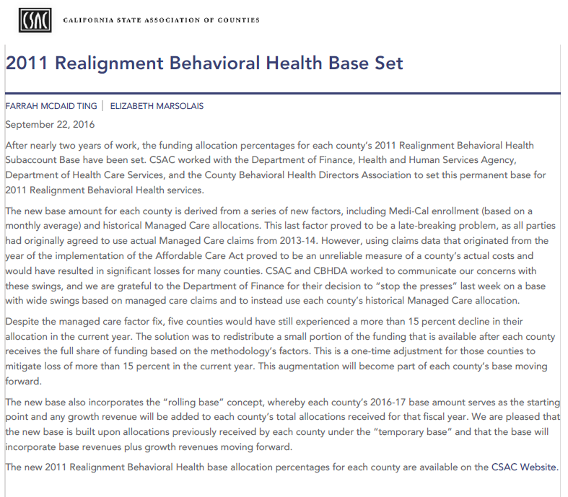
CHANGES
BEHAVIORAL HEALTH COUNTY DISTRIBUTION RATIO

Slide 66
Growth Account
State Structure
2011 REALIGNMENT GROWTH
Base Restoration
(if needed)
Support Services Growth
65%
Law Enforcement Growth
35%

Slide 67
Support Services Growth Account
State Structure
Support Services Growth
65%
Protective Services Growth
45%
Mental Health
Subaccount
5%
Behavioral Health Growth
50%

Slide 68
2016-17 Behavioral Health Growth Allocation
ALLOCATION METHODOLOGY | PERCENTAGE OF FUNDING A | TOTAL FUNDING (A*$98,363,658) B
One-time % adjustment to correct omission of Drug Medi-Cal claims in FY15-16 BHRS Growth | N/A
Percentage of Claims | 50% | $49,181,829
Medi-Cal Enrollment | 50% | $49,181,829
TOTAL | 100% | $98,363,658

Slide 69
Law Enforcement Growth Account
State Structure
Law Enforcement Growth
35%
Trial Court Security
Growth
10%
DA/ Public Defender Growth
5%
Juvenile Justice Growth
10%
Community Corrections
Growth
75%

Slide 70
Law Enforcement Growth Account
County Structure
County Law Enforcement Growth
County Trial Court Security
Growth
County Juvenile Justice Growth
County Community Corrections
Growth
County DA/ Public Defender Growth
10 %
10 %
10 %
10 %
Local Innovation Subaccount
(Beginning FY 15-16 each County shall transfer 10% from Trial Court Security Growth Special Account, Community Corrections Growth Special Account, DA and Public Defender Growth Account, and Juvenile Justice Growth Special Account)

Slide 71
Group Activity

Slide 72
The Basics of 1991 and 2011 Realignments
Realignment 101:
September 27 & 28, 2018

Slide 73
Agenda – Day 2
Tools and Models
Recap - Similarities & Differences
Outcomes & Opportunities
Group Activity
Trends
The Realigned View
Discussion & Wrap-up

Slide 74
Tools and Models

Slide 75
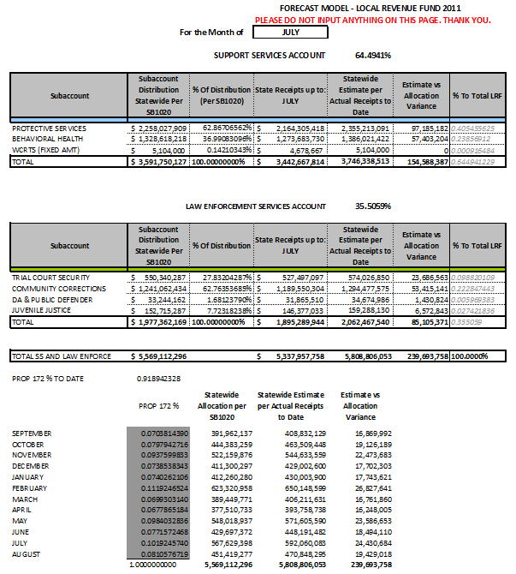
2011 Realignment Forecasting Tool

Slide 76
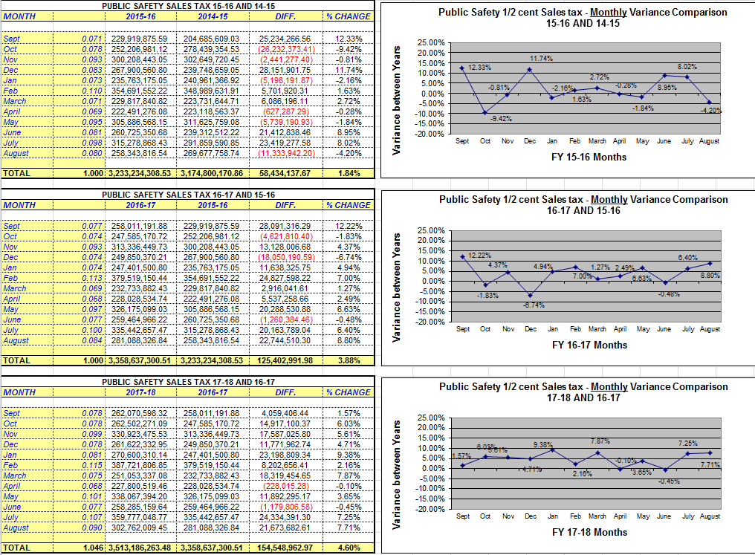
Forecasting VLF & Sales Tax

Slide 77
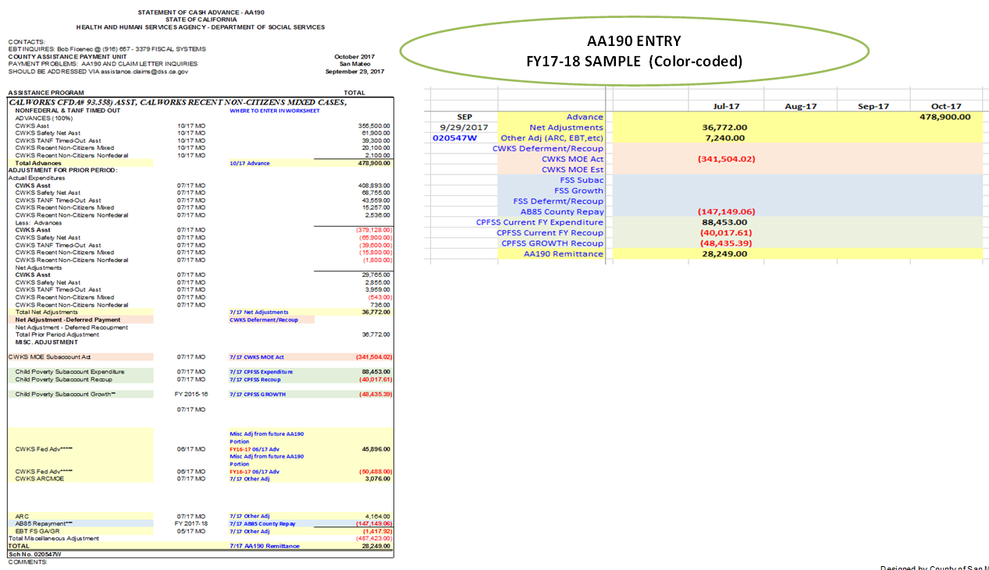
CalWORKs MOE Reconciliation Spreadsheet

Slide 78
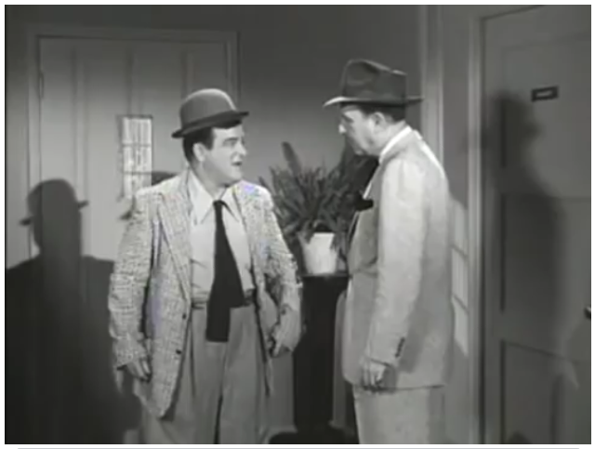
Video

Slide 79
Realignment Overview & Structure - 1991 & 2011
Similarities and Differences

Slide 80
1991 Realignment Structure
State
Local Revenue Fund
Source: ½ cent Sales Tax; Source: 74.9% Vehicle License Fees
Sales Tax/VLF Base Account
Vehicle License Collection
Sales Tax/VLF Growth Account
(Revenues in Excess of Base Payments)
Mental Health Subaccount
($1.12 billion base funding from 2011 Realignment)
Social Services Subaccount
Health
Subaccount
CMSP
CalWORKs MOE
(capped at $1.12 billion)
Child Poverty and Family Supplemental Support
Family Support
If CalWORKs has reached cap, funds in excess go to Mental Health

Slide 81
2011 Realignment Structure State
Local Revenue Fund 2011
Mental Health Account
(1991 Mental Health Responsibilities)
$1,120,551,024
Support Services Account
Law Enforcement Services Account
Sales and use Tax Growth Account
(Excess revenues above
base allocations)
County Intervention Support Services Subaccount
Trial Court Security Subaccount
District Attorney and Public Defender Subaccount
Support Services Growth Subaccount (65%)
Law Enforcement Services Growth Subaccount (35%)
Protective Services Subaccount
Community Corrections Subaccount
Juvenile Justice Subaccount
Protective Services Growth Special Account (45%)
Trial Court Security Growth Special
Account (10%)
Behavioral Health
Subaccount
Enhancing Law Enforcement Activities Subaccount
$489,900,000
Behavioral Health Services Growth
Special Account (50%)
Community Corrections Growth Special
Account (75%)
Juvenile Reentry Grant
Special Account
Mental Health Subaccount (5%)
Juvenile Justice
Growth Special
Account (10%)
Women and Children’s Residential Treatment Special Account (subset of BH Subaccount) $5,104,000
Enhancing Law Enforcement Activities Growth Special Account (Residual VLF revenue above the capped allocation)
Youthful Offender Block
Grant Special Account
District Attorney & Public Defender Growth Special
Account (5%)

Slide 82
Intersection of Realignment Programs
1991 Realignment
2011 Realignment
AB 8 County Health Services
Local Health Services
California Children’s Services
Indigent Health
CalWORKs
Employment Services
County Services Block Grant
In-Home Supportive Services
County Stabilization Subvention
County Juvenile Justice Subvention (AB90)
Adult Protective Services
Child Abuse Prevention, Intervention & Treatment (CAPIT)
Women and Children’s Residential Treatment
Drug Medical
Nondrug Medical
Drug Court
Law Enforcement
Trial Court Security
Juvenile Justice
District Attorney and Public Defender
Community
Corrections
Local Public Safety
Subventions
Shared
Foster Care
CWS
Adoptions
Mental Health
EPSDT
Managed Care
APS

Slide 83
Impact of 2011 Realignment to 1991 Sharing Ratios
Program
Foster Care
Child Welfare Services
Adoptions Assistance
Adoptions Eligibility
Adult Protective Services
Child Abuse Prevention, Intervention, & Treatment (CAPIT)
60%
30%
25%
0%
MOE
16%
New 2011 Share (non-Fed)
100%
100%
100%
100%
100%
100%
1991 Share (non-Fed)

Slide 84
Similarities and Differences 1991 & 2011
Base Restoration
Programs
Reserve Account
VLF vs. Sales Tax
Transfer Abilities
Reporting Requirements
Fed/Court Changes
Flexibility
Growth allocated
County Intervention Services Account
Fiscal Years
Constitutional Protections

Slide 85
Outcomes and Opportunities
Realignment

Slide 86
Realignment Outcomes and Opportunities
General Observations
Coordination / Innovation Examples
Outcome Data
Future Possibilities

Slide 87
General Observations
Local Flexibility and Accountability
Improved Program Understanding and Connectivity
Significant Learning Curve - Still Learning
Potential of Successful Partnerships

Slide 88
Coordination / Innovation Examples
Santa Clara County Re-entry Resource Center
Santa Clara County Medical Mobile Unit
Public Defender Expungement Programs
Sacramento County Collaborative Specialty Court Programs
Los Angeles County “Breaking Barriers” Rapid Re-Housing Program

Slide 89
Outcome Data
Recidivism
Housing
Medical Services
Employment

Slide 90
Future Possibilities
Pre-Trial Release
Expanded Collaborations – Correctional Health, Behavioral Health, Probation
Housing / Homelessness Prevention
Partnerships with Non-Profits / Community Organizations

Slide 91
Group Activity

Slide 92
Realignment Trends

Slide 93
1991 Sales Tax and VLF Collections By Fiscal Year

Slide 94
1991 Realignment Collections By Fiscal Year

Slide 95
1991 Realignment 1991 vs 2016 Collections

Slide 96
2011 Realignment Sales Tax Collections By Fiscal Year

Slide 97
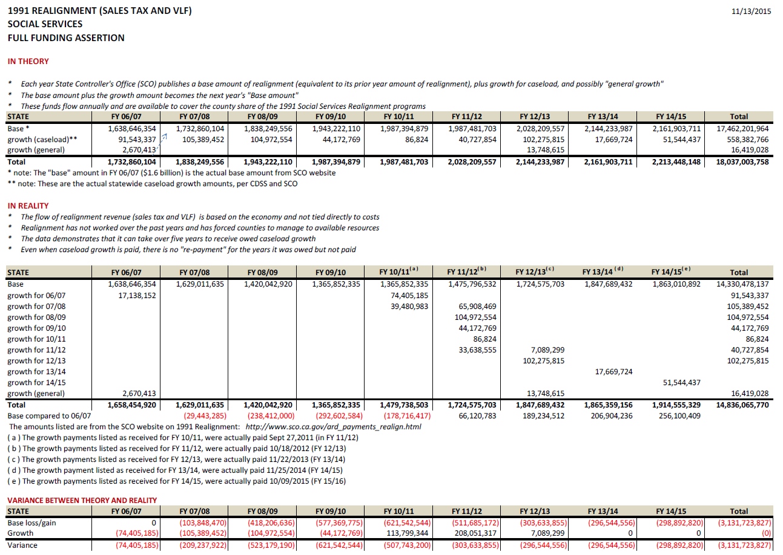
Flow of 1991 Realignment Theory and Reality

Slide 98
Model for Realignment Moving Forward

Slide 99
REALIGNED
THE
VIEW

Slide 100
Discussion and Wrap-Up

Slide 101
Contact Information
PRESENTERS
Diane Cummins, Special Advisor to the Governor; (916) 445-4141; diane.cummins@dof.ca.gov
Robert Manchia, County Budget Director, San Mateo County Manager’s Office; (650) 363-4597; rmanchia@smcgov.org
Andrew Pease, Finance Director, County of San Diego, Health & Human Services Agency; (619) 515-6548; andrew.pease@sdcounty.ca.gov
Bruce Wagstaff, Deputy County Executive, County of Sacramento, Social Services Agency; (916) 874-5886; wagstaffB@saccounty.net
Geoff Neill, Principal Analyst, CSAC; (916) 650-8115; gneill@counties.org

Slide 102
Thank You

