Slide 1
Sloane Dell’Orto, Streamline™
Streamline builds tools to help local government with online compliance:
Website Builder for local gov, with features designed to make having a website easier
And (surprise!) a free tool for SB 272 / Public Records Act compliance
Notes:
Started by offering a powerful, easy to use content management system to help local government build a compliant website. We have a passion for using technology to solve problems.

Slide 2
What is SB 272?
Addition to the Public Records Act (no reimbursement for cost of compliance)
Local government agencies must create “Enterprise System Catalog” by July 1
Exemptions are local educational agencies, state agencies...and the legislature

Slide 3
What is SB 272?
Don’t let the Public Records Act inclusion confuse you - the rules aren’t quite the same
What is required: list of computer systems that qualify
What isn’t required: the actual data in those systems, along with a few other exemptions

Slide 4
Who has to comply?
Almost any entity defined as a local agency in the Public Records Act must comply with 272:
“A local agency includes a county, city (whether general law or chartered), city and county, school district,* municipal corporation, special district, community college district or political subdivision.”
*Although local educational agencies and state agencies are included in the PRA, they are exempt from SB 272.

Slide 5
Wait. Really?
It doesn’t matter if you have a website or not.
It doesn’t matter if you have computers or not! (Although you probably use one to create your agendas and minutes, and that counts.)
If your agency is considered local government, and you aren’t a school district, you need to do this.
Notes:
Cemetery district with paper maps and agendas, etc - sharpie it up and put it on the wall where you meet!

Slide 6
(Sorry!)
Notes:
Cemetery district with paper maps and agendas, etc - sharpie it up and put it on the wall where you meet!

Slide 7
Bill text
...The catalog shall disclose a list of the enterprise systems utilized by the agency and, for each system, shall also disclose all of the following:
(1) Current system vendor.
(2) Current system product.
(3) A brief statement of the system’s purpose.
(4) A general description of categories or types of data.
(5) Department that serves as the system’s primary custodian.
(6) How frequently system data is collected.
(7) How frequently system data is updated.

Slide 8
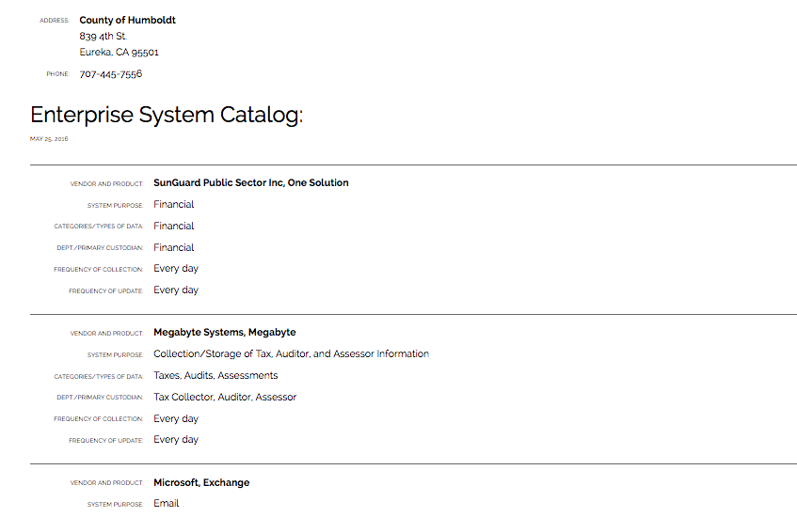

Slide 9
Bill text
(1) “Enterprise system” means a software application or computer system that collects, stores, exchanges, and analyzes information that the agency uses that is both of the following:
(A) A multidepartmental* system or a system that contains information collected about the public.
(B) A system of record.
(2) “System of record” means a system that serves as an original source of data within an agency.
*any agency without official departments should consider every system multidepartmental

Slide 10
Exemptions
(3) An enterprise system shall not include any of the following:
(A) Information technology security systems, including firewalls and other cybersecurity systems.
(B) Physical access control systems, employee identification management systems, video monitoring, and other physical control systems.
(C) Infrastructure and mechanical control systems, including those that control or manage street lights, electrical, natural gas, or water or sewer functions.
(D) Systems related to 911 dispatch and operation or emergency services.
(E) Systems that would be restricted from disclosure pursuant to Sec. 6254.19.*
(F) The specific records that the information technology system collects, stores, exchanges, or analyzes.
*if disclosure would reveal vulnerabilities to, or otherwise increase the potential for an attack on, an information technology system of a public agency

Slide 11
Stated purpose of the Bill
“...Members of the public too often are not aware of what data local governments collect, the format the data is in, or the location where the data is stored. Similarly, a lack of information about local agencies’ data systems may impede efforts among local agencies to collaborate on projects to standardize and share public data sets. “By requiring local governments to share information about their enterprise data systems, SB 272 takes a significant step towards making California local government data more accessible to the public.”

Slide 12
Disclaimer
The law can be confusing. Is it “and?” Is it “or?”
…”Enterprise system” means a software application or computer system that collects, stores, exchanges, and analyzes information...
...The specific records that the information technology system collects, stores, exchanges, or analyzes...
Ask your Counsel for advice if you are concerned, otherwise do your best–intention matters.
Notes:
We’ll do our best to answer all of your questions, but in the end, we’re all guessing until someone gets sued and the courts give a better definition.

Slide 13
Examples of compliance
County of Humboldt - using Streamline
City of Palm Springs - using Streamline
City of Santa Clarita - using a spreadsheet
City of Stockton - link to PDF / table
Lots of ways to do this.

Slide 14
Q & A
If there are any questions we can’t get to today, we promise to follow up with an email.

Slide 15
Tell your friends about SB 272
• July 1 deadline
• Every local agency has to comply except school districts (size doesn’t matter!)
• Our tool is free, but not the only way

Slide 16
Resources
Full text of the bill: https://leginfo.legislature.ca.gov/faces/billNavClient.xhtml?bill_id=201520160SB272
More info on SB 272: www.getstreamline.com/sb272
Additional webinars: www.getstreamline.com/webinars

