Slide 1

California State Association of Counties
Innovation Summit
November 26, 2012
Richard Sanchez
Chief Information Officer

Slide 2
Global Economic Crisis
Increased Demand for Services
Requirement to Streamline Processes
Quick Hit Information Technology Solutions
Reduced Printing & Used Double Sided Printing
Configured Smaller Fonts
PC Off-hour Shut Down
Eliminated over 15,000 Unused Phone & Fax lines
Extended Technology Refresh Cycles
Set Video and Tele-Conference Service Agreements
Vendor Master Agreements

Slide 3

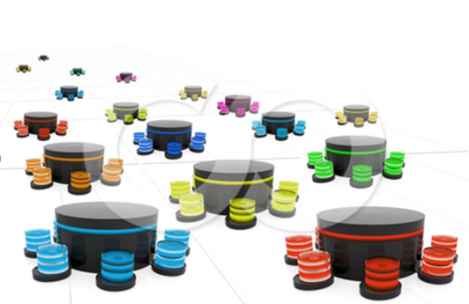




Current State of County IT
Over 60 data centers
Over 4,000 IT staff
FY 12-13 IT Budget of $1.2 Billion
88,000 personal computers
108,000 email accounts in 110 email servers

Slide 4
Key Enterprise IT Initiatives
Shared Services – Email, File
Software Sourcing
Centralized Services – GIS, BI, Portal,
E-mail Centralization
Server Virtualization
Managed Print Services
Data Center Centralization
Private Cloud Service Offerings
Information Management / Data Sharing
E-government and Mobility

Slide 5

E-mail Centralization
$10.00/mailbox
Per month
21,051
mailboxes
$6.29/mailbox
Per month
44,744
mailboxes
$4.30/mailbox
Per month
69,744
mailboxes
**
$3.50/mailbox
Per month
94,744
mailboxes
**
* Funding established
** Potential CJIS implications

Slide 6









Server Virtualization
Hypervisor
Hypervisor
20%
utilization
70%
utilization
Reduced Operating Costs

Slide 7
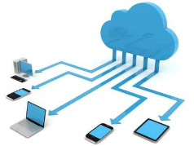
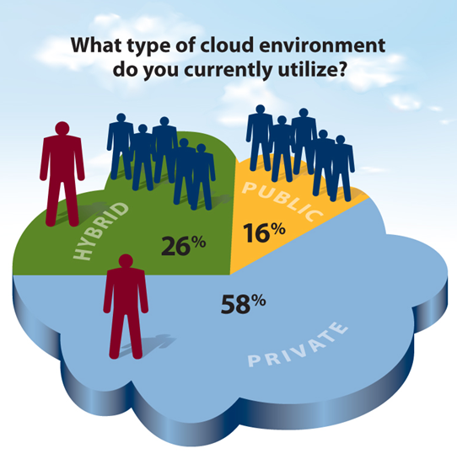
Cloud Computing
Private Cloud
  Enterprise-owned or leased, e.g. County’s IT Shared Services
Public Cloud
  Mega-scale infrastructure shared by multiple tenants
Hybrid Cloud
  Composition of two or more types of clouds

Slide 8
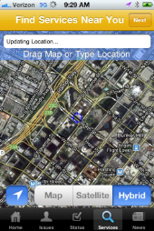


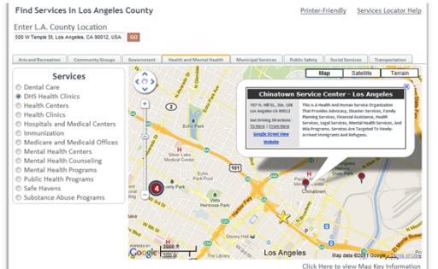


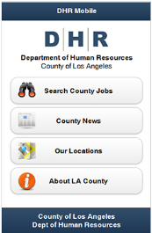
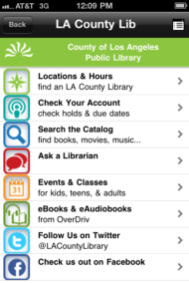

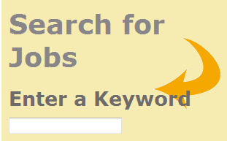
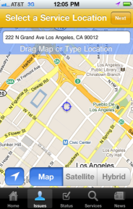







Service Delivery Model
Information WHEN you want it, HOW you want it
Online Reservations

Slide 9
?

