Slide 1
Linking Childhood Experience to Juvenile and Criminal Justice Involvement
Angela Irvine, Ph.D.

Slide 2

The National Council on Crime and Delinquency
Organizational Overview
Over 100 years old
We work to create just and humane social systems
Two offices
  Madison
  Oakland

Slide 3
California
NCCD Works in 56 California Counties
  Structured Decision Making and Safe Measures
  JAIS/CAIS
  Research and technical assistance related to DMC, girls, and LGBT youth

Slide 4
Santa Clara Juvenile Probation Data on Trauma Experience
Trauma Type | Boys | Girls
None | 19% | 16%
Rape | 1% | 15%
Sexual Abuse | 4% | 24%
Physical Abuse | 15% | 27%
Death | 41% | 42%
Witnessing Violence | 40% | 40%
Serious Accident | 16% | 18%
Other Major Disruption | 19% | 19%
Multiple (2 or more) | 42% | 56%

Slide 5

Trauma as a Driver into Juvenile Justice
NCCD Projects
Children Exposed to Violence Task Force
Los Angeles Child Welfare Risk Assessment

Slide 6

LGBT Youth: Family Rejection and Conflict
National Survey
2200 respondents
15% of all youth
11% boys, 27% of girls
Same disclosure across race/ethnicity
LGBT youth 2x more likely
  Run away
  Homeless
  Detained for status and survival crimes

Slide 7
Linking Child Welfare and Juvenile Justice
NCCD Permanency Project: Outcome Driven Technical Assistance and Training
Four counties: Alameda, Fresno, Orange, and Sacramento
Identifying interventions to increase housing stability
  Orange County Survival Crime Risk Assessment
Developing data collection protocols to track outcomes

Slide 8
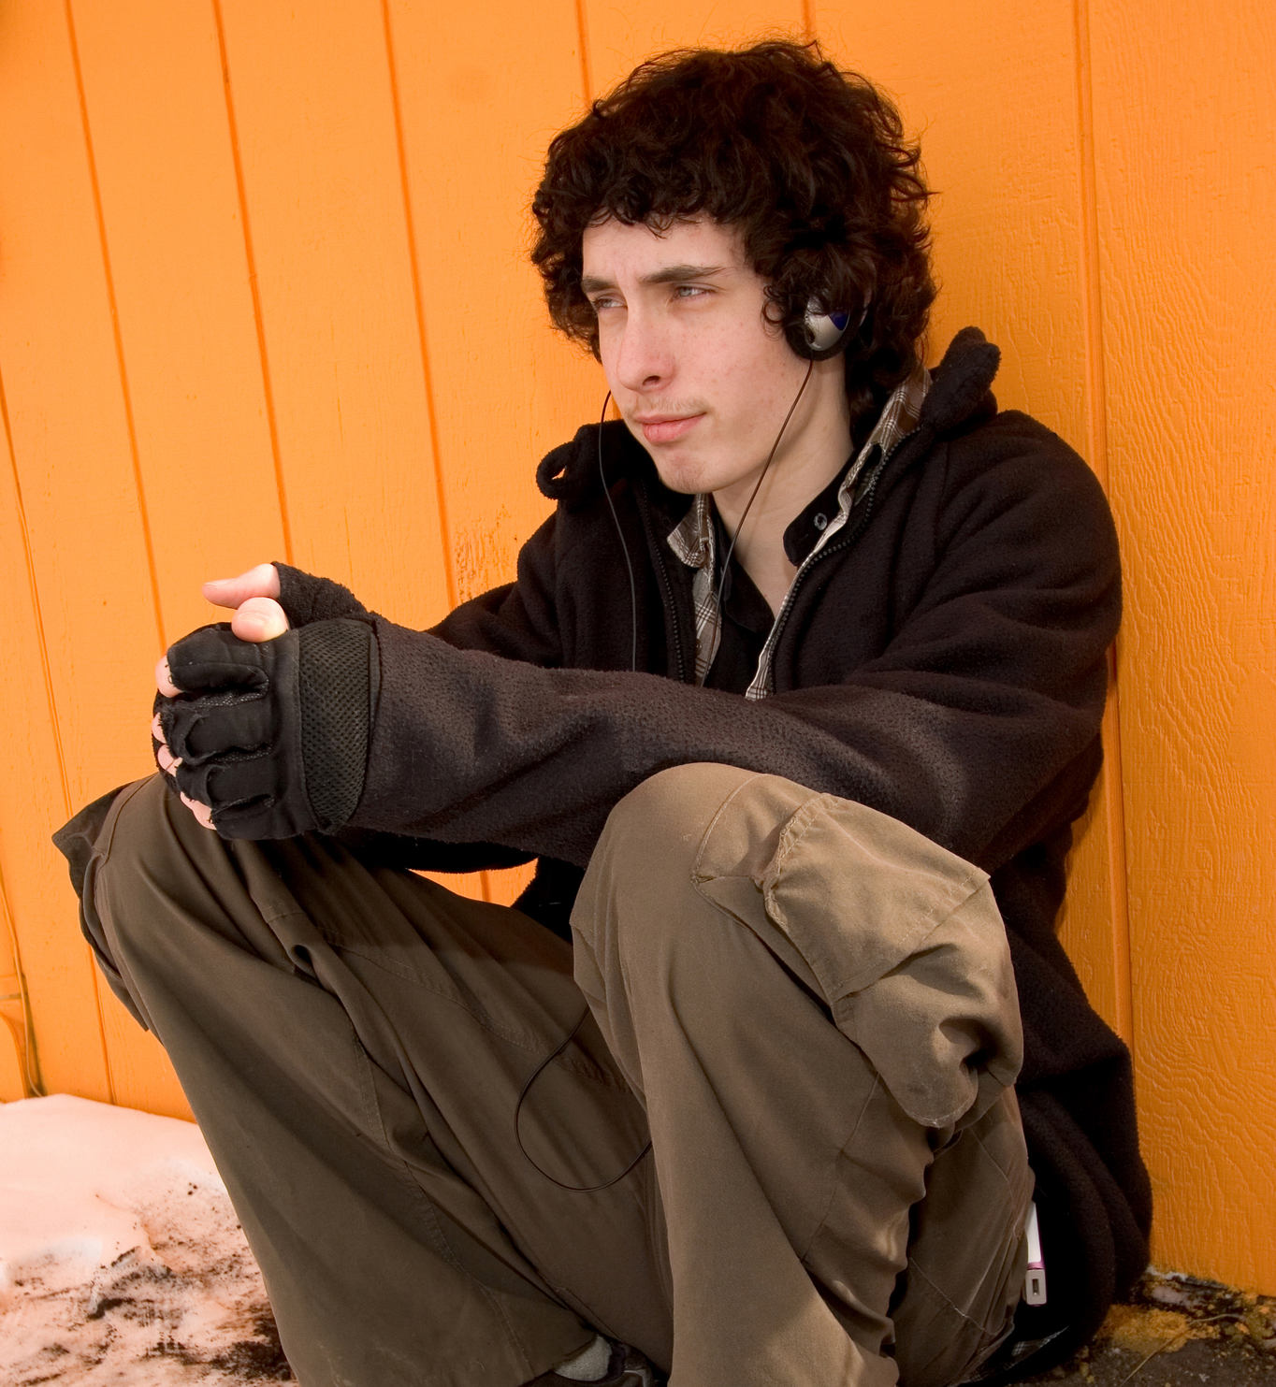
Linking Schools and Juvenile Justice
OUSD Decision Matrix and Risk Assessment
Under VRP to reduce suspensions of African American students.
PBIS and Restorative Justice
Working to develop decision matrix to reduce referrals
  When given the chance to talk and identify solutions, teachers agreed on responses

Slide 9

Invest in Communities, Families, and Youth
Real Justice Reinvestment
Deincarceration Project
  Improved supervision and placement involves families and is close to home
Positive Youth Justice

