Slide 1
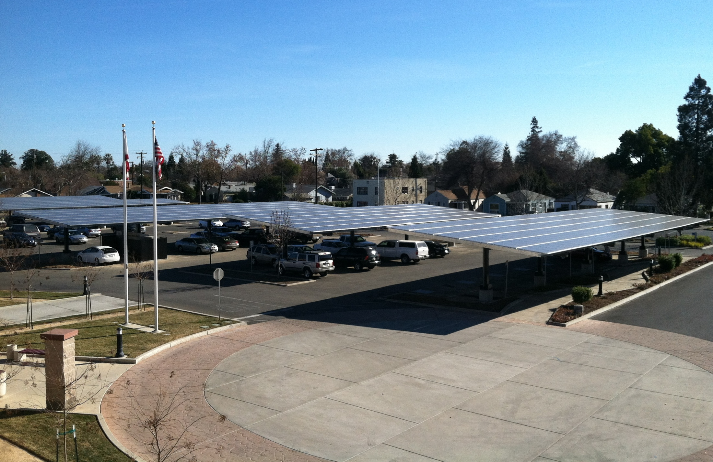
386-kW Solar Parking Canopies at Yuba County Government Center

Slide 2
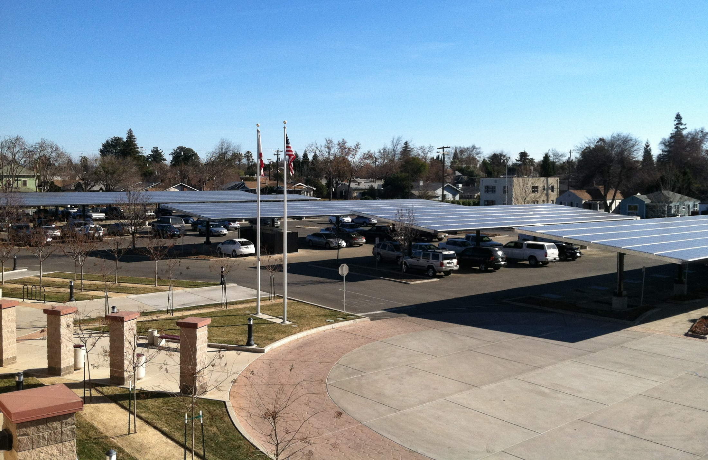
386-kW Solar Parking Canopies at Yuba County Government Center

Slide 3
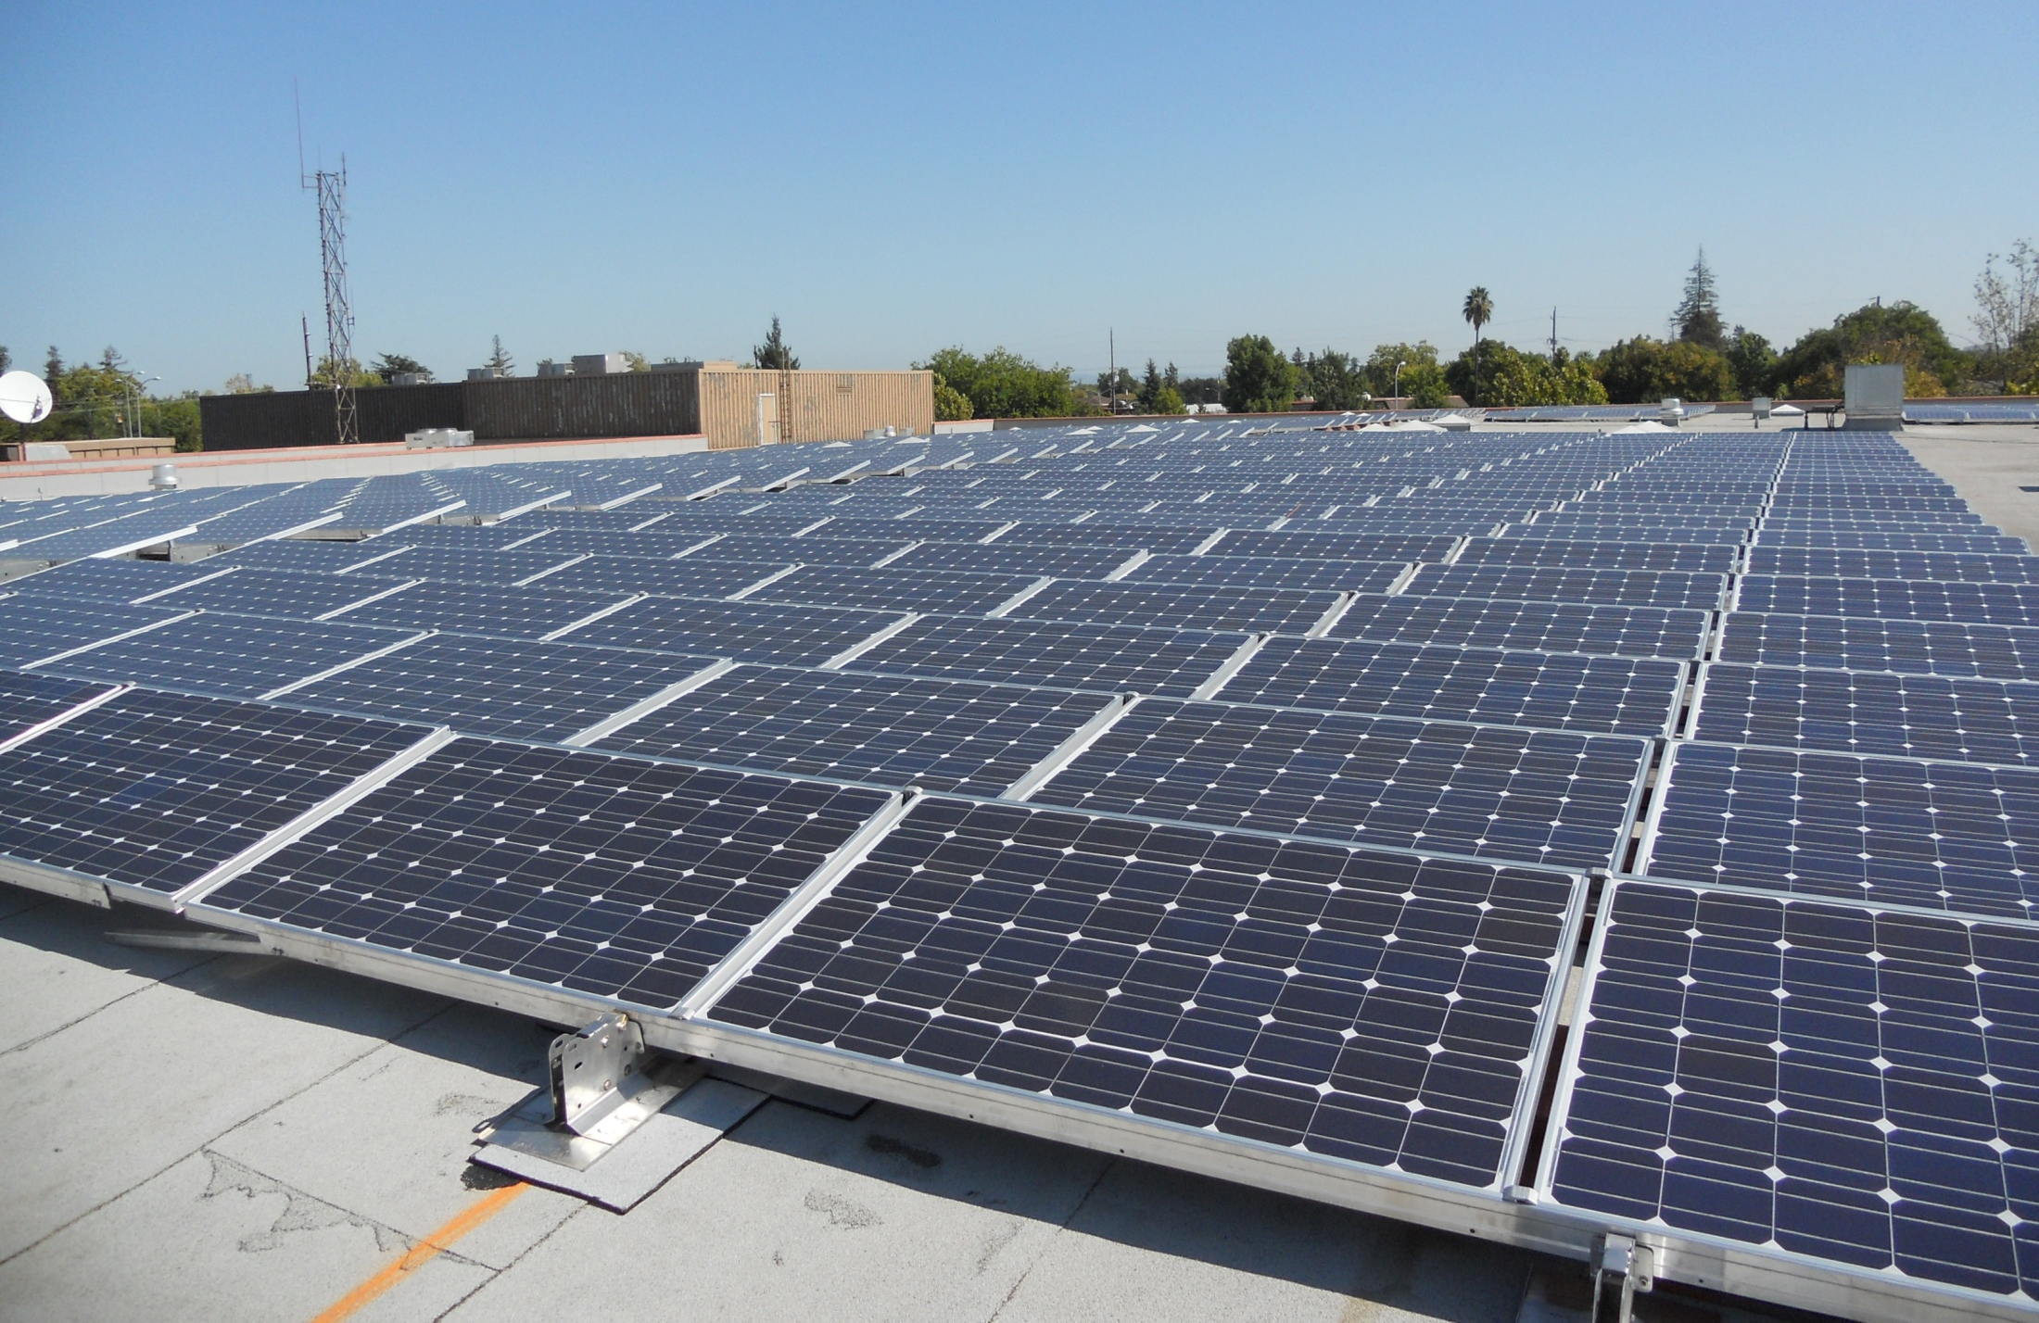
212-kW Roof-mounted Solar System at Yuba County Government Center

Slide 4
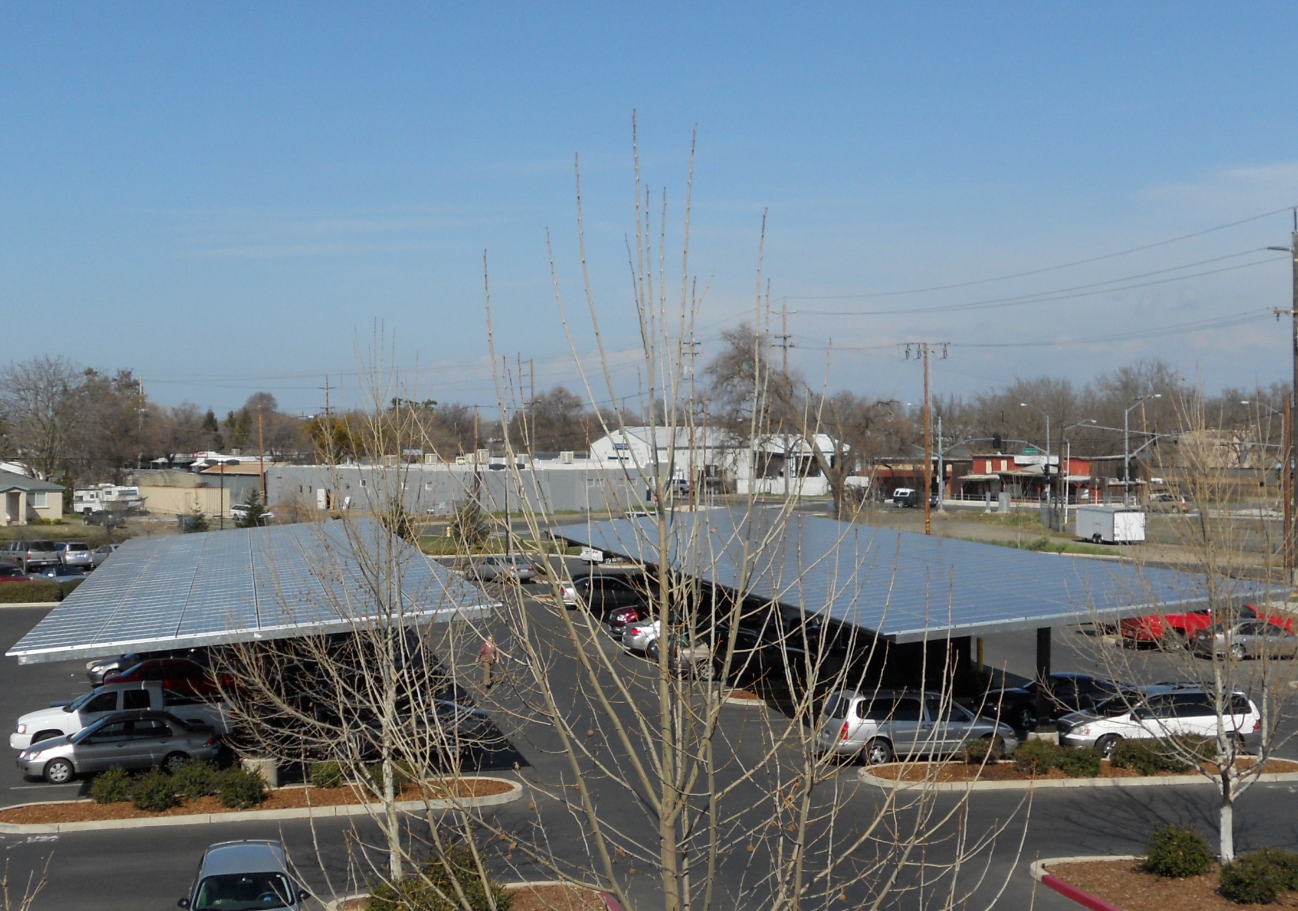
131-kW Solar Parking Canopies at Yuba County Packard Building

Slide 5
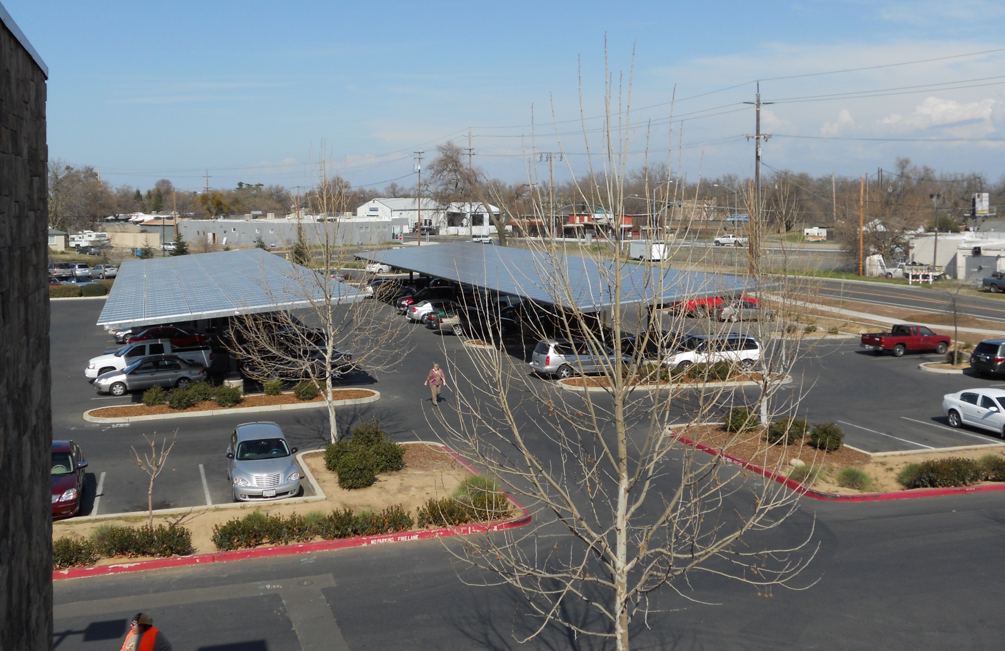
131-kW Solar Parking Canopies at Yuba County Packard Building

Slide 6
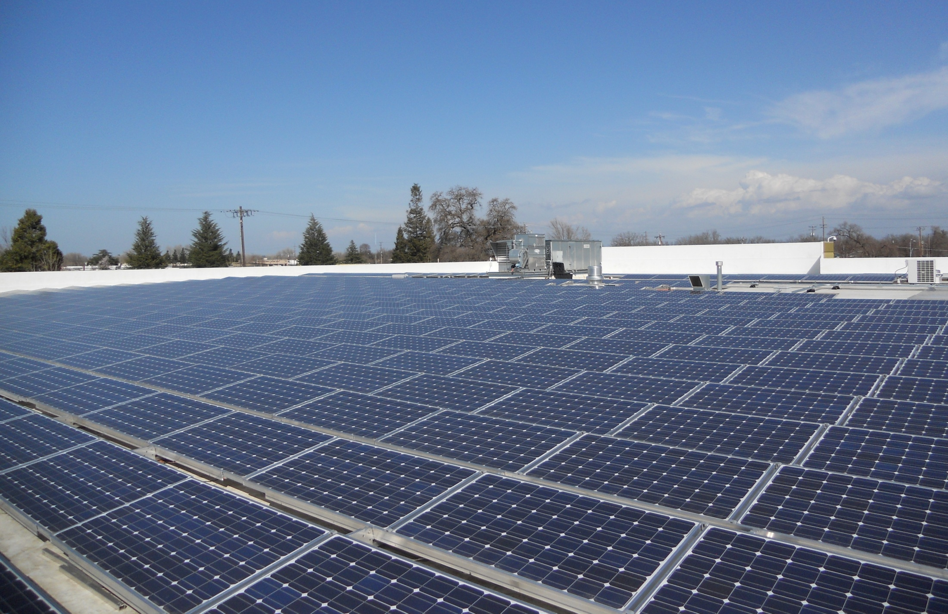
430-kW Roof-mounted Solar System at Yuba County Packard Building

Slide 7
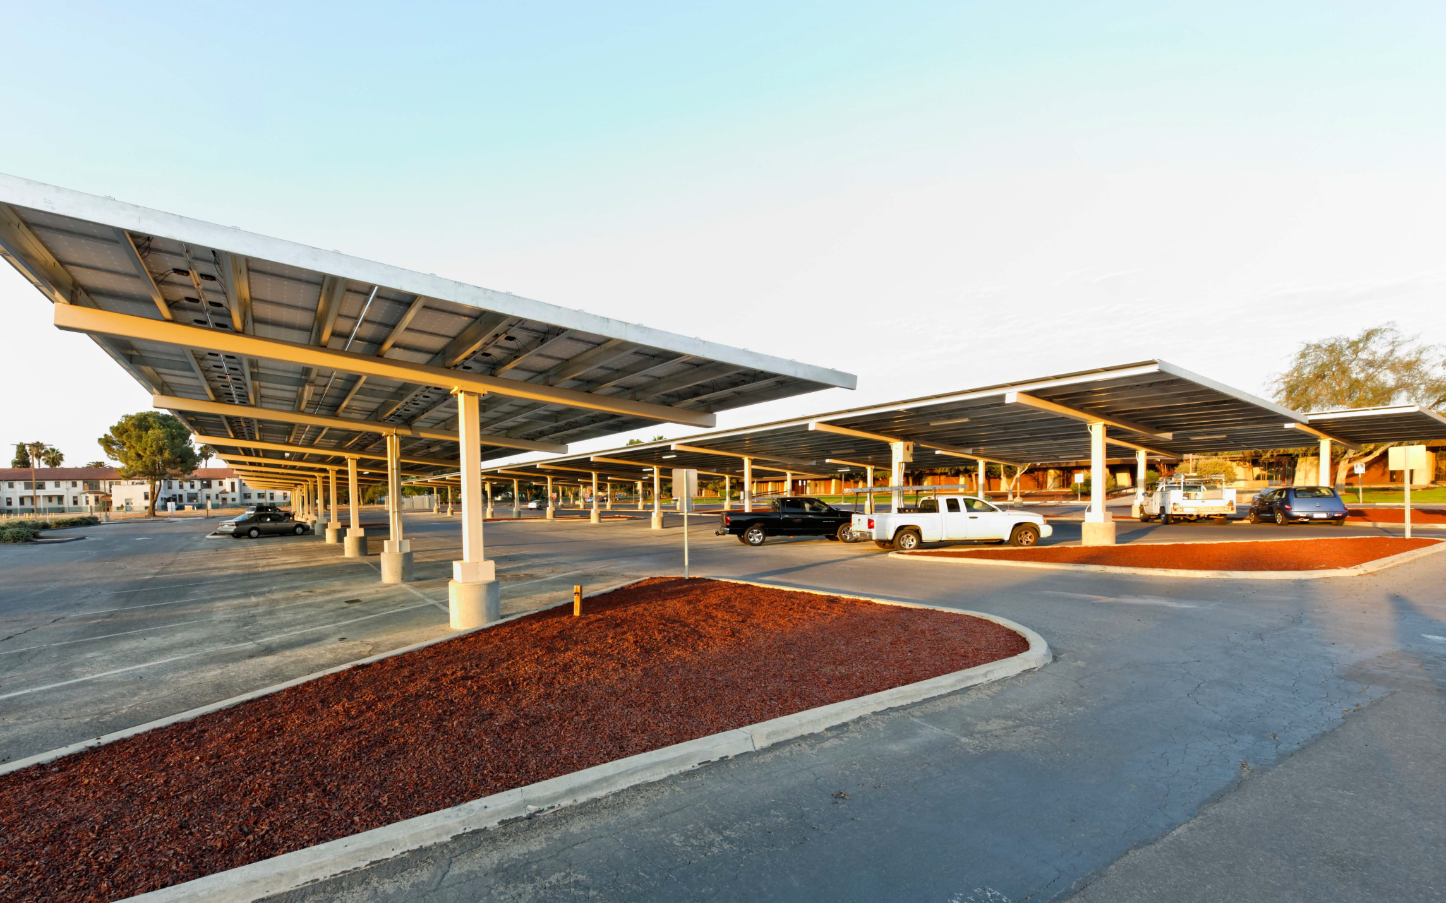
378-kW Solar Parking Canopies at Kings County Government Center

Slide 8
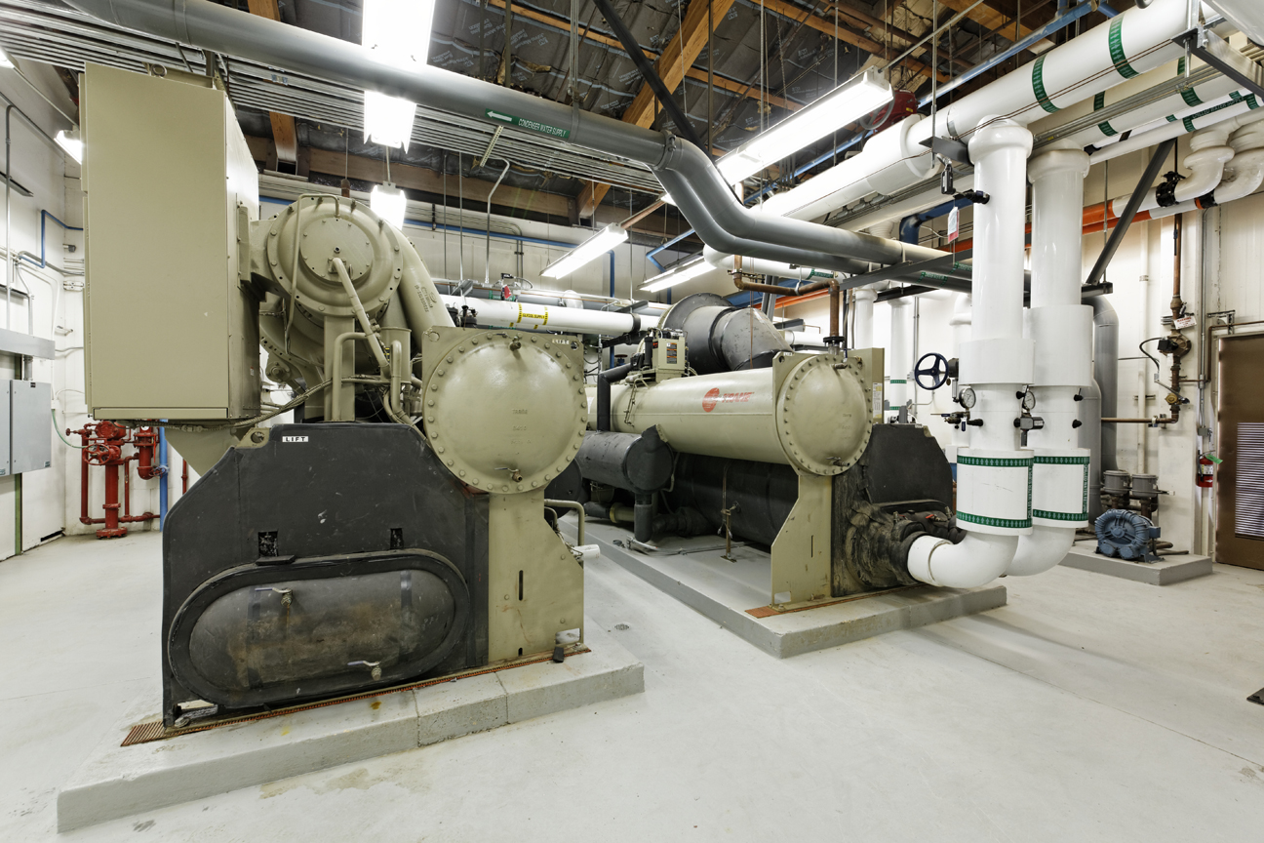
New Central Heating and Cooling Plant for Kings County Government Center

Slide 9
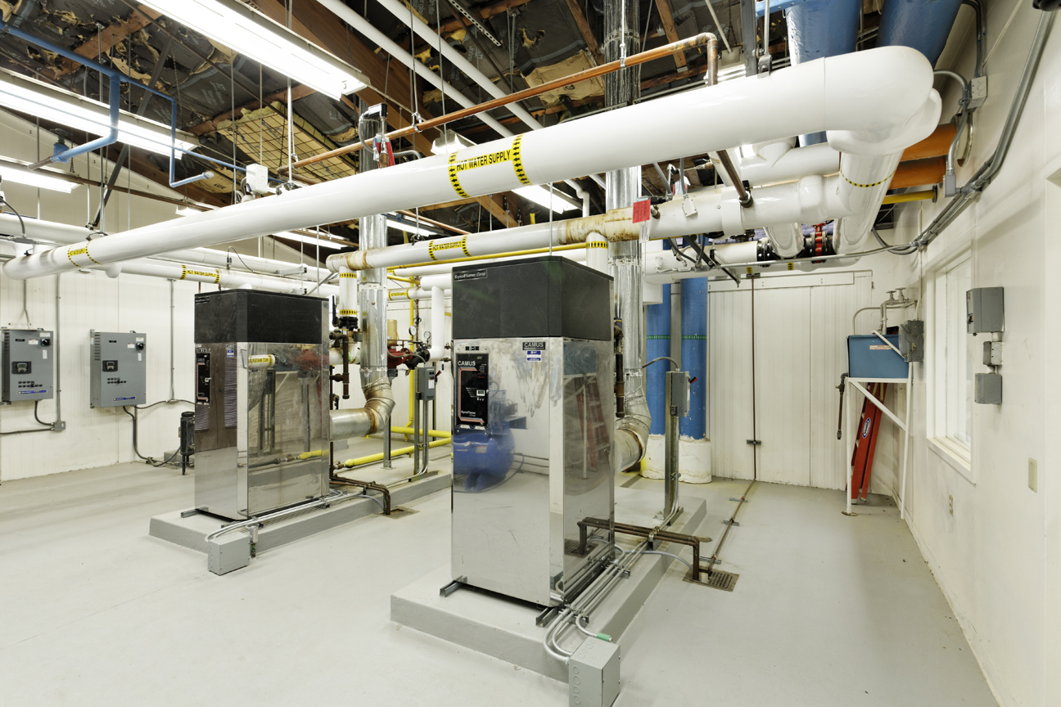
New Central Heating and Cooling Plant for Kings County Government Center

Slide 10
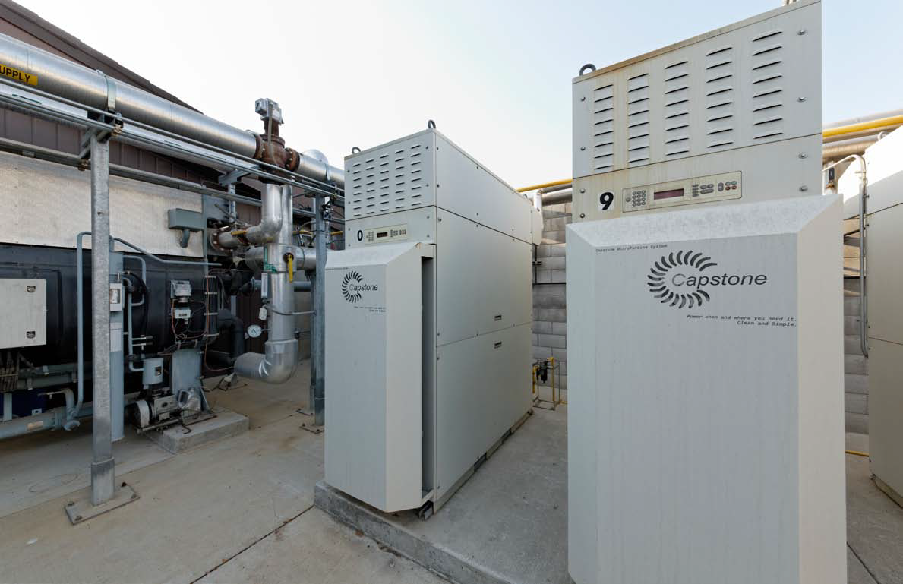
600-kW Cogeneration System at Kings County Government Center

Slide 11
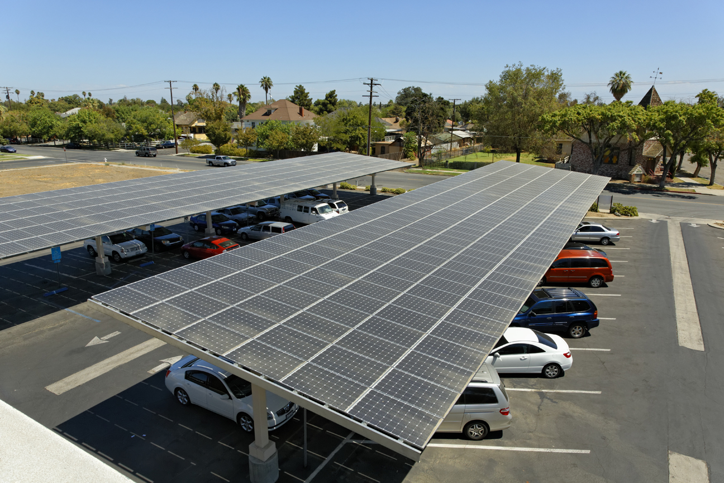
126-kW Solar Parking Canopies at Kings County Hanford Library

Slide 12
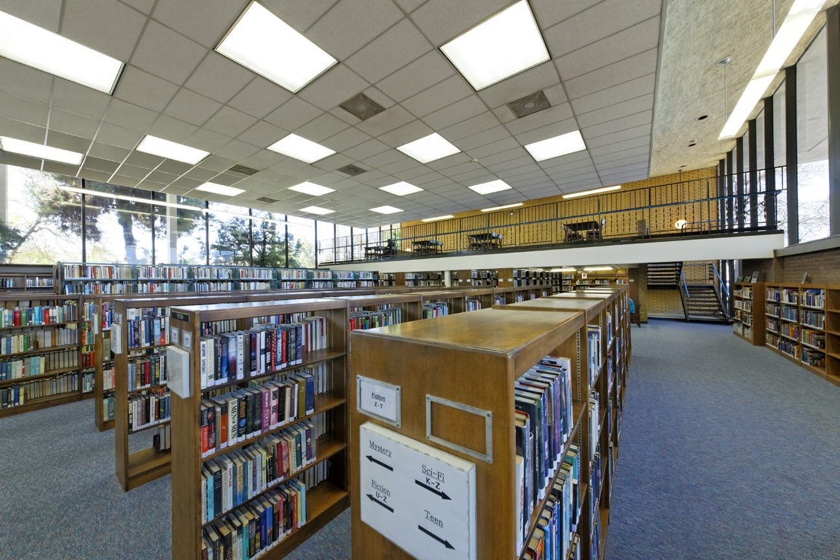
Energy Efficient Lighting at Kings County Hanford Library

