Slide 1
The Road to 2020
Roberto Garcia
Partnership Specialist
U.S. Census Bureau
San Diego Regional Census Office
November 29, 2018

Slide 2
2020 Census
Notes:
Our goal is to count everyone once, only one, and in the right place.

Slide 3
Why We Do a Census
Article 1, Section 2 of the US Constitution
The actual Enumeration shall be made within three Years after the first Meeting of the Congress of the United States, and within every subsequent Term of ten Years, in such Manner as they shall by Law direct.
Key Purpose is Apportioning the US House of Representatives

Slide 4
Why does the 2020 Census matter?
Power
Congressional representation
Reapportionment & redistricting
Money
$675 Billion distributed annually
Funding distributed based on population
California
Over $76 Billion each year to the State
$2,000 approx. per Californian counted*
Notes:
Our goal is to count everyone once, only one, and in the right place.

Slide 5
Federal Funding
Census data informs how $675 billion is distributed annually among local, state, and tribal governments for programs like:
Transportation
Job training centers
Schools (Title 1 Grants, National School Lunch Program, Head Start/Early Head Start)
Senior and Foster Care Centers
Housing (Section 8 housing choice vouchers
Medical Assistance Programs (Medicaid, Medicare)

Slide 6
Goals for the 2020 Census
Maintain Quality
Reduce Costs
Four Areas of Innovation
Efficiency in Building an Address List
Easier Ways to Respond
Better Use of Information We Already Have
More Efficient Field Operations
Notes:
We plan to maintain high quality results and reducing the costs by implementing 4 areas of Innovation:
Improving the efficiency of building a Master Address File
• That is happening right now. In building out the address list, the Census Bureau is verifying the majority of stable addresses in the office, using aerial imagery and existing data sources. This will cut the on-the-ground address canvassing workload from nearly 100% last decade to approximately 30% this decade.
The Census is also using other government and business records to refine the list again and again.
There are more than 135 million households in the United States.
For the first time, people will have multiple ways to self-respond – online, by phone, or by mail – and full choice to opt for the mode with which they feel most comfortable.
Better Use of the Information we Already Have
Will knock on door up to 6 times
A Census worker will ask your neighbors or a manager in your apartment building or subdivision how many people live in your house if they haven’t been able to get a hold of someone at your home.
“last resort.” Using existing government data records about who lives in your home (i.e., tax forms, food stamps, Medicaid roles, etc. – HUD, VA, HHS, SSA, IRS)) to determine if Housing unit is vacant or to obtain population count using administrative records.
Improving the efficiency of the Field Operations
Streamlined office and staffing structure
Increased use of Technology
For enumerating nonresponding households, the Census Bureau has fully automated field operations, replacing paper and pencil with mobile devices. Census enumerators will carry smartphones with a secure data collection app. This streamlining in how field operations are conducted allows the Census Bureau to cut in half the number of temporary field offices and the number of staff that would otherwise have been needed.

Slide 7
New Ability to Self Respond
Starting March 23, 2020
Internet Phone Paper Form In-person
*13 languages including English will be supported
Notes:
We are making it easier to respond with technology.
• For the first time, people will have multiple ways to self-respond – online, by phone, or by mail – and full choice to opt for the mode with
which they feel most comfortable.
• The Census Bureau will be encouraging individuals nationwide to respond whenever and wherever they are. This includes the ability for
folks to respond on the go or at community events, even if they do not have the unique Census ID sent to their address.
Mailing process still being finalized in end-to-end test.

Slide 8
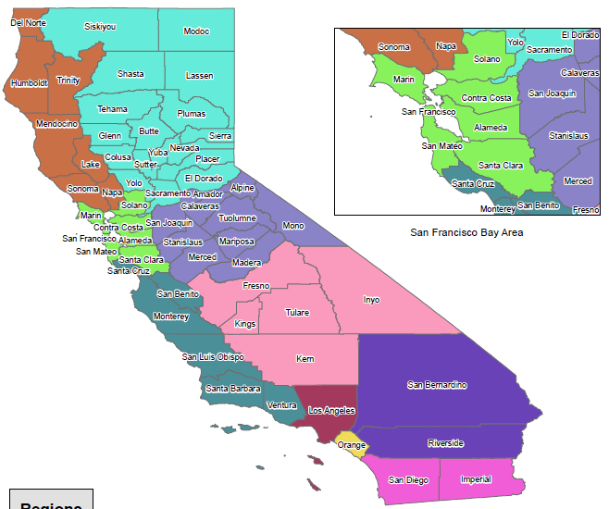
Impact to California
Notes:
We are just beginning
Infrastructure starts with the RCC in LA
Wave 1 - manage building the list of addresses – Address canvassing

Slide 9
Impact to California
73%
California Census Mail Participation Rate in 2010
76%
California Census Mail Participation Rate in 2000
10,000,000 Californians
Requiring follow-up by Census enumerator in 2010
Notes:
We are just beginning
Infrastructure starts with the RCC in LA
Wave 1 - manage building the list of addresses – Address canvassing

Slide 10
Impact to California
280,000
Estimated net undercount in 2020 based on 2010 Census
$ 1,950*
Potential per person Federal funds available
$ 560 Million Amount of Money California stands to gain or lose over the next decade
Notes:
We are just beginning
Infrastructure starts with the RCC in LA
Wave 1 - manage building the list of addresses – Address canvassing

Slide 11
Impact to California
California has 10 of the most populous counties in the nation with a population of 28 million
Participation rate is lower than 70% in hard-to-count census tracts
Notes:
Wave 2 – manages peak enumeration activities

Slide 12
Hard-to-Count Populations
Communities of Color | Children under 5 | Persons who do not speak English fluently
LGBTQ+ | Undocumented Immigrants | People with disabilities
People experiencing homelessness | Tribal members | Rural Communities
Notes:
Wave 2 – manages peak enumeration activities

Slide 13
How can we work together to ensure a complete count in 2020?

Slide 14
Where you can help
Identify community organizations in your county that work directly with hard-to-count populations and who we can partner with to conduct outreach
Incorporate census outreach and education efforts into your existing community engagements
Collaborate with California’s diverse stakeholders to deliver tried and tested messages
Utilize and leverage existing County infrastructure and resources
Notes:
Wave 2 – manages peak enumeration activities

Slide 15
Recruiting
Recruiting Information for All Positions
www.census.gov/fieldjobs
www.usajobs.gov
www.2020census.gov/jobs
1-888-658-5564 (RCC recruiting hotline)
Contact Partnership Specialist to attend recruitment events in your area

Slide 16
Community Partnership and Engagement Program (CPEP)
Enroll community partners to increase participation in the 2020 Census of those who are less likely to respond or are often missed.
Educate people about the 2020 Census and foster cooperation with enumerators
Encourage community partners to motivate people to self-respond
Engage grass roots organizations to reach out to hard to count groups and those who aren’t motivated to respond to the national campaign

Slide 17
Complete Count Committees
Background and Structure of Complete Count Committees (CCCs)
Tribal, state and local governments work together with partners in their communities to form CCCs to promote the 2020 Census to their constituents. Community-based organizations also establish CCCs that reach out to their members.
Committee members are experts in the following areas:
Government *Education
Media *Community Organizations
Workforce development *Faith-Based Community
Business *Other, Based on Needs

Slide 18
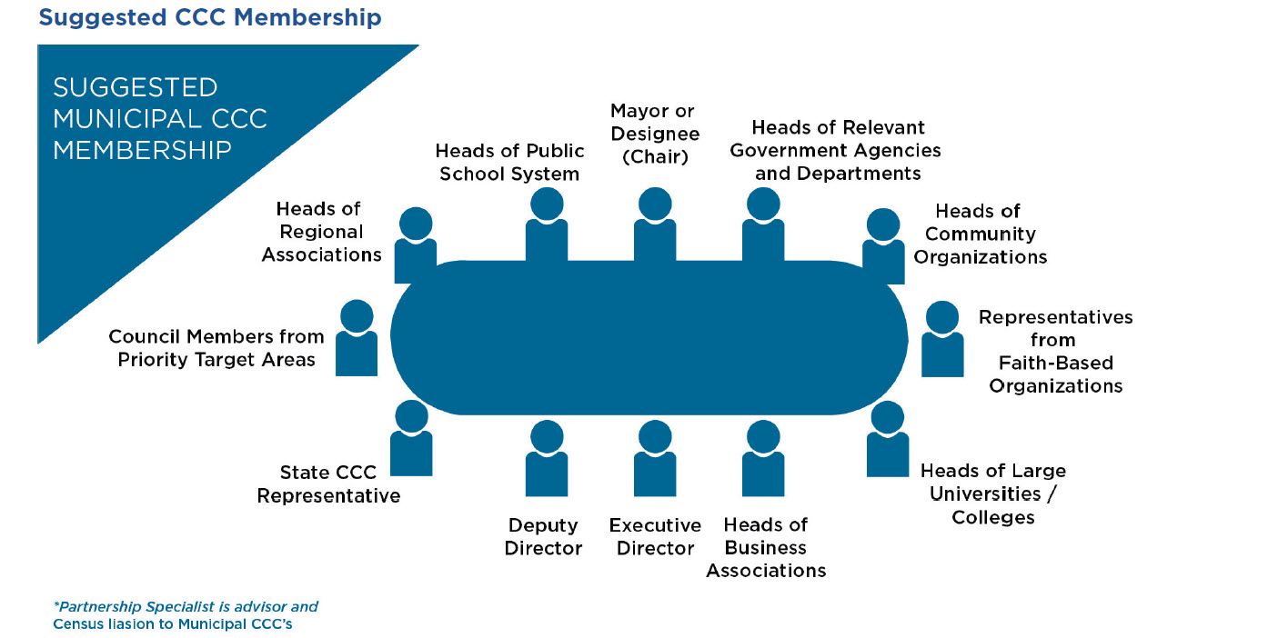
Complete Count Committees
Notes:
Still on page 8 in their Training Manual. Review and use the slides to prompt you to say the following:
It is essential that a SCCC/CCC subcommittee address and reflect key facets of the community. The decision to form subcommittees is based on community need and the opportunities and challenges in reaching areas or populations that may not respond or may potentially be undercounted.
The Census Bureau recommends including the subcommittees focused on:
Government
Education
Faith-based community
Media
Community-based organizations
Business
Recruiting
It is important to note that in the past, SCCCs/CCCs have also created subcommittees devoted to:
seniors
veterans
youth
homeless
special housing
LGBTQ
tenants
public safety
homeowners associations
recruitment

Slide 19
Timeline – Key Communications
The 2020 Census Phases
Education Phase – 2018-2019
Awareness Phase – April 2019
Motivation Phase – March – May 2020
Reminder Phase – May – July 2020
Thank You Phase – Starts July 2020
Local governments and community leaders throughout California participate in activities highlighting the message that the 2020 Census is imminent and that it is easy, important and safe to participate
Notes:
Please turn to page 11 in your training manual.
Let them know these are the communication phases and processes that continue on page 12.
Review and use the slides to prompt you to say the following:
We have covered what a SCCC/CCC is, the different types of committees, and the types of subcommittees.
During the various phases, the SCCC/CCC implements activities of the work plan through their government, faith-based organization and community-based organization, business, media, and recruitment partners. An effective strategy guarantees that community residents will encounter census messages during times of work, play, leisure, school, and worship.

Slide 20
Questions ?
Notes:
We know the census will be a challenge in many communities throughout California.
It is important to us to make sure we work together to count everyone.
After all – we live here too and want what is best for our state.

Slide 21
Contact Information
Roberto Garcia
Partnership Specialist, San Diego Region
Roberto.Garcia@2020census.gov
619-701-2098
Notes:
We know the census will be a challenge in many communities throughout California.
It is important to us to make sure we work together to count everyone.
After all – we live here too and want what is best for our state.

Slide 22
References
Hard to Count Tracts:
https://www.census.gov/roam
Participation Rate:
https://www.census.gov/censusexplorer/2010ratemap.html?#
Population:
https://www.census.gov/quickfacts/fact/table/ca/PST045217
Congressional districts undercount:
http://www.govtech.com/data/Millions-of-Californians-Might-Go-Uncounted-in-2020-Census.html
https://www.sandiegouniontribune.com/sdut-california-claims-census-undercount-of-15-million-2010dec23-story.html
http://www.latimes.com/politics/la-pol-ca-census-accurate-count-study-20180806-story.html
https://www.sfchronicle.com/politics/article/California-at-risk-of-census-undercount-that-13294310.php
Notes:
We know the census will be a challenge in many communities throughout California.
It is important to us to make sure we work together to count everyone.
After all – we live here too and want what is best for our state.

