Slide 1
Voting Systems
Assessment Project
Los Angeles County Registrar-Recorder/County Clerk
May 8, 2014

Slide 2
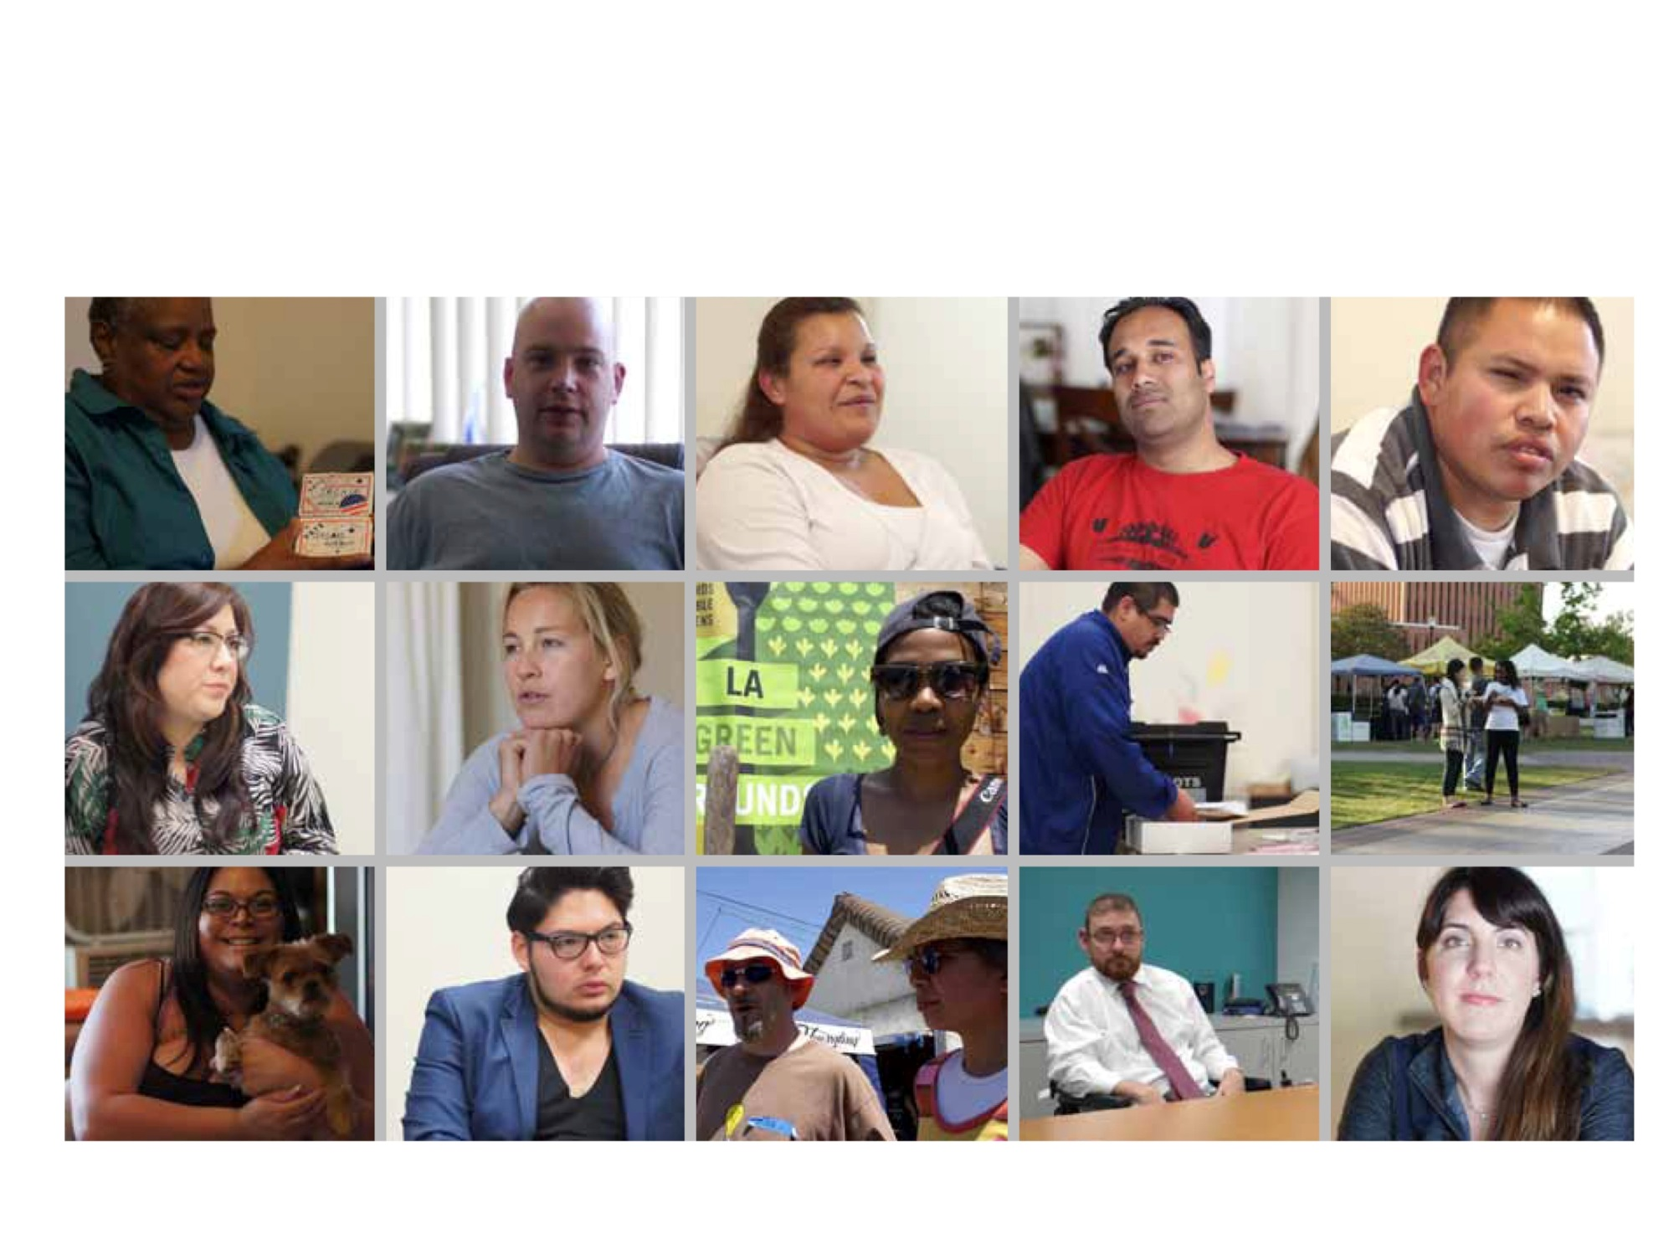
Goal : Design a new voter experience that is voter-centered and sensitive to the human experience

Slide 3
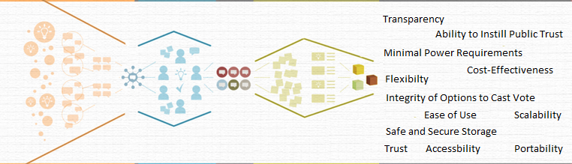
VOTING SYSTEMS PRINCIPLES
Through a collaborative process between the department and the VSAP Advisory Committee, the project adopted 14 distinct principles to guide the design and implementation of new voting systems.

Slide 4
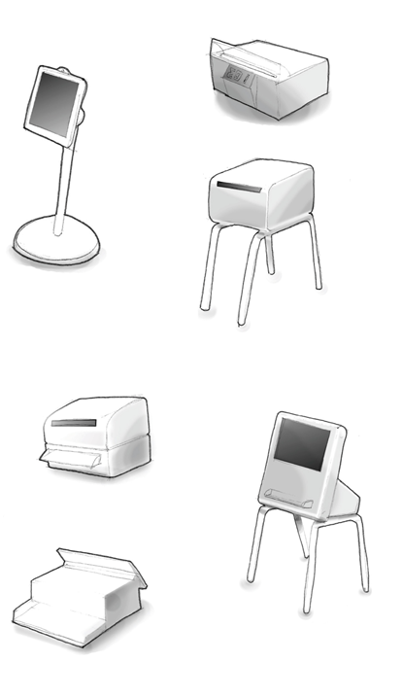
Iterative process
Final design:
was evolutionary
went from many design into one
leveraged the strengths of various designs

Slide 5
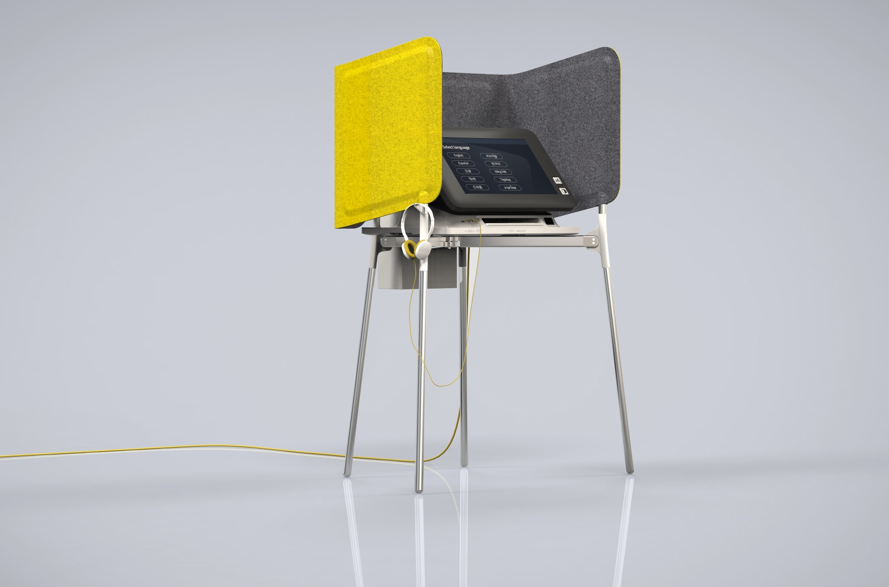
Proposed design

Slide 6
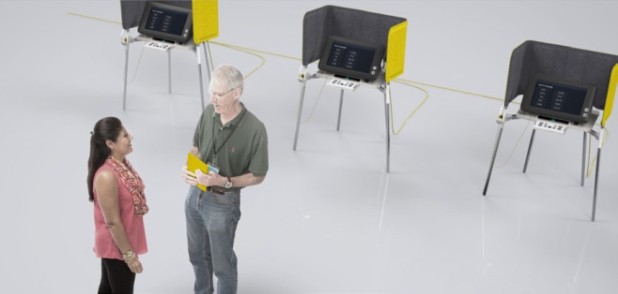
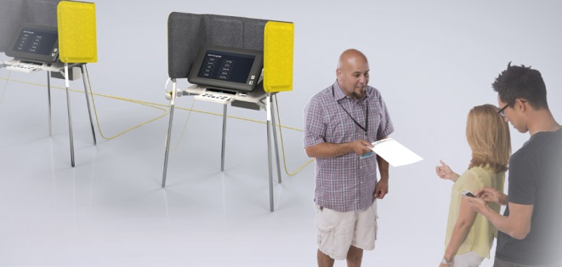
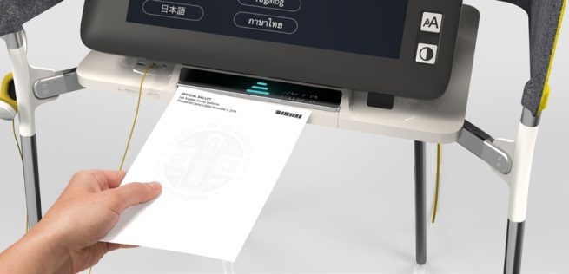
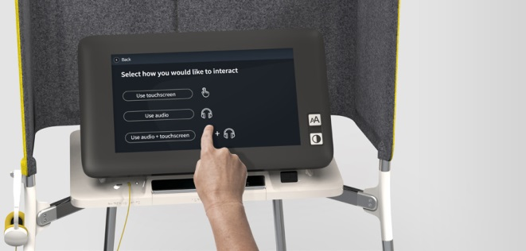
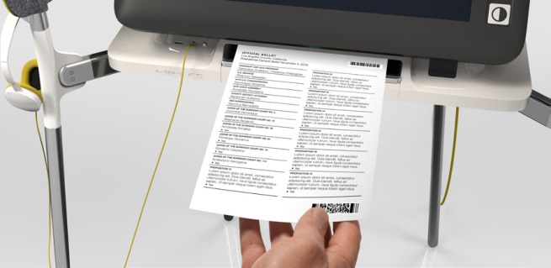
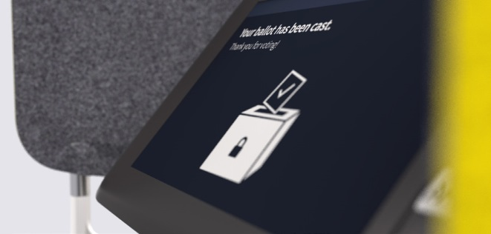
The Voting experience
1. CHECK IN 2. RECEIVE 3. INSERT
Voter Check in at Polling Site Voter Receives Official Ballot Insert Paper Ballot to Activate and Pull Correct Style
4. MARK AND VERIFY 5. PRINT AND VERIFY 6. CAST
Select Language and Setup Mark Choices and Verify Selections On-Screen then Cast Ballot on the Same Device
Using Touch Screen Review on Screen Print Official Ballot

Slide 7

VSAP FUNDING
Refinement
and
specifications
Research
System design
Manufacturing
Implementation
2009
2013
2014
2015
2016
2017
$
$150,000
Voting Technology Project (Caltech/MIT)
James Irvine Foundation
$1,133,130
County Funding
(PIF Grant and NCC)
Spent
to
date
$3,200,000
NCC Funds
$49,000,000
Voting Modernization Bond Funds (Prop 41)
$24,282,000
HAVA 301
Dedicated Funding

Slide 8

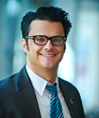
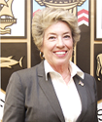
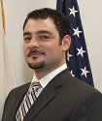
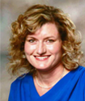
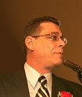
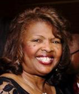
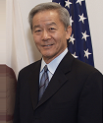
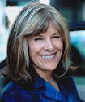
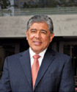
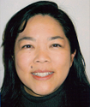
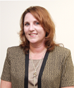
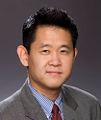
ADVISORY COMMITTEE
Nancy Mahr- Chair
President
League of Women Voters LA County
Jaclyn Tilly Hill
Chair Emeritus
Quality and Productivity Commission
Los Angeles County
Holly L. Wolcott
Interim City Clerk
City of Los Angeles
Carolyn Fowler
Election Protection Board Co-Chair
Los Angeles County Democratic Party
Mimi Kennedy
Board Chair
Progressive Democrats of California
Kathay Feng
Executive Director
California Common Cause
Theresa Devoy
City Clerk
City of Norwalk
Eugene Lee
Director of Voting Rights
Asian Pacific American Legal Center
Evan Bacalao
Senior Director of Civic Engagement
National Association of Latino Elected and Appointed Officials.
Justin Levitt
Associate Professor
Loyola Law School
Eric Bauman
Chair
Los Angeles County Democratic Party
Bryce Yokomizo
Adjunct Faculty School of Public Administration
California State University, Northridge
Larry Herrera
City Clerk
City of Long Beach
Hillary Sklar
Attorney
Disability Rights California
Vacant
Chair
Republican Party of Los Angeles County

Slide 9
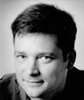
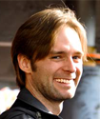
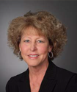
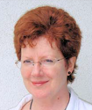
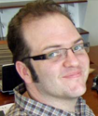
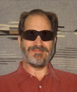
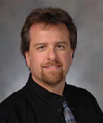
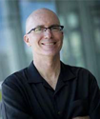
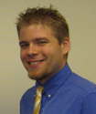
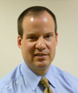
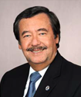
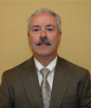
TECHNICAL ADVISORY COMMITTEE
David Wagner
Professor of Computer Science
U.C. Berkeley
Diane Cordry Golden
Policy Coordinator
Association of Assistive Technology
Act Programs
Joseph Lorenzo Hall
Senior Staff Technologist
The Center for Democracy and Technology
Michael Byrne
Professor of Psychology and
Computer Science
Rice University
Joshua Franklin
IT Specialist, Security
National Institute of Standards and
Technology (NIST)
Richard Sanchez
Chief Information Officer
Los Angeles County
Jared Marcotte
Technology Manger
The pew Charitable Trusts
Pamela W. Smith
President
Verified Voting Foundation
Noel Runyan
Personal Data Systems
Owner
Charles Stewart III
Kenan Sahin Distinguished Professor of Political Science
MIT
Brian J.Hancock
Director of Testing and Certification
U.S. Election Assistance Commission
Henry Balta
Senior Associate C.I.O
Los Angeles County

Slide 10
WHAT PEOPLE ARE SAYING
“From the frustrations of finding adequate voting equipment technology on the market, promising collaborations have arisen in communities such as Los Angeles County, California, and Travis County, Texas, that may inform the setting of stan­dards for future technologies.”
-The American Voting Experience: Report and Recommendations of the Presidential Commission on Election Administration
“Dean is really leading the country…election officials are turning to California to see what they can come up with, because Los Angeles is going to potentially build its own voting machine.”
– Nathaniel Persily, Research Director, Presidential Commission on Election Administration and Professor of Law, Stanford University
“What LA county is doing is turning the entire process of procuring voting equipment on its head: with deep expertise and care…This exercise, and doing it in an open manner, is critical for the future of voting systems as many, many more jurisdictions will face the unique challenges of LA in the coming future.”
-Joseph Lorenzo Hall Senior Staff Technologist, The Center for Democracy and Technology

Slide 11
AWARDS
2010- National Association of County Officials Achievement Award
2010- Election Verification Network Award
2012- Election Center Professional Practices Freedom Award for Innovation
2012- Election Verification Network Award
2012- Quality and Productivity Commission Certificate of Recognition

