Slide 1
It’s a WRAP: Solano’s Women’s Reentry Achievement Program Stephan Betz, Ph.D.
Lt. Mitchell Mashburn
Capt Gary Faulkner Pat Nicodemus
CSAC Conference 2013

Slide 3
Using evidence-based practices that address women's traumatic experiences reduces recidivism among women and cuts the intergenerational cycle that can pass down criminogenic behaviors to their children.
Problem -> solutions -> savings.

Slide 5
Problem
Traumatic experiences -> Criminogenic behaviors.
Re - entry = re – abuse.
Riskier substance abuse behaviors -> detriment to social network.
Current assessment tools address men's criminogenic risks and needs, but not those of women.
Female prison / jail population has been steadily increasing.

Slide 7
Solutions: (1) Status
November 2010: system-wide training
Served 249 women as of October 31, 2013.
77 women graduated into an alumni program
65 discharges – incomplete, did not recidivate
47 discharges, - incomplete, recidivated
60 women currently active in program
National demonstration project U.S. Dept. of Justice
3 independent evaluators: UCLA, RTI International, The Urban Institute, currently evaluating as a potential national model
Strong support from Solano Sheriff
Services leading from jail to the community

Slide 9
Solutions: (2) Principles
Voice of the customer : gender responsive, trauma informed, passion responsive
Assign resources by risk, need, and return on investment
Multi generational long term approach
Fidelity to evidence based practices system wide
A “Who cares” network, no wrong door
“One face”
Concurrent measures

Slide 10
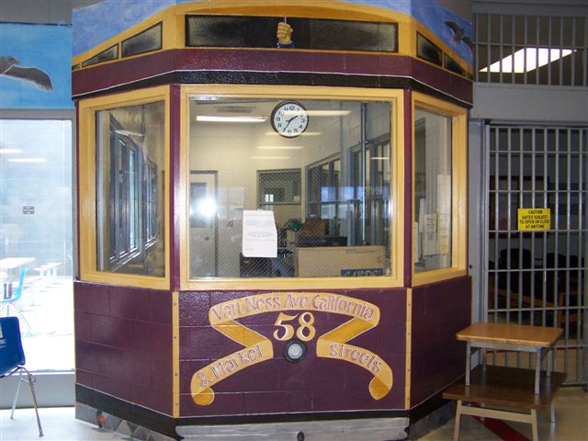

Slide 11
Solutions - (3) Evidence Based Practices
EBP = reduced recidivism
One face = one program
Practice vs. framework: Women’s Risk and Needs Assessment, Helping Women Recover, Beyond Trauma (Covington)
Fidelity vs. subject matter expert
Agreement on one practice across agencies
From " I am here and you are there " to " we are here "

Slide 13
Solutions – (4) Components
Joint release planning
Triaged services
Self sufficient learning Helping Women Recover
Three legged stool: Employment, Housing, Health

Slide 15
Solutions (5) - Key Stakeholders
Solano Reentry Council and strategic plan
Sheriff, Health and Social Services
Public Defender, District Attorney
U.S. Department of Justice
UCLA
Solano Reentry Council

Slide 17
Savings: Social Return on Investment including savings - Now
Total costs $1.4 M for the period from November 2010 – October 2013
28% of cost data evaluation
Recidivism rate of 19% compared to the control group’s 48%,
Cost savings approx. $1.1 M
Earned income amounting to $196,000
SROI = 92.8%.
Total True Cost: $0.1 M

Slide 19
Savings: Compare future in 10 years
48% Recidivism Rate:
Starting point: Current Cost = $ 1.3 M,
Cost of placing children in foster care, children
adopting criminogenic behaviors: $ 1.5 M
Add cost of repeated recidivism (rate: 48%) $ 1.8 M
_______________
Total Cost incl current cost: $ 4.6 M
WRAP 19 % recidivism rate:
Cost + Avoided Cost = $1.4 M - $1.3 M = $ 0.1 M
Cost of placing children in foster care, children
adopting criminogenic behaviors: $ 0.4 M
Add cost of repeated recidivism (rate: 19%) among
Solano women $ 0.5 M
________________
Total Cost: $ 1.0 M

Slide 21
Savings: Compare future in 10 years Summary
48% Recidivism Rate:
Total Cost incl current cost: $4.6 M
WRAP 19 % recidivism rate:
Total True Cost: $ 1.0 M
Savings: $ 3.6 M

Slide 23
Questions? sjbetz@solanocounty.com

