Slide 1
COVID-19 Tenant Relief Act AB 832 Update
July 21, 2021

Slide 2
Purpose of Meeting
Provide a briefing on the recently passed Assembly Bill (AB) 832.
Overview of tenant and consumer protections.
Overview of changes to the CA COVID-19 Rent Relief Program.
Questions and comments.

Slide 3
AB 832 Signed
Notes:
Rents Covered at 100%
Increase rental assistance payments to 100% of unpaid rent, making landlords whole and keeping tenants housed.
100% of rental arrears and prospective rent.
Critical Protections for Californians
3-month eviction protection extension until Sept 30, 2021.
Additional protections to tenants that apply by Sept 30, 2021.
Simple & Accessible Application
Takes less than an hour to apply.
Requires less paperwork.
Simplified questions.
Applicants Must Prove Financial Hardship
COVID-19 impact.
Income eligible.
Sign hardship declaration form under oath of perjury.

Slide 4
Review of CA COVID-19 Rent Relief Program
Campaign and application launched March 15, 2021.
Program Focus: Stabilize low-income households through the payment of rental arrears to landlords and tenants.
Over 100 organizations in our Local Partner Network with “boots on the ground” to assist people in their communities.
Working with jurisdictions to administer Options A, B and C.
As of 7/14, 118K complete applications have been submitted and another 88K in progress.
To date, $178 million has been paid to assist nearly 13K households.

Slide 5
Amy Wilson Deputy Secretary of Legislation Business, Consumer Services and Housing Agency

Slide 6
Programmatic Changes
AB 832 authorizes the use of federal rental assistance funding made available from the American Rescue Plan Act (ARPA) that was enacted into law in March 2021.
Round 1 + Round 2 funds = Estimated $5.2 billion in federal funds to the state and local governments for rental assistance.
Provides 100% payment for unpaid and future rent and utilities.
Extends eviction protections for non-payment of rent.
Establishes a temporary court process for evictions beginning October 1, 2021.

Slide 7
Eviction Protections
Existing eviction protections extended by another three months – to September 30, 2021.
Follows the same tenant eligibility and declaration requirements:
Declaration of financial hardship.
25% payment of monthly rent.
Debt still accrues but cannot be grounds for eviction.

Slide 8
Consumer Protections
Maintains COVID-19 related debt protection measures set by SB 91 including the prohibition on selling or assigning of debt.
AB 832 extends debt masking protections, made permanent for households that qualify for assistance.
Extends the time limitation on landlords pursuing the recovery of rental debt and requirements for debt recovery through small claims court.
Extends to December 1 homeowner protections in which a request for forbearance has been denied.

Slide 9
Temporary Court Process
After September 30, 2021, a modified civil procedure will be in effect from October 1, 2021, until March 31, 2022.
The process is intended to provide protections for tenants who are eligible for and in need of assistance…
…while providing landlords with an opportunity to initiate an eviction for non-payment of rent and in which the tenant is not eligible for assistance.
More coming soon on Housing is Key!

Slide 10
Lynn Von Koch-Liebert Deputy Secretary of Housing Business, Consumer Services and Housing Agency

Slide 11
Key Program Updates
Makes all Recipients Whole: Allows those already paid by the program to be “topped off” to 100% without having to reapply.
Authorizes Non-Occupancy Payments: Allows rental assistance to be paid in situations where tenant has vacated the premises but still owes rental arrears.
Broadens Arrears Timeframe: Amends the definition of arrears starting “on or after April 1, 2020.”
Adds Payment Protections: Requires tenants that receive direct payments to remit the payment to the landlord within 15 business days or face a penalty.

Slide 12
Same Eligibility, Prioritization & Eligible Uses
Eligibility
Income must be below 80% AMI.
Risk of experiencing homelessness or housing instability.
Experienced financial hardships due, directly or indirectly, to COVID-19.
Prioritization will be given to those most at risk of eviction and impacted by COVID-19.
Eligible uses to include rental arrears, prospective rent, utility arrears, prospective utilities, and other housing related services.

Slide 13
Program Improvements
New simplified application
Uptick in applications submitted
Less time to complete
Quicker to review
Website fully translated in six languages
Easier to navigate website

Slide 14
Geoffrey Ross Deputy Director, Division of Federal Financial Assistance Department of Housing and Community Development

Slide 15
How is Rent Relief Being Delivered to Californians?
Rent relief for counties under 200K in population (and for the cities within them) is administered through the state’s program (Option A)
Large counties and cities over 200K in population receive rent relief dollars directly from the federal government
These jurisdictions can choose to partner with the state’s program (Option A) or administer a local program (Options B or C)
AB 832 allows for Option C jurisdictions to move to Option A or B by 7/29/21
Application portal on HousingIsKey.com

Slide 16
How is Rent Relief Being Delivered to Californians?
OPTION A
State-Administered Program
Jurisdictions under 200K in population (and the cities within them)
Jurisdictions over 200K that received a federal allocation that opted in to have the state administer their funds
OPTION B
Locally Administered Program
Jurisdictions over 200K in population that received a direct federal allocation
agreed to follow the state program parameters
received a block grant of additional rent relief funds from the state
OPTION C
Dual Program
Jurisdictions over 200K in population with direct federal allocation
opted to run their own program with different parameters than the state
State program administers the jurisdiction’s state funding following SB 91 and AB 832
Notes:
Rent relief for counties under 200K in population (and for the cities within them) is administered through the state’s program (Option A).
Large counties and cities over 200K in population receive rent relief dollars directly from the federal government
These jurisdictions can choose to partner with the state’s program (Option A) or administer a local program (Options B or C)

Slide 17
Round 2 Administrative Options
Reaffirms intent to remain in the same Option as selected for Round 1.
Change from Option C to Option A, close its locally administered program to new applicants, and redirect its direct federal allocation to be distributed to local residents via the state-administered program.
Change from Option B to Option A, close its locally administered program to new applicants, and redirect its Round 2 federal allocation to be distributed to local residents via the state-administered program.
Change from Option C to Option B and receive a state block grant, if eligible, to administer the local program in conformity with state and federal laws.*
Deadline: July 27, 2021

Slide 18
Veronica Harms Deputy Secretary of External Affairs Business, Consumer Services and Housing Agency

Slide 19
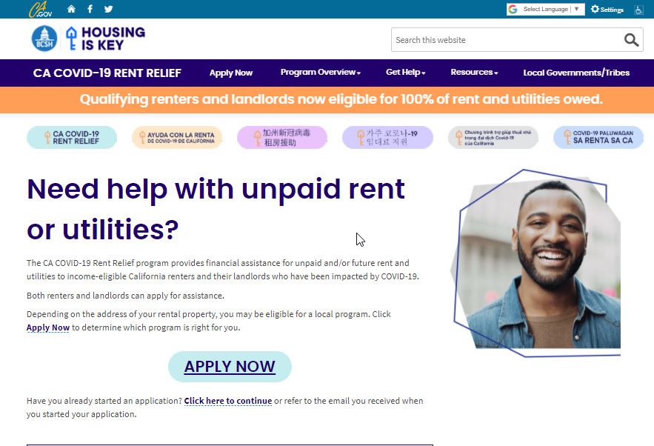
Updated Website

Slide 20
Local Partner Network
Over 100 partners statewide.
Serving 22 different languages in person and more by phone.
Assistance available in person, by phone, or at home.
Help filling out an application, or uploading required paperwork.
Make an appointment: 833-687-0967

Slide 21
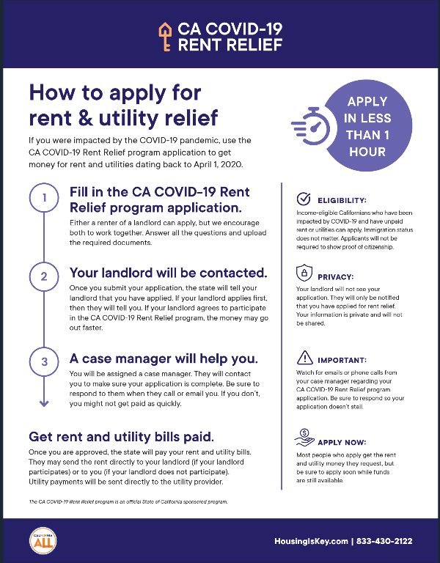
HousingIsKey Dropbox
Materials to help promote rent relief
Available in multiple languages
Don't see something you need? Contact us!
https://www.dropbox.com/sh/68zoyqb1ztjs9yq/AAAvBWnxHG7ca-FJLUlPse06a?dl=0

Slide 22
Questions / Comments?
Questions
ERAP@hcd.ca.gov
Landlord / Tenant / AB 832 Information
Housingiskey.com

