Slide 1
P
Charter Counties
Presented by Eric Lawyer, Legislative Advocate, California State Association of Counties
January 24, 2023

Slide 2
California State Association of Counties
CSAC is a non-profit association composed of, and governed by, all 58 counties in California.
Founded in 1894.
Advocates on behalf of county government before state and federal policymakers.
Provides education opportunities to county supervisors, county administrators, and top staff.
Educates the public about county government.
www.counties.org

Slide 3
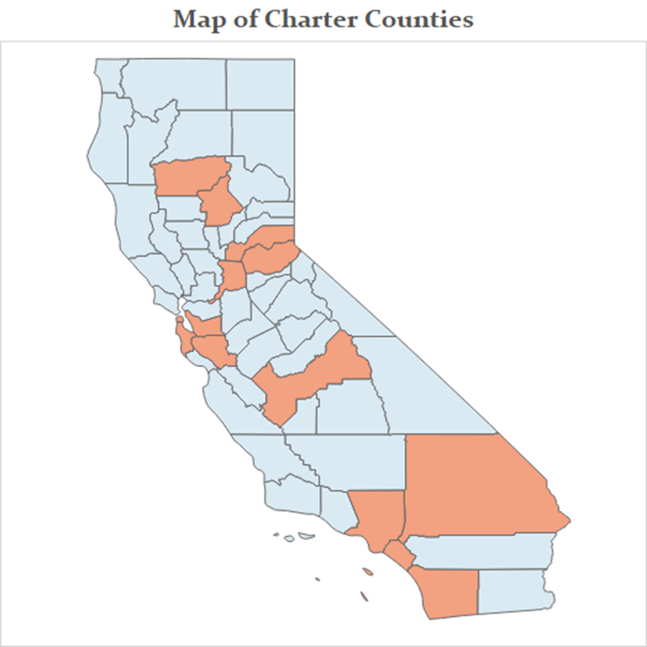
California’s Charter Counties
58 counties in California
14 Charter Counties
44 General Law Counties

Slide 4
California’s Charter Counties
County
Ratification of Charter (Year)
County
Ratification of Charter (Year)
Los Angeles
Butte
Tehama
Alameda
San Bernardino
San Francisco*
Fresno
1913
1917
1917
1927
1931
1931
1933
San Diego
San Mateo
Sacramento
Santa Clara
Placer
El Dorado
Orange
1933
1933
1933
1951
1980
1994
2002
Lorem
Ipsum
*Also a Charter City.

Slide 5
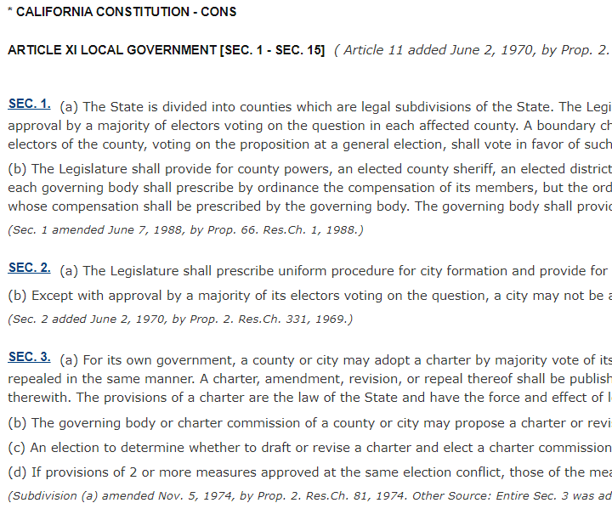
Charter Authority
As legal subdivisions of the state, all counties deliver the services mandated by the state and federal governments, for instance, health, welfare, criminal justice, elections, and more.
The California Constitution authorizes Charter counties to have a limited degree of “home rule” for specified duties of government.
A charter does not give county officials extra authority over local regulations, revenue-raising abilities, budgetary decisions, or intergovernmental relations.
Charter Authority in the California Constitution:
Article XI, Section 3 (cities and counties)
Article XI, Section 4 (counties)
Article XI, Section 5 (cities)
Link to Constitution text online.

Slide 6
Article XI, Section 3
Counties and cities may adopt, amend, revise, or repeal charters with a majority vote.
Adopted charters supersede inconsistent laws where allowed and have the force and effect of legislative enactments.
Key:
Gives counties and cities charter authority.
Charter Proposal
Charters and Elections
Charter Commissions
A charter can be proposed to voters by the Board of Supervisors or a via a charter commission.
An election to decide whether to draft, revise, or repeal a charter can be proposed to voters by the Board of Supervisors or a charter commission.
Via initiative, voters can elect 15 individuals to a charter commission to draft a county charter and voters decide whether to adopt the charter at the next election.

Slide 7
Article XI, Section 4
Once a charter is approved, the provisions included below in a county charter supersede the general laws adopted by the Legislature. Charter counties have all the powers provided by the California Constitution or by statute for counties.
Key:
What can and what must be in a county charter.
County charters must include:
Officials Administration of Officials
A elected governing body of 5 or more members.
An elected sheriff.
An elected district attorney.
An elected assessor.
Other elected or appointed officers.
The compensation, terms, and removal of officials.
The performance of functions of these officials.
The powers and duties of the governing board and all other officers, including consolidation of duties and filling vacancies.

Slide 8
Government Code § 24009 and 24204
Statute also provides general law counties authority to make elective positions appointive if approved by voters via local initiative approved by a majority of voters. When changed via charter, elected officials must be allowed to complete their elected term.
Key:
Voters can make elective positions appointive.
Electable Positions Include:
Treasurer
County Clerk
Auditor
Sheriff*
Tax Collector
District Attorney*
Recorder
Assessor*
Public Administrator
Coroner
*Must be elected

Slide 9
Charter Cities vs. Charter Counties
“There is no corresponding grant of authority and autonomy over the ‘county affairs’ of charter counties…Indeed…the Constitution requires charter counties to provide for the performance of functions required by statute…”
Dibb v. County of San Diego
Charter cities have plenary authority to govern on all “municipal affairs” and those provisions “supersede all laws inconsistent” with them.

Slide 10
County
“(Counties) may make and enforce within its limits all local, police, sanitary, and other ordinances and regulations not in conflict with general laws.”
California Constitution, Article XI, Section 7
County Power
The State is divided into counties which are legal subdivisions of the State.
California Constitution Article XI, Section 1.
A county may use its police powers to do “’whatever will promote the peace, comfort, convenience, and prosperity’ of (its) citizens…”
San Diego County Veterinary Medical Assn. v. County of San Diego (2004)

Slide 11
County
Charter Power
“Charter counties lack the ‘municipal affairs’ authority of charter cities,…they nevertheless share much of the authority exercisable by charter cities over the structure and operation of their local government.”
Dibb vs. County of San Diego (1994)
Charter counties can control the structure and operation of county government within the parameters of California Constitution Article XI, Section 4.

Slide 12
County
A county…possesses and can exercise only such powers as are expressly granted it by the constitution or statutes. Byers v. Board of Supervisors (1968)
Only such provisions of a county charter as are authorized by the Constitution supersede State laws in conflict therewith, and then only to the extent that such provisions are not limited by the Constitution.
Wilkinson v. Lund (1929)
Charter Limits
Charter provisions supersede state law, but only certain provisions can be in a county charter to begin with – within the parameters of California Constitution Article XI, Section 4.

Slide 13
Typical Applications
Examples
A county charter may:
Define the compensation, term length, term limits, removal, and replacement of supervisors.
Consolidate or segregate county offices.
Stipulate how the five-member board of supervisors are elected (by district, at large or at large, from a district).
Impose residence requirements on the office of county supervisor.

Slide 14
Limitations on Authority
Examples
A county charter does not provide any additional authority for:
Local regulations
Revenue-raising abilities
Budgetary decisions
Intergovernmental relations

Slide 15
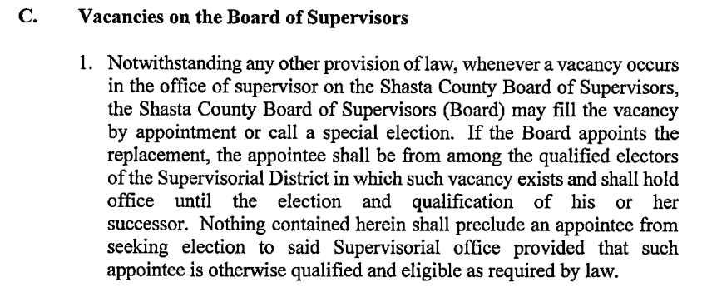
Current Issue
Proposed charter solely addresses filling Board vacancies, allowing the Board to appoint a replacement or hold a special election.
Shasta County
The Shasta County Board of Supervisors voted to propose a charter for public vote at March 5, 2024 election.

Slide 16
The Charter Process
The process for becoming a charter county is outlined in Government Code Sections 23700 to 23732.
A Board of Supervisors proposes a charter OR voters, by initiative, decide whether to draft a charter and elect a charter commission.
Voters, by majority vote, decide whether to adopt the charter at the next election.

Slide 17
The Charter Process
The process for becoming a charter county is outlined in Government Code Sections 23700 to 23732.
Board of
Supervisors
Charter
Commission
Proposed
Charter
Voters
If Approved…
At the will of the voters, prepares a charter for the county, which must be signed by a majority of the 15 elected commissioners.
Can prepare and propose a county charter for the voters to consider.
Must include the components outlined in California Constitution Article XI, Section 4.
The charter takes effect and is filed with the Secretary of State.
Decide whether to adopt the charter by simple majority vote.
OR

Slide 18
THANK YOU
Copyright 2023 by California State Association of Counties®

