Slide 1
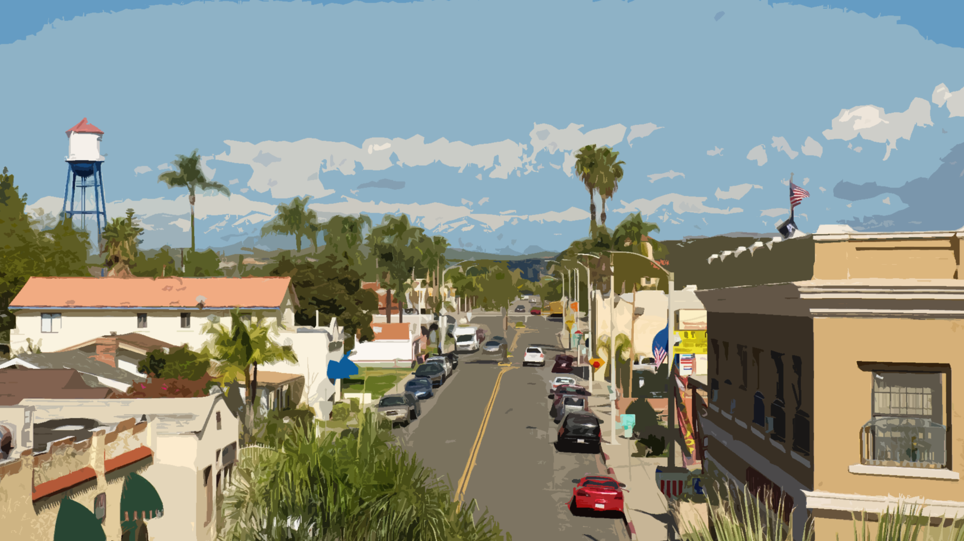
Surplus Land Act:
Know the Facts Before You Transact
Kosmont Companies
Larry Kosmont
CA Dept. of Housing & Community Dev.
David Zisser
Best Best & Krieger LLP
Matthew Cody
Sacramento County
Stephen White
California State Association of Counties

Slide 2
Session Overview
Larry Kosmont Chairman & CEO Kosmont Companies | Introduction, Overview & Trends
David Zisser Assistant Deputy Director CA Dept. of Housing & Community Development | SLA Implementation & Compliance
Stephen White | Public Agency Perspective
Matthew Cody Of Counsel Best Best & Krieger | SLA Transactions & Documentation
Proprietary
Do Not Duplicate
Without Authorization
2

Slide 3
Overview & Trends – Larry Kosmont

Slide 4
What is the Surplus Land Act?
The Surplus Land Act (SLA), originally enacted in 1968, was modified in 2020 (AB1486), to ensure availability of property for affordable housing development.
Under the new SLA structure, public agencies that want to sell or lease a property must go through a structured sale disposition process that first requires exposing the property to a state published list of affordable housing developers and other interested parties.
Proprietary
Do Not Duplicate
Without Authorization
4
Notes:
We have a reconfigured economy, and the objective is to capture private sector momentum
Housing shortage and the state is pushing us to develop housing with an avalanche of state policeis
SLA is one of the states platforms for catalyzing affordable housing opportunitis
Unique opportunity, beyond compliance with surplus act, how should a community look at the properties that fall under SLA with regard to new economy and instent of economic resiliency, vitality,
Beyond that, in context of current reconfigured economy that is shifting retail office, etc, how do you lok at compliance with SLA in a manner that advances your community’s objects and uses these assets to leverage private momentum, econ deve results, econ dev, resiliency, and house
First slide – what is the SLA –
Before we talk about compliance, go to current slide 2- think about context
Being asked to review properties where private momentum is shifted and consumer preferences have changed. Retail is not the same, housing in depmand, industrial, office is sideways. Beyond compliance, how should you view SLA in a way that lets your community further economic development, vitality, resiliency
Next is slide 5 – what is the reconfigured economy? IT is a new investor / consumer / policy mindset.
Nest key trends – how do surplus properties fit into key trends
Next is public
Next is overview
Next is new world
New slide - Prior to complying with SLA on any specific property, theres a bigger set of questions. What do you have, what is it worth, what is highest and best use, do you want housing on those properties? Public use? Commercial use? Is there an adjacent owner it could go to?
In essence, with those Qs in mind, the big question is what do you have? What’s in your garage?
SLA requires a garage sale permit
Split the Surplus Property slide
Surplus is pathway to aff housing project or something else
Cahnge title: Case Studies – Compliance Unique to each property and pub agency – why you need a plan
Compliance and Strategy key elements of success nagivation of SLA – strategy and execution go hand in hand in hand with compliance; get rid of first sentence, keep and play with second
Steps to SLA Success
Put the final three points under the rocket slide,
Other slide is more to come – SLA is not going away,

Slide 5
Communities at Crossroads:
An Opportunity to Use Surplus Properties for a Vital Future
Private sector investor momentum has shifted, and consumer preferences have changed.
The post-COVID economy is a new world – retail is rightsizing from e-commerce, the office market is sideways from telework, industrial is booming, and housing is in high demand.
The housing shortage has led to an avalanche of state policy requirements imposing density, zoning standards, and redirecting the disposition of local public agency owned real estate (aka…Surplus Land Act).
Beyond SLA compliance, public agencies have a timely opportunity to review their property portfolio, leverage private sector momentum, and advance their community’s objectives for economic development, resiliency, and housing.
Proprietary
Do Not Duplicate
Without Authorization
5

Slide 6
What is the Reconfigured Economy?
The New Consumer / Investor / Policymaker Mindset.
Consumers driven by quality of life, cost of living and housing, amenities, essentials, and experiences Want it all in a 15-Minute Community | Investors driven by new technology, shifting demand, supply chain anomalies, and new live / work patterns Seeking value from new demand drivers | City Hall driven by resident and employer needs & new state policies which seek to install housing Tension: Comply with state priorities vs. achieving community priorities in a post covid digital world (RHNA, Density Bonus, SLA)
Proprietary
Do Not Duplicate
Without Authorization
6

Slide 7
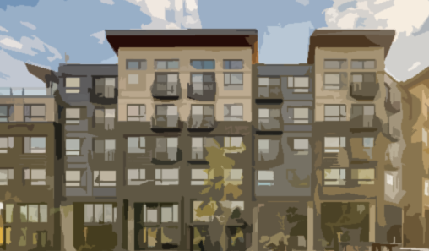
Key Land Use Trends for Economic Development
Housing is Not a Loss Leader, it’s a Growth Driver | Retail is Not Just Retail Anymore | Telework is Reconfiguring Office | Industrial / Distribution is Critical for Your Economy
Housing Creation as Economic Development | Retail Reimagination as Economic Development | Office Conversions as Economic Development | Industrial & Fulfillment as Economic Development
New housing can generate significant new tax revenues and support local jobs Housing is not necessarily a net negative fiscal impact, especially at current property values | US over-built on retail; ~25% of U.S. malls may close over next 5 years; COVID accelerated reuse Blended/mixed use projects integrate multiple uses (housing, retail, open space, office, hotel) onto one site | Telework and work from home options are reshaping needs for office space & business districts Job redistribution tied to housing Vacancies can lead to reduced assessments and fiscal pressure | Modern industrial is not “your father’s industrial” – not smokestacks Retail won't thrive without distribution Booming demand for distribution, e-commerce, and data centers, blending for fulfillment/delivery, job creators
Proprietary
Do Not Duplicate
Without Authorization
7

Slide 8
Public Sector Perspectives
State Policy | Land Use | Economic Development
State focused on housing production especially in high-demand job centers and TOD New focus on housing policy enforcement RHNA, Density Bonuses/HAA and SLA pressure communities to deliver homes SLA targets public agency owned property for affordable housing | Land use demands blending retail centers w/ apartments; office conversions to residential; infill distribution for delivery Flexible zoning needed for new integration Rethinking outdoor spaces parks, green space, outdoor commercial, pedestrian orientation, entertainment, pop-up venues | Communities can’t just focus on attracting large employers make places with amenities, experiences, and housing that attracts workers Attracting workers and attractive housing is as essential as job creation Strategy Matters leveraging own resources and attracting state / local funds Get ahead of the SLA by updating your asset plans
Proprietary
Do Not Duplicate
Without Authorization
8

Slide 9
Surplus Land Act (SLA) Overview
Origin | In a response to the massive Statewide housing shortage, State Legislature passed dozens of housing bills including AB 1486 (Surplus Land Act) to address this crisis.
Purpose | The SLA gives affordable housing developers a right of first refusal on all public agency owned land in the State of California. Does not necessarily prevent agencies from ultimately selling or leasing property for other uses or fair market value.
Mandate | Public Agencies in California (e.g., cities, counties, special districts, school districts, etc.), with certain exceptions, must follow this mandate prior to selling or leasing any public agency owned real estate.
Process | The SLA requires an up to 180-day request for proposal/bid process to either select or reject an affordable housing project/proposals. Once rejected, the property can be sold or leased to broader market.
Proprietary
Do Not Duplicate
Without Authorization
9

Slide 10
New World of Surplus Land Act Requirements
The Old Days:
Want to sell / lease a Public Agency property? Just put out an RFP/Q
The New World Order:
The SLA requires public agencies to first go through a process of offering property to affordable housing developers before pursuing other opportunities.
Opportunity:
Public agencies should look at SLA as a “Value Capture” Opportunity to more efficiently use public properties:
Performance-based leases / ground leases
Monetizing assets (such as civic centers, parking garages, etc.)
Selling property to private sector – includes lease-back strategies, continued operation of existing use, redevelopment into new uses
Headlines
“Let’s Tap the Breaks.” San Diego Not Ready to Solicit Bids to Redo City Hall Complex
San Diego Union-Tribune, 1/9/23
[Santa Monica] Takes First Step Toward Offering Lease on Civic Auditorium, Other Site
Santa Monica Daily Press, 10/20/22
555 New Apartments Planned for South Natomas as Sacramento Sells Land to Developer
Sac Bee, 1/25/22
Proprietary
Do Not Duplicate
Without Authorization
10

Slide 11
The Primary SLA Questions
What properties do you have?
What are they worth?
What is the highest and best use?
Do you want housing on these properties?
Do you want to use them for other purposes?
Public Use? Commercial Use? Special Conditions?
Is there an adjacent owner who wants the property?
Proprietary
Do Not Duplicate
Without Authorization
11

Slide 12
The Big Question: What’s in Your Agency’s Property Garage?
Civic Center/ Downtown Site(s)
Remnant Lots/ROWs
Parking Lot & Structure(s)
Former RDA sites
And…what will it take to Get A Garage Sale Permit?
Proprietary
Do Not Duplicate
Without Authorization
12

Slide 13
Post COVID Economy: Opportune Time to Use Real Estate Tools
New Rules & New Tools for Public Agencies to Deploy Strategically and Proactively
SLA Taking Off New rules being used for property disposition and housing creation | New Processes Public Agencies navigating evolving procedures and compliance | New Strategies Public Agencies using property assets strategically to pursue priorities
Today’s Program
David Zisser will provide insights re HCD’s compliance & implementation | Stephen White will explain Sacramento County’s SLA approach | Matthew Cody will discuss SLA transactions, documentation, & key issues
Proprietary
Do Not Duplicate
Without Authorization
13

Slide 14
HCD’s Insights regarding SLA Implementation – David Zisser

Slide 15
HCD’s Implementation of the Surplus Land Act (SLA)
California State Association of Counties
Sacramento, CA
April 13, 2023
Notes:
Thank you for having me here today. I appreciate the opportunity to talk with our local partners.
I’m Laura Nunn, Senior Manager with HCD’s Housing Accountability Unit overseeing the Surplus Land Act
Today, I’m going to provide an overview of HCD’s implementation of the Surplus Land Act and answer a few common questions.

Slide 16
What is the Purpose of the Surplus Land Act (SLA)?
Provide more affordable housing options in all parts of the state
Cities, counties, and special districts have land that can reduce cost barriers to housing development
SLA requires local agencies to make land available for affordable housing before selling or leasing the land for another purpose
Notes:
The purpose of the SLA is to provide more affordable housing in all areas of the state.
One factor that drives the cost of housing is the lack of available land.
The Surplus Land Act, as amended in 2019 by AB 1486, makes surplus land available first to entities that build affordable housing.
The Surplus Land Act applies to local agencies—this includes cities and counties, as well as other agencies such as districts.
Among other things, the SLA requires local governments – cities, counties, transportation districts, etc., to make their surplus land available for affordable housing.

Slide 17
Successes
As of 3/17/23, HCD has received:
525 exempt surplus land declarations
237 full dispositions
Overwhelming majority have been approved
Rendering of the Hollywood Arts Collective project under construction in Los Angeles; the project received an affordable housing exemption under the SLA.
Notes:
The vast majority of local agencies have had success bringing their surplus properties through the SLA process.

Slide 18
Successes
The SLA is helping to create housing!
Through the SLA, HCD has approved dispositions as of 3/17/23 proposing:
8,387 housing units (5,800 affordable)
These new homes help jurisdictions and the state meet their housing goals (Regional Housing Need Allocations)
Notes:
The SLA has proved to be a tool for creating housing.
These new homes help jurisdictions and the state meet their housing goals (Regional Housing Need Allocations)

Slide 19
Standard SLA Process for Surplus Land
Declare the land “surplus”
Issue notice of availability to required parties (60 days)
Negotiate in good faith (90 days) and prioritize affordability
Send proposed disposition to HCD for review
Address HCD’s findings
Dispose of the land
Notes:
There are six main steps to the surplus land disposition process:
Step 1: Declare the land surplus at a City Council, Board of Supervisors, or District Board of Directors meeting.
Adopt a resolution declaring that the property is surplus and no longer necessary for the agency’s use.
Step 2: Before disposing of the property, let people know the land is available by issuing a Notice of Availability, or NOA, for at least 60 days.
Two categories of housing developers:
Housing sponsors that have expressed interest in surplus property. These are housing developers certified by CalHFA. They express their interest in surplus property by completing a survey on HCD’s website.
Local public entities that have a jurisdiction that includes the property. These are government entities that develop or operate housing for low/moderate income households.
Step 3: Negotiate in good faith with respondents for at least 90 days.
Generally required to prioritize affordable housing uses. However, local agencies must prioritize parks and recreation on sites that are already being used for park and recreational purposes.
Step 4: Report to HCD by sending disposition paperwork showing that you’ve followed the steps of the SLA.
Within 30 days, HCD will let you know if you’ve correctly followed the law, or if you need to make any corrections.
Place a covenant or deed restriction on the land for future use.
If no responses are received to the NOA or no price and terms were reached with a respondent after good faith negotiations, the covenant or deed restriction must note that if the land is ever used to build 10 or more housing units, at least 15% of those units must be affordable.
Step 5: If HCD finds problems, a local agency has 60 days to address the findings and correct the issues.
While HCD is prepared to provide technical assistance to help local agencies resolve issues, if a local agency does not correct the issues HCD identifies, there are potential penalties. This can be 30 percent of the final sale price in the case of a first violation and 50 percent for any subsequent violation.
Step 6: The last step is to dispose of the land.
It is important to note that the SLA does not prohibit the local agency from disposing of their property for fair market value.

Slide 20
Declaring property as “Exempt Surplus”
Exemptions from standard SLA process
Still requires HCD review and other requirements
“
“Grandfathering”
The version of the SLA in effect before 12/31/2019 applies if the local agency entered into an exclusive negotiating agreement or other legally binding agreement to dispose of property before a certain date
Land for Affordable Housing
Must meet certain criteria in the SLA
Land dedicated for other public uses
Land restricted for another use (parks, schools, etc.) transferred to federal/state government, land traded for other land to be used by the local agency, etc.
Land not suitable for housing
Small parcels, former streets, parcels with legal restrictions that prohibit housing
Notes:
I’d like to switch gears and talk about transactions that don’t follow the main process.
Broadly speaking, there are 14 official exemptions to the Surplus Land Act, though we tend to group them into four rough categories:
“Grandfathering”: deals entered into or completed by a certain date or properties identified in a long-range plan
Streamlining for properties already intended for development as Affordable Housing.
Other Public Uses:
Land restricted for another use such as for parks or recreational purposes
Agency use (Utilities, watersheds, schools, etc.)
Land exchanged for another property the agency needs
Land transferred to another agency (local, state or federal)
Surplus land owned by school districts
Land that is unlikely to be developed as affordable housing:
Small surplus land sold to contiguous property owner (Lots smaller than 5,000 sq ft. or 10,000 if no recorded access)
Land that was once a street, right of way or easement.
Legally restricted land (covenants/legal restrictions that prohibit housing)
The process for an alternative disposition:
First, identify property that may qualify for exemption from the standard process.
If the agency is unsure, it should consult HCD to confirm.
Second, declare the publicly-owned land as exempt surplus – generally in a resolution with findings supporting the determination.
HCD will review draft resolutions upon request. Allow at least 30 days for review prior to disposition.
Within 30 days, HCD will either approve the exemption or notify the local agency that the property does not qualify for the exemption.
If HCD approves the exemption, the local agency should then give notice according to the applicable alternative process and dispose of the land according to the applicable alternative process

Slide 21
Other Cases that Lie Outside the Scope of the SLA
Besides the 14 official exemptions from the standard process, the following transactions do not fall under the SLA:
Short-term leases
Land leases for a term of less than five years
Leases that do not allow demolition or development of the property
Governing board does not need to pass a resolution to declare land as surplus or exempt surplus in these cases
Notes:
Beyond the 14 Official Exemptions, there are a few other groups of transactions that do not fall under the Surplus Land Act.
And unlike the exemptions, these cases would not require the jurisdiction to declare the property as exempt surplus. Instead, we ask that the local agency inform HCD of its determination and obtain our agreement before proceeding with a sale or lease.
The SLA defines surplus land as land that is “not necessary for agency’s use.”
That means that land that is necessary for agency’s use would not be surplus.
Properties that support the agency’s core mission and operations would be considered “agency’s use.”
Note that the definition of agency’s use generally excludes purely commercial or revenue-generating uses.
The SLA guidelines also provide a carve-out for short-term leases, as well as leases that do not allow for demolition and redevelopment of the property.

Slide 22
Tips and Best Practices for Local Agencies
Survey and catalogue the potential surplus properties
Have a general sense of whether and how the SLA applies for each property
Gather documents and reach out to HCD to confirm understanding of SLA applicability and process
Develop basic in-house familiarity with the SLA
Notes:
Our Guidelines can be dense reading, but compared to the statute, they’re written in much plainer language. We strongly advise that staff responsible for disposing of surplus property skim the Guidelines. This way, they will at least be familiar with the main requirements of the SLA and the main exemptions available to your agency.
Once the agency has a general idea of the SLA’s contours, they can look at each of their potentially surplus properties and make a preliminary determination as to whether or not the SLA applies to each property.
If they have any properties that they believe are exempt or fall outside of the SLA for some other reason, they will need to gather documents and confirm the rationale for the exemption with HCD.

Slide 23
Flexibility
Notice of Availability may include “reasonable conditions or restrictions.”
If the local agency does not agree to price and terms with an entity, then it may dispose of the property outside of the SLA.
Exemptions.
Meeting affordability requirements through multiple buildings.
HCD is available to walk through the options with local agencies.
Notes:
The SLA largely requires a specific process.
Within that process, there is flexibility about the outcome.
For example:
The NOA may include reasonable conditions – HCD must approve.
If a local agency, after good faith negotiations, cannot land on price and terms, then it may dispose of the property outside of the SLA – with a 15% covenant, and it must document negotiations and get sign-off from HCD.
There are a number of exemptions, as I’ve discussed.
If it’s not feasible to mix the affordable units with the market-rate units in one building, some jurisdictions have opted to create two separate buildings – one affordable and one market-rate – in order to make the financing work.
Those are just a few examples – and HCD is here to work with jurisdictions to figure out what an NOA could look like, what exemption might apply, etc.
[The SLA is still in its infancy, so its interpretation is continually evolving. HCD’s own analysis is evolving as we gain experience looking at these dispositions, talking with local jurisdictions and other stakeholders, and updating our guidelines.]

Slide 24
How can HCD help? – Technical Assistance
HCD is committed to helping jurisdictions navigate this law:
Assist with responding to questions
Develop informational materials
Provide legal analysis
Provide trainings to “de-mystify” the SLA and proactively address stakeholder concerns
Notes:
HCD is here to help.
The Department has responded to hundreds of TA requests on the Surplus Land Act from local agencies, developers, and attorneys and is available to help answer any SLA questions that you get from your constituents.
We are expanding our policy and legal staff to increase capacity to provide TA.
And we’re glad to provide trainings like this.

Slide 25
Updates and Resources Available
Our webpage hosts a variety of resources, reference materials, and templates that will help you navigate the SLA:
Guidelines – Updated guidelines expected this year
SLA 101 PowerPoint, FAQs, and Exemption User Guide
Lists of Notices of Availability Received (w/map) and Developers Interested in Surplus Property
Sample Notice of Availability and Covenant/Deed Restriction Forms
Compliance Self-Assessment
Contact us
For requests for technical assistance, email publiclands@hcd.ca.gov
To report potential violations, email compliancereview@hcd.ca.gov
Notes:
HCD also has lots of resources on our website, including our Guidelines and informational materials, including an FAQ, an Exemption Guide, and these slides.
We also provide templates and resources on whom to notify for a disposition.
We have started the process of updating our Guidelines and are holding stakeholder listening sessions. We hope some of you may be interested in participating in a listening session with us – to help inform the Guidelines update based on your experience implementing the SLA.
I hope the biggest takeaway is that HCD is here to provide TA throughout the process – we’re here as partners to get to the right outcome together.

Slide 26
Thank You!

Slide 27
Public Agency Perspective – Stephen White

Slide 28
SLA Key Compliance Aspects and Processes – Matthew Cody

Slide 29
Key Compliance Aspects and Processes
MUNICIPAL LAW

Slide 30
Questions we’ve been hearing
What if I declared the property surplus ages ago?
Any tips for my Notice of Availability
When negotiating, what latitude does a public agency have?
What other laws do I need to think about?

Slide 31
Property declared surplus pre-AB 1486
Did you comply with the SLA that was in place at the time you declared it surplus?
Yes
you don’t need to declare it surplus again and go through the NOA process
You will need to record the restrictive covenant against the property
No (declared it surplus but never issued the NOA)
You will need to go through the NOA process
Tips
Find your staff report, notice of availability or any evidence of negotiations
Submit all the documentation you have to HCD to demonstrate compliance with the SLA at the time you declared it surplus

Slide 32
Notice of Availability
Accurately describe the property
Describe all its warts and limitations
Identify the Public Agency’s desires for the property
If you want a mixed use project, say so.
Identify what you want in the developer’s responsive notice of interest
You can’t weigh proposals if all you get is “yes, I’m interested” from the developer
Ask for a description of what they will build. Number of units? Mixed use? Affordability levels?
You cannot determine order of priority without some details
Incomplete responses burn up negotiation time (90 days required)

Slide 33
Negotiation Latitude
What is “good faith negotiation?”
Public Agency can’t disallow residential use as a condition of disposal
Public Agency can’t reduce the number of units or max lot coverage below what is allowed by zoning or GP requirements
Public Agency can’t apply design stds or arch requirements that substantially effect the viability or affordability of the housing development
Public Agency DOES NOT have to sell at below fair market value
Public Agency MAY limit residential use or density if specific findings can be made

Slide 34
Ending Negotiations
Grounds to reject an offer:
If the Public Agency and buyer can’t agree on a sales price or lease terms
When the Public Agency is giving priority to a competing offer that includes a greater number of affordable units, or if there is a tie in the number of units, then lowest average level of affordability
When the developer is not responsive to the Public Agency’s reasonable conditions or restrictions as described in the NOA

Slide 35
What else do I need to think about?
CEQA
There is a CEQA exemption for selling surplus land but it doesn’t apply if selling for a specific project.
Relocation
Is the property occupied? You may need to pay relocation expenses
Prevailing wages
Selling below market?
Developer funding sources?
SB 330/SB 35/Density Bonus
Projects developed on surplus land can take advantage of other laws designed to facility housing development

Slide 36
What else do I need to think about?
Exemptions – Due Diligence and HCD Consultation
Annual Inventory
Cities/counties must prepare by 12/31 each year an inventory of surplus land and all land in excess of cities/counties foreseeable needs
Surplus land : land no longer necessary for agency use and has been declared surplus
Excess land: land that is beyond an agency’s foreseeable needs but has not been declared surplus yet
Available to anyone who requests it and submitted to HCD by 4/1 each year as part of the HE annual progress report
Inventory details
Address or location information
APN
Existing use
Whether site is surplus or excess
Size in acres

Slide 37
Matthew Cody
Matthew.cody@bbklaw.com | (925) 482-3123

Slide 38
Key Takeaways – Larry Kosmont

Slide 39
Compliance and Strategy: Key Steps to Successfully Navigate the SLA
Strategy and execution go hand-in-hand with compliance. Public Agencies need to act strategically and proactively to get the most out of their property assets and advance their goals.
1) Know Your Portfolio | 2) Know Your Priorities | 3) Know Your Strategies
Understanding your agency’s property portfolio is key Perform due diligence and prioritize potential portfolio of properties contemplated for disposition and/or development | Consider the variety of economic development priorities that you can use your properties to pursue: Housing Civic/Public amenity purposes In conjunction with private projects Other uses Do you want to keep the property for public use or put into private service? | Make a strategic determination of which properties to keep or sell. Agencies can use a variety of strategies to increase market/reuse value of its land & comply with the SLA Be sure to consider CEQA / Entitlements & RHNA Align these property strategies with other economic development tools / approaches
Proprietary
Do Not Duplicate
Without Authorization
39

Slide 40
Primary Steps to SLA Success
1
Property Inventory (Start Early)
Identify priority properties and/or projects now that may be impacted by SLA & can be put into productive use.
Prioritize, Screen, & Select an Approach
Confirm value, SLA applicability, Preferred Disposition Strategy/Use (e.g., asset monetization, sale or lease, public use, housing, etc.), Econ Dev Tools, & Financing Mechanisms.
2
Implementation (Transparency is Key)
Execute preferred disposition (sale, lease, etc.) strategy that’s done openly & fulfills community goals and objectives (job creation, tax revenues, housing)
3
Proprietary
Do Not Duplicate
Without Authorization
40

Slide 41
Surplus Land Act: New Rules for Public Real Estate
SLA Here to Stay New rules being used for property disposition and housing creation | New Processes Agencies navigating evolving procedures and compliance | New Strategies Time to be strategic: use property assets to pursue priorities
Sooner better than later. Agencies should start NOW to review/evaluate property portfolio in alignment with econ. development goals/objectives
SLA is nuanced and circumstantial. Engaging HCD early in process is important to determination of compliance
Transparency is key. Promote the Public Agency’s repositioned asset program to community to achieve HCD compliance
Proprietary
Do Not Duplicate
Without Authorization
41

Slide 42
What’s Next For SLA? There’s More to Come
Bill | Sponsors | Summary
AB 480 | Asm. Ting Sen. Umberg | Includes expanding exemptions, administrative process changes for declaring “exempt surplus land”, violation / penalty changes
AB 457 | Asm. Patterson | Expand definition of “exempt surplus land” to include parcels smaller than 2 acres that are identified for future roadway development, are zoned / used for retail commercial use, and abut a state highway ROW
AB 837 | Asm. Alvarez | Expands “exempt surplus land” to include land acquired by an agency to develop a university / innovation district in accordance with a plan (City of Chula Vista)
AB 983 | Asm. Cervantes | Expands “exempt surplus land” to include land that is designated in an adopted downtown revitalization plan (area less than 1.1 square miles) and includes residential, commercial, office, civic and hospitality uses.
AB 510 | Asm. Jackson | Exempts land placed into a local land trust / disposed out of a local land trust from the disposal requirements of the SLA
SB 747 | Sen. Caballero | Administrative process for declaring property as “exempt surplus land”
SB 229 | Sen Umberg | Open / public session for local agency to review notice of violation; prohibit agency’s governing body from taking final action to ratify/approve proposed disposal until a public session is held.
SB 34 | Sen. Umberg Sen. Min Sen. Newman Asm. Quirk-Silva Asm. Ting | Makes legislative findings / declarations as to the necessity of a special statute for Orange County regarding notification / violation process
SB 693 | Sen. Seyarto | Exempts specific parcels in the City of Murrieta from the SLA
AB 1734 | Asm. Jones-Sawyer | Changes annual deadline of when cities must provide inventory of surplus land to HCD from April 1st to March 1st
1
Proprietary
Do Not Duplicate
Without Authorization
42
Notes:
791 – technical assistance, resources at hcd to work with cities and developers to make it work

Slide 43
What Needs to Get Done in Your Community?
How do I add housing, comply with RHNA, & address density?
How do I revitalize downtown?
How do I meet these escalating state requirements?
How do I fix regional shopping centers and retail corridors ?
How do I meet the needs of today and prepare for the future?
How do I replace sales tax?
How do I pay for constituent service demands?
Can sale or deployment of Surplus Assets help?
Proprietary
Do Not Duplicate
Without Authorization
43

Slide 44
Surplus Land Act:
Know the Facts Before You Transact
Kosmont Companies
Larry Kosmont
CA Dept. of Housing & Community Dev.
David Zisser
Best Best & Krieger LLP
Matthew Cody
Sacramento County
Stephen White
California State Association of Counties

Slide 45
First, is Your Property Exempt?
Property can be declared “exempt surplus” if it falls under a few categories:
“Grandfathered” Land – if Public Agency had agreement (e.g., ENA) in place prior to 9/2019, land is subject to a pre-AB1486 version of the SLA
Land Destined for Affordable Housing - at least 75% units restricted for lower income families, or a mixed-use development with 300+ units and at least 25% restricted for lower income
Land Dedicated for Other Public Uses – transferred to another agency or exchanged for another property for local agency’s use
Land Not Suitable for Affordable Housing – former street, right-of-way, easement; small sites (less than 5k SF or less than 10k SF with no recorded accesses); sold to owner of contiguous land
Proprietary
Do Not Duplicate
Without Authorization
45

Slide 46
The SLA Pathway to Affordable Housing
If Property is not “exempt surplus”, it must go through a noticing process to affordable housing developers and certain agencies:
Notice of Availability given to affordable housing developers
Notice given to local agencies including school districts for school facilities and parks and recreation districts for open-space use (given priority to other proposals)
Parties have 60 days to express interest and then provided 90 days to negotiate in good faith
Public Agency does not have to sell the property for less than fair market value
If agreement on price/terms not reached, then Public Agency can sell to other parties (Post HCD Approval)
Property that completes process is subject to covenant requiring any residential development w/10 or more units to provide at least 15% of units to lower income households
Enforcement: If local agency does not comply with SLA, HCD will impose fine of 30% of final sale price for first violation, 50% of final sale price for second violation
Proprietary
Do Not Duplicate
Without Authorization
46

Slide 47
SLA: Steps for Disposition Process
Step 1 | Public Agency declares property “surplus” or "exempt surplus" land If exempt, then Public Agency pursues HCD concurrence by providing written findings If not exempt, then Public Agency prepares Notice of Availability (NOA)
Step 2 | Public Agency sends NOA to qualified affordable housing developers & other required public entities for 60 days
Step 3 | If "Step 2" responses received, 90-day good faith negotiation period commences If no responses received or negotiations at impasse (e.g. FMV), agency may negotiate with other non-affordable housing developers Process will require HCD approval which can take up to 30 days for a Letter of Compliance
Step 4 | Post HCD Approval, Public Agency may dispose of surplus land without regard to SLA Agency must still record 15% affordability covenant, which is triggered if 10 or more units
Proprietary
Do Not Duplicate
Without Authorization
47

Slide 48
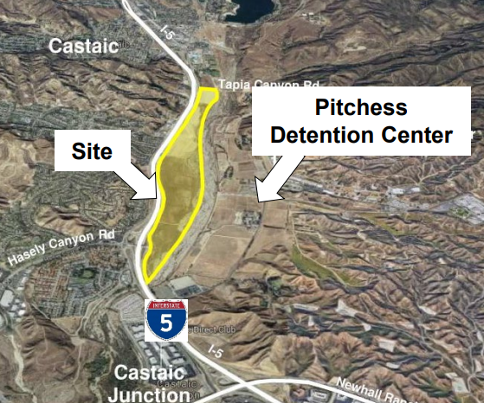
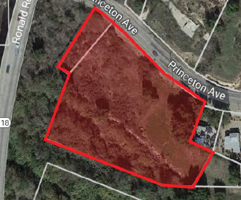
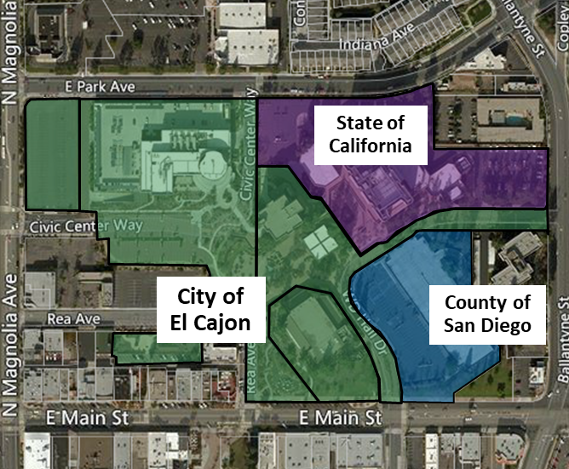
Case Studies: SLA Compliance is Unique to Each Public Agency
Each Public Agency needs to devise a real estate disposition strategy that considers its own economic development priorities in light of SLA.
County of Los Angeles
+/- 200 Acre Property
Zoning: Heavy Agriculture
$229M flood risk mitigation, Adjacent to Detention Center
SLA Status: Process completed, HCD certified, property brought to market via RFP
Moorpark Successor Agency
+/- 1.8 Acre Property
Zoning: Industrial
Adjacent to Floodplain, Liquefaction issues
Pre-Existing Agreement with Developer
SLA Status: Pre-existing agreement did not close; property under City review
City of El Cajon
+/- 20 Acre Property
Zoning: Commercial, Downtown Master Plan
Complex Civic Center Revitalization; County/State owners/users
Reuse program requires public uses
SLA Status: City reviewing alternatives
Proprietary
Do Not Duplicate
Without Authorization
48

