Slide 1
County Funding Allocation
2020 U.S. Census
Dorothy Johnson
CSAC Legislative Representative
Notes:
Fact sheet CSAC created in your packet
Quick show of hands – how many counties have a resolution already passed

Slide 2
Key Points
Counties’ Role in the 2020 Census
Funding Allocations
Essential Contract Components
Important Deadlines

Slide 3
Counties’ Role in the Census
Federal and state government have different roles
No state or federal statutory requirements
Role of Counties
  Educators
  Trusted Messengers
  Conveners
  Administrators
Educate
Motivate
Activate
Notes:
Strong ground game and air game

Slide 4
Counties as Administrators
State Budget Act of 2018 = $90.3 million
Counties eligible to receive nearly $27 million statewide
Counties may “opt-in” to accept the funding allocations
Indirect funding to support regions through community based organizations, media, and state regional managers
Notes:
What if you don’t want the Money? Will get put back into your “county” pool and GovOps will work to designate to a city, COG

Slide 5
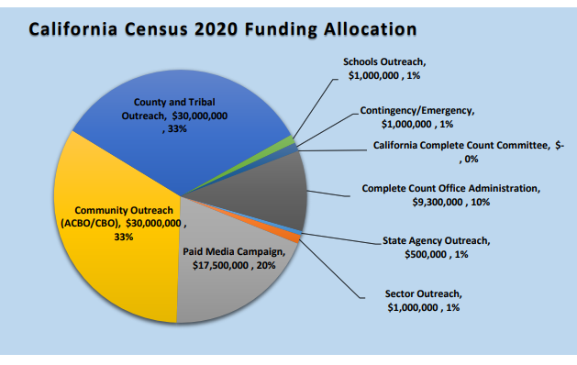
Notes:
This is the $90.3 Million dollar breakdown
Last year we had a representative from the LUCA program – the address update program to tell the federal government where your addresses are and where people live

Slide 6
Essential Contract Components
Funding provided in phases, not lump sum
Contract terms must be agreed upon through adopted resolution by the Board of Supervisors
  Must have a Complete Count Committee formed
  Strategic Plan
  Monthly in-person meeting/or call with assigned Regional Program Manager
  Quarterly Written Reports
  Implementation Plan
  Final Report

Slide 7
Important Dates
Nov. 9, 2018 – Counties notified of funding allocation formula
Nov. 30, 2018 - Tribal grant funding letters will be distributed
Dec. 14, 2018 - Community-based organizations RFP (regional and statewide applications) released
January 2019 – Media RFP release
February 8, 2019 – County BOS Resolution with Opt-in Letters to CA Complete Count
Notes:
Two critical dates for right now are on the top and the bottom of the screen.
In accordance with state contracting procedures, specific requirements and corresponding timelines will be released on the aforementioned dates
(Small community-based organizations should apply to the ACBOs in their region)

Slide 8
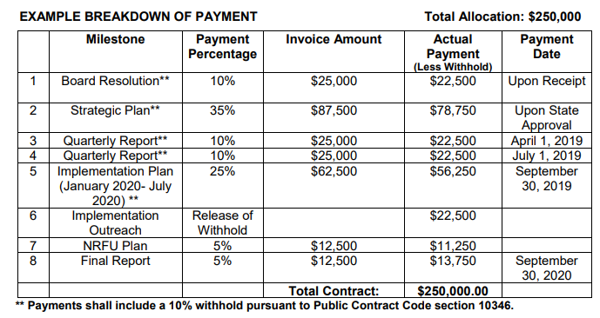
Funding and Project Timeline

Slide 9
For More Information
CSAC 2020 US Census Webpage:
www.counties.org/2020-census
Details on State Funding: census.ca.gov/2018/11/09/funding/
Notes:
In accordance with state contracting procedures, specific requirements and corresponding timelines will be released on the aforementioned dates

