Slide 1
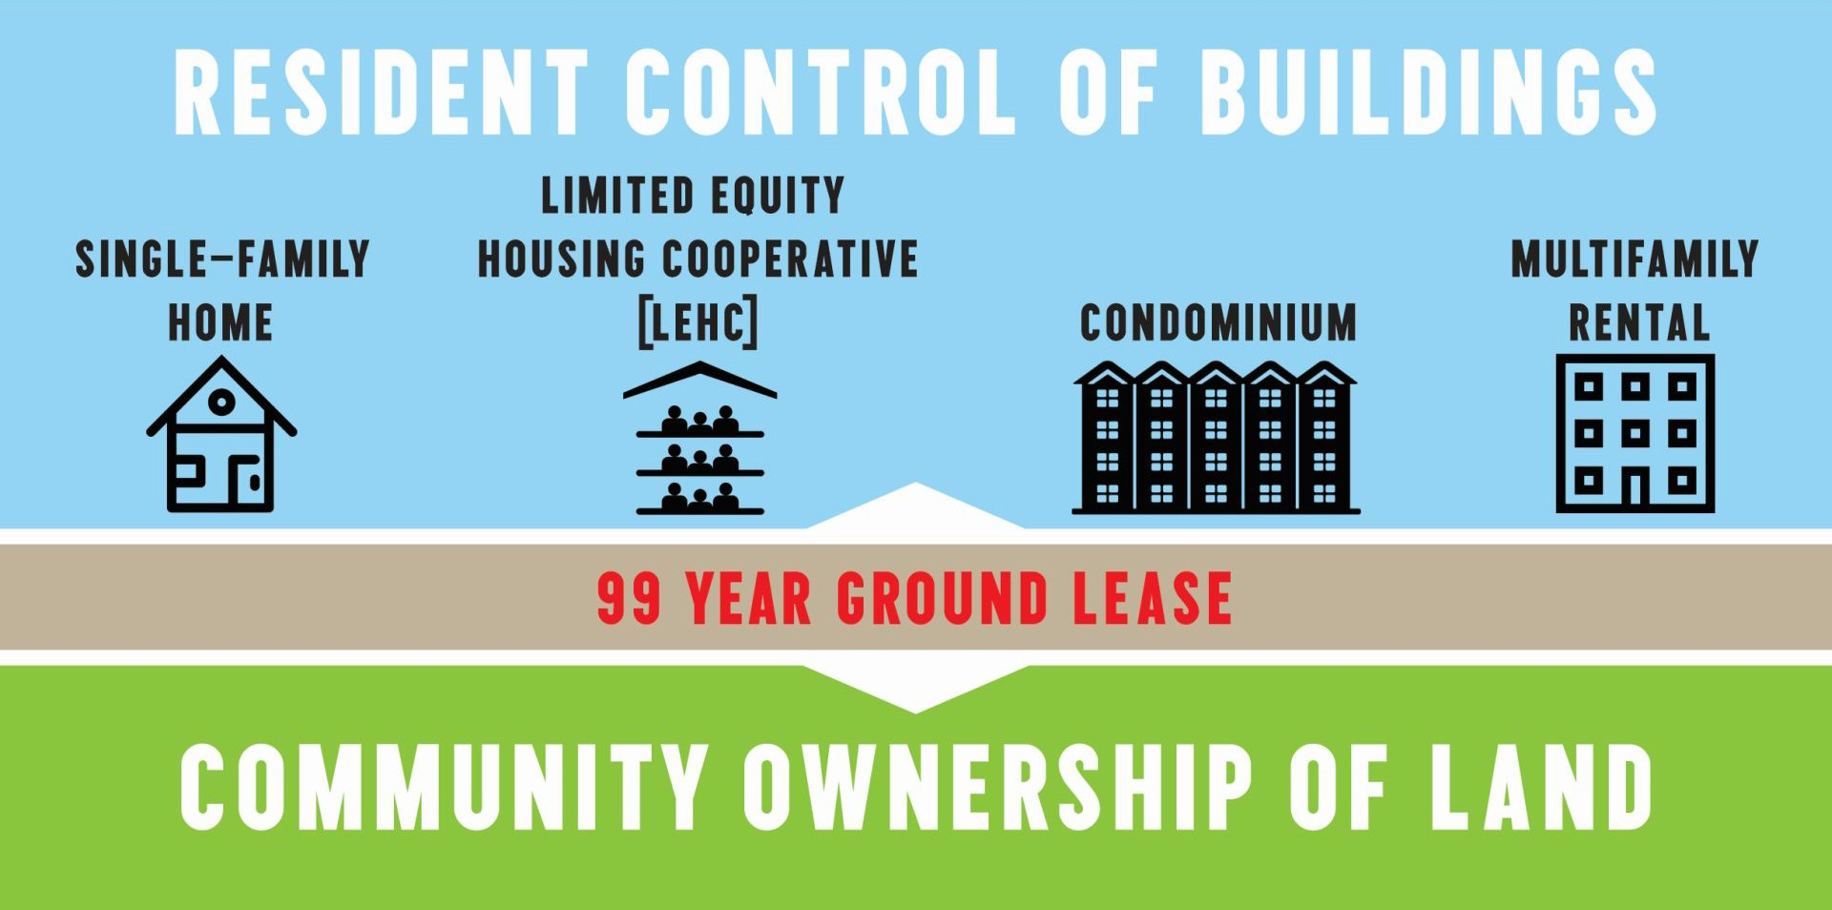
Community Land Trust
Avanzando San Ysidro Community Land Trust
fig 1
fig 2

