Slide 1
The State of Behavioral Health; Challenges and Opportunities:
Anne Bakar, President and CEO, Telecare Corporation, CSAC Regional Meeting

Slide 2
Telecare Today
Dedicated public sector behavioral health care provider — Services in 7 states; partnering with 26 California counties. Smaller counties in CA include Sonoma, El Dorado, Santa Barbara, Santa Cruz; in WA/OR, include Skagit, Grays Harbor, Deschutes.
Broad Spectrum of Services — Approximately 50% of services are inpatient (acute care and sub-acute), and 50% are community-based. Focus on individuals with complex needs.
Diverse Workforce — Diverse workforce of 3,500+ employees; physicians services organization with more than 200 psychiatrists and prescribers.
53 Year History — Family- and employee-owned, mission-driven, long-term orientation, building capacity for next 50 years.

Slide 3
Telecare Corporation
From the perspective of a direct service provider, there are several areas that present challenges and opportunities for county behavioral health systems today; especially smaller counties in less urban areas.
Workforce
Collaboration & Innovation
Facilities
*There are also many systems-wide strengths to recognize in California as well: MHSA, crisis funds, the strengths of our local systems of care, and more.

Slide 4
Workforce
Telecare has been working since 2010 to build skills and systems to support integrated physical, substance and MH care
Issues & Context:
HHS predicts moderate to severe workforce shortages in nearly every behavioral health profession nationally by 2023:
Ongoing national shortage of psychiatrists and prescribers
High cost of education for licensed positions; relatively low ROI given current pay; supply shortages of nurses, social workers, etc.
Barriers to certification, optimal use of unlicensed staff/peer specialists
Models of education do not support integrated care, social determinates of health.

Slide 5
Workforce
Telecare developed organization in 2015 for physician employment
Solutions: Creative Approaches to Prescriber Shortages
Telecare Physician Services Organization Created in 2015
Formerly outsourced; start-up process entailed recruiting new physician leadership and infrastructure.
136 psychiatrists and 71 NP or PMHNPs now on staff; stable prescriber capacity, operations integration.
Nurse Practitioners:
Full Scope NP prescriber capacity in Oregon, Washington and Arizona; not in CA
Nurse Practitioners: focus on ANCC certification, experience, and flexible supervision
Telepsychiatry: Progress and on-going challenges
Operate at 36 sites; many sites are for backup and urgent coverage, smaller counties or more remote locations more comprehensive use
Experience in Ridgecrest in Kern County, 100% telepsychiatry
Experience in Perris, Riverside

Slide 6
Workforce
WRAP certification training for Telecare peer staff, funded by Telecare’s Calhoun Peterson Scholarship. Telecare’s New Hire Orientation Program has reduced turnover in new hires by 40%
Solutions: Other Creative Staffing Models
Peer workforce & “bridgers” to inspire hope, enhance continuity of care
Career ladder, dedicated scholarship funds to develop of peer workforce
Shared psychiatric staff between Telecare programs & county (e.g. Santa Barbara, Placer)
Management contracts within general acute care hospital settings
Creative approaches to on-boarding and reducing turnover
Team approach to engage homeless and other clients where they are in the community
Notes:
**California SB 906 was signed by on 9/7 by the Governor which requires DHCS to establish Peer Support Services certification for mental health and/or substance use disorders by 7/1/2020, however, it does not provide for a new Medi-Cal billing code category. (last minute strike to the bill)
So, the above will help support the training and development of a Peer Services Workforce but peer services will still potentially have barriers to billing capacity.
Telecare has established a career ladder and dedicated scholarship funds to the development of Peer Services Workforce

Slide 7
Workforce Commission
Solutions: Telecare is advocating with healthcare providers, elected officials, and other stakeholders to advance strategies that will increase workforce supply and reduce disparities
Enhance Behavioral Health Professions Education
Support Educational/Career Pipeline for Unlicensed Staff
Remove Workforce Licensing and Technology Barriers
Increase sustainable funding sources and incentives to address the high cost of professional education, such as MHSA WET.
Peer Support Specialist Certification is key to optimizing peer role; bill is on governor’s desk for signature.
Remove barriers for Psychiatric Nurse Practitioners to allow services in Psychiatric Health Facilities
Ensures job classifications and billing process will be enhanced.
Need to demonstrate effectiveness of WET allocations to ensure funding continuity
$10mm one year state allocation is in the budget
Push for NP full scope of practice in CA

Slide 8
Collaboration & Innovation
Issues & Context:
Counties must contract with providers to meet a huge range of specialized needs with limited and siloed funding streams.
The regulatory and procurement process can impede innovation and value creation.
More flexibility is needed to address the programming scale relevant to a small county.
TEIR Early Intervention Program
San Joaquin County, CA

Slide 9
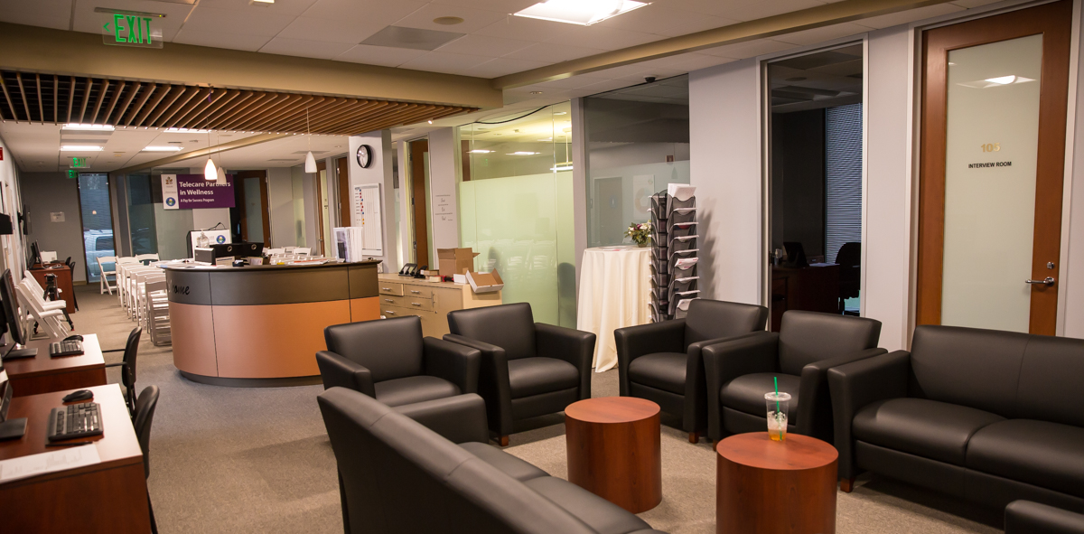
Collaboration & Innovation
Partners in Wellness
Santa Clara County, CA
First MH PFS program
in the U.S.
Solutions: We work to put the County and provider on the same side of the table, to meet shared goals with limited resources in a streamlined, more efficient manner.
Historic Models of Transformation:
MHRCs to leverage Medicaid for longer-term care (Ventura); FSPs to reduce IMD and acute care usage (Sonoma, Ventura); voluntary crisis services to fill gaps in the safety net. (Perris)
Pay for Success Model
Santa Clara County, CA: Identifying target population and desired outcomes on cost and quality, sharing risk, allowing for design innovation. Can be applied in smaller counties.
Intensive Support for High-Utilizers
Kaiser Permanente, Northern California: Pilot project designed and implemented to reduce mental health inpatient admissions by 30% and generate $185,135 cost reduction for 25 high utilizers (3+ admissions in 3 months). Can be applied in smaller counties.
Early Psychosis Program
San Joaquin County, CA: Modifying an EBP to meet local, culturally specific need. Future state focus.

Slide 10
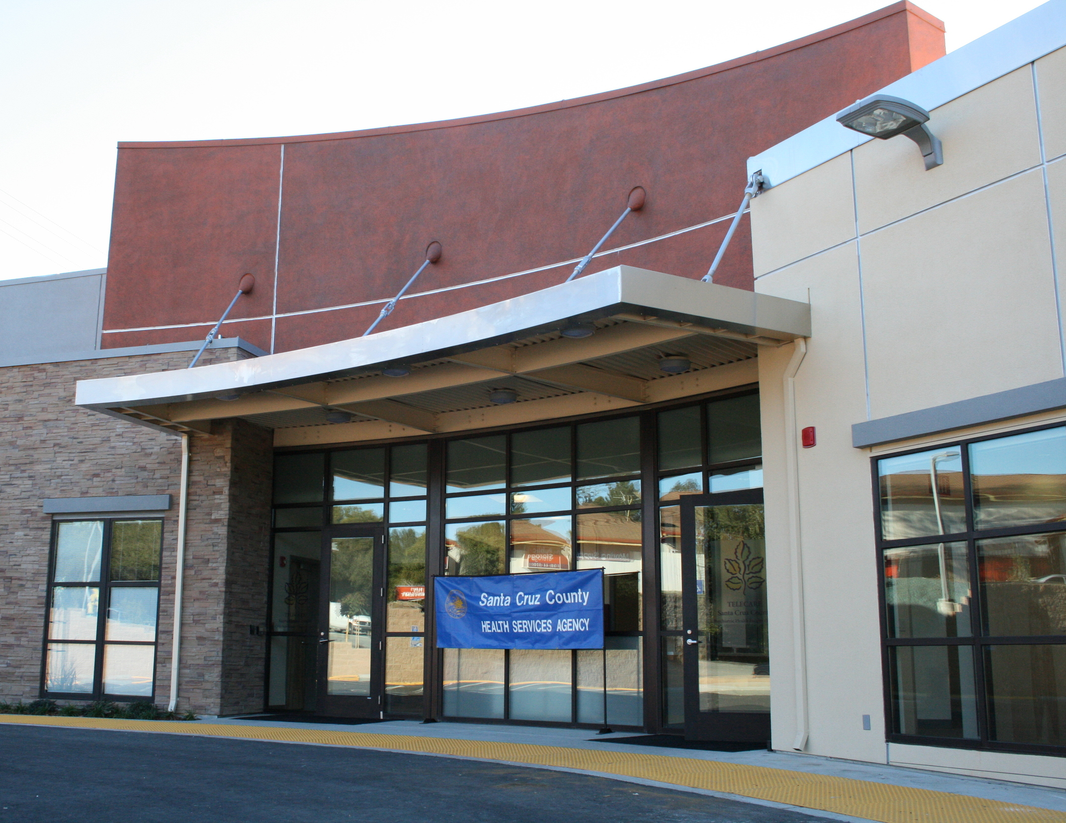
Facilities
Santa Cruz PHF & CSU
Santa Cruz County, CA
Recovery-centered acute/crisis setting
Issues & Context:
Often, there is a strong County desire to expand or add new services for the community, but barriers are high.
Lack of available or appropriate real estate, especially for locked/acute or crisis care
Concerns and/or resistance from landlords or local community
Insufficient client/patient population in smaller county to support program or facility development
Historic lack of capital to support development, however climate is changing recently. Examples include crisis (SB82) and re-entry and incompetent to stand trial (IST).

Slide 11
Facilities Solutions to Reduce Barriers
Villa Fairmont MHRC
Stanislaus TRAC/TMRS
Santa Cruz PHF & CSU
Alameda County (Sponsor) + Multiple Other Counties (Purchase beds)
Stanislaus County
Co-located with County programs
Santa Cruz County
Co-located acute and crisis facilities
Array of Telecare programs within single location to meet multiple care types and levels of need; expanded scope and scale over time
Existing County building
Existing County building
New construction, Telecare providing design expertise
Designed with healing environment objective, emphasizing safety, clinical efficiency
Redesigned multiple times since 1981
Sub-acute for mid-length inpatient supports (90-120 days), but flex unit carved out over recent years to meet shorter and longer term needs of complex clients
Notes:
Retrofitting Existing Hospital Wing to Create an Acute Evaluation and Treatment Center in Grays Harbor County, WA
Rural, small county; retrofitting offered cost-effective method to meet an acute psychiatric need — and serve patients who will come from throughout the region
Telecare providing design consultation, conducting extensive outreach through job fairs, community meetings, etc. to alleviate concerns, smooth opening process, etc.

Slide 12
Housing
TAO Central Program
Orange County, CA
Homeless focus
Issues & Context:
Without stable housing, homeless crisis is expanding, making recovery and recidivism more difficult. Many solutions are needed, but promising examples exist.
Orange County offers positive example. Six-month hotel lease to move over 200 people out of Riverbed into immediate housing and treatment. Allowed time for comprehensive assessments, triage, linkage to appropriate services — while offering more flexible window of time for identifying permanent housing & supporting housing transition.
Several CA Justice Involved Mental Health (JIMH) bills recently passed which will provide funding opportunities for counties to apply for capital and program funding which can include funds for housing.

Slide 13
Summary Wrap-Up
Workforce:
Advocacy, initiatives to support increased supply
Alleviate barriers
Pursue creative staffing models
Collaboration & Innovation:
Flexibility in meeting outcomes
New models, pilots, etc.
Collaborative problem-solving
Facilities:
Maximize existing facilities
Shared efforts for small counties
Tap available funding streams
Housing:
Build on positive strategies
Leverage new legislation, funding
Keep innovating

Slide 14
Telecare Corporation
Questions?
For additional information, please contact Faith Richie, SVP of Development, frichie@telecarecorp.com, or Shea McGuier, Director of Communications, smcguier@telecarecorp.com.

